Slide 1
SOCIAL distancing

Slide 2
Key Vocabulary
Social distance
Space
Germs
virus
Bubble
Moving
Safely
Careful
EYFS
L.O: To understand what we can do to stop the spread of germs and viruses.

Slide 3
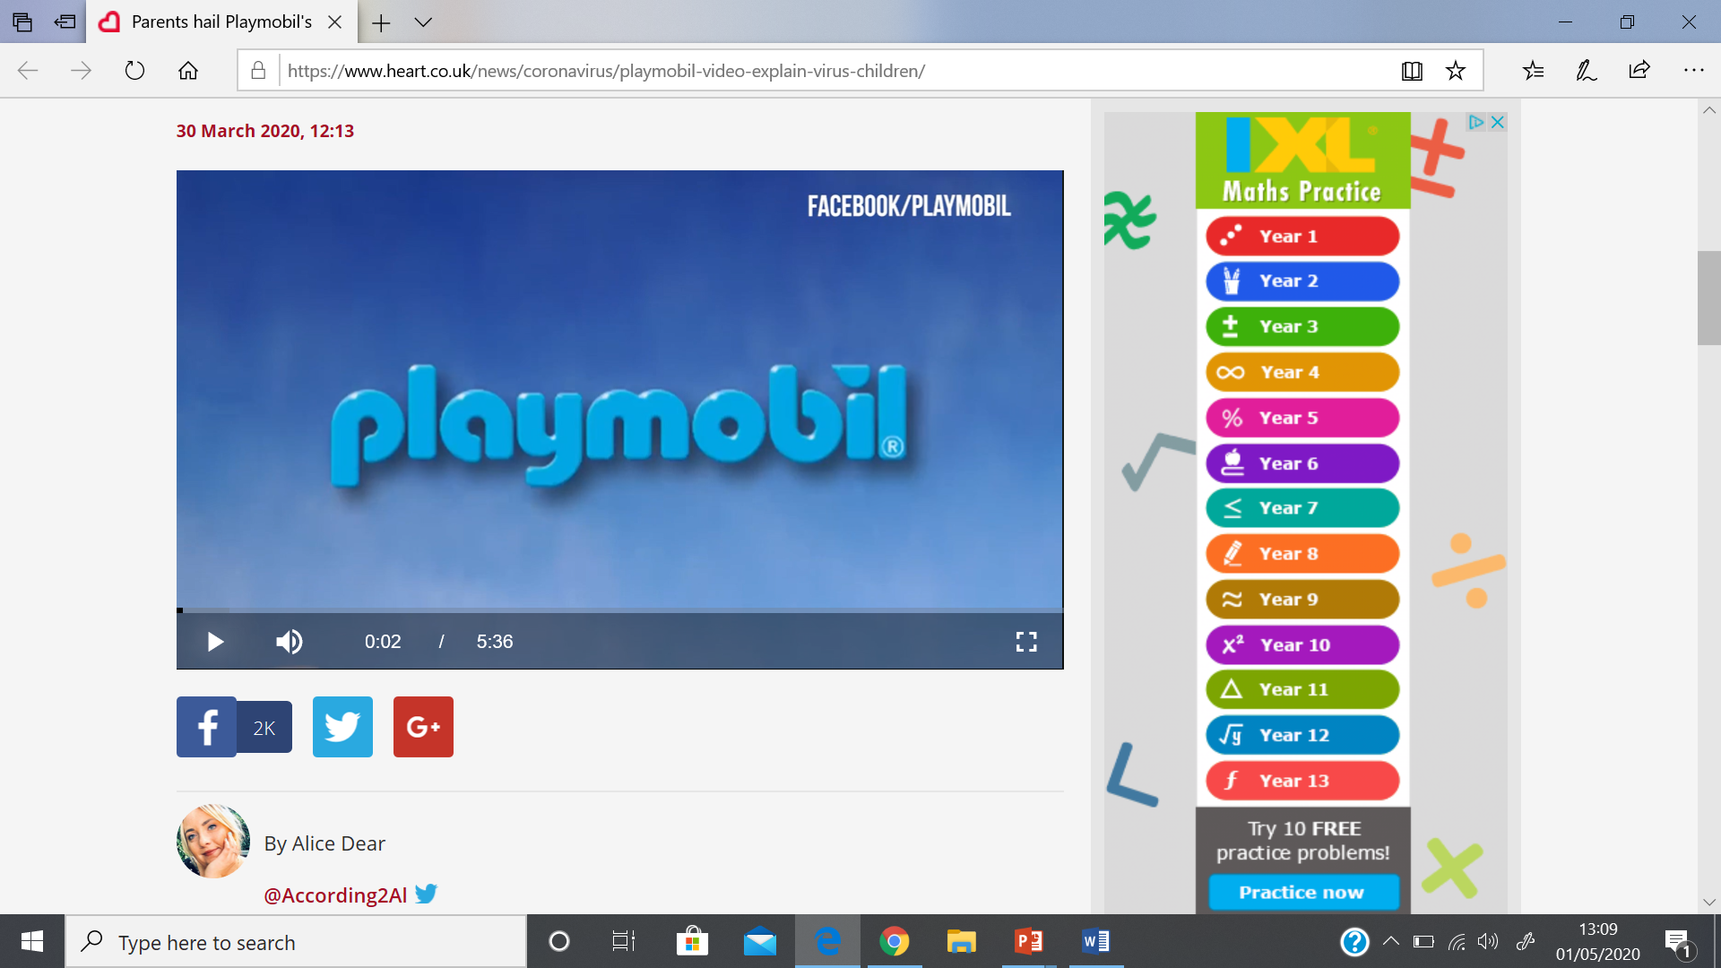
https://www.heart.co.uk/news/coronavirus/playmobil-video-explain-virus-children/
Notes:
After three minutes there is information about social distancing although the beginning part will reinforce the last lesson on what coronavirus is.

Slide 4

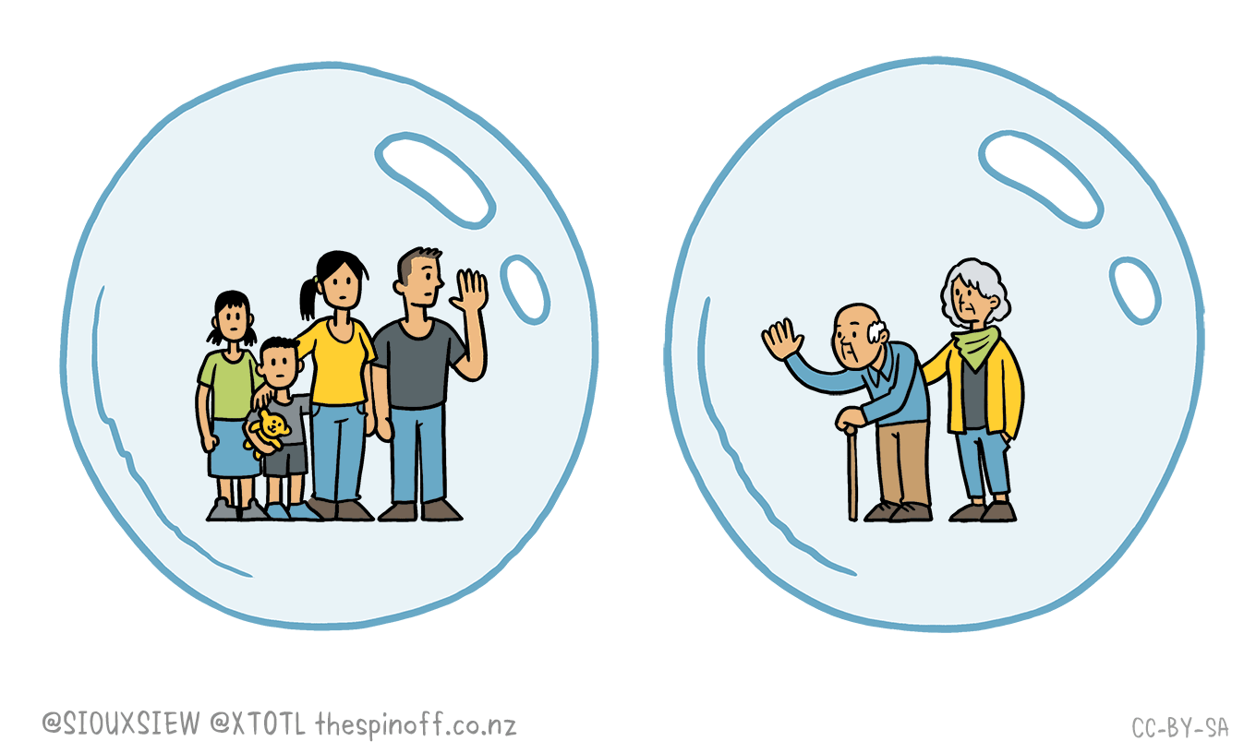


Imagine you are all in a bubble.
How could you stop your bubble bursting?

Slide 5
Key Vocabulary
Social distancing
Measuring
Coronavirus
Spread
Safety
Space
Patience
KS1
L.O: To understand what we can do to stop the spread of germs and viruses.

Slide 6
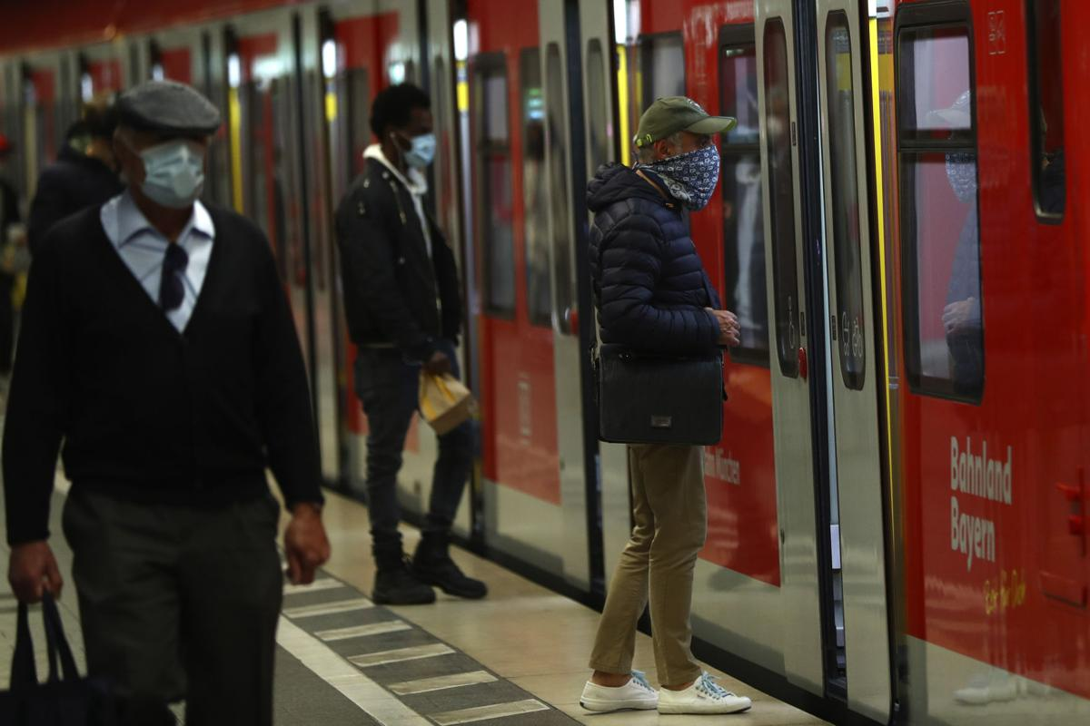
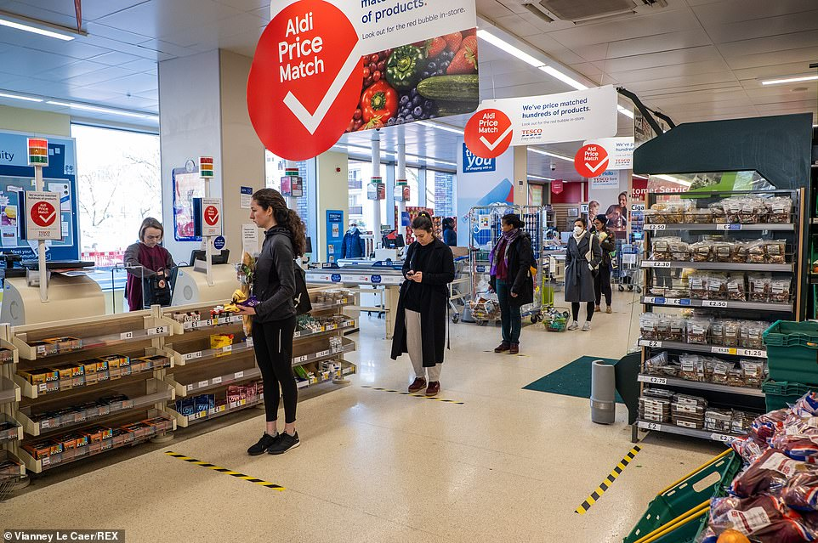
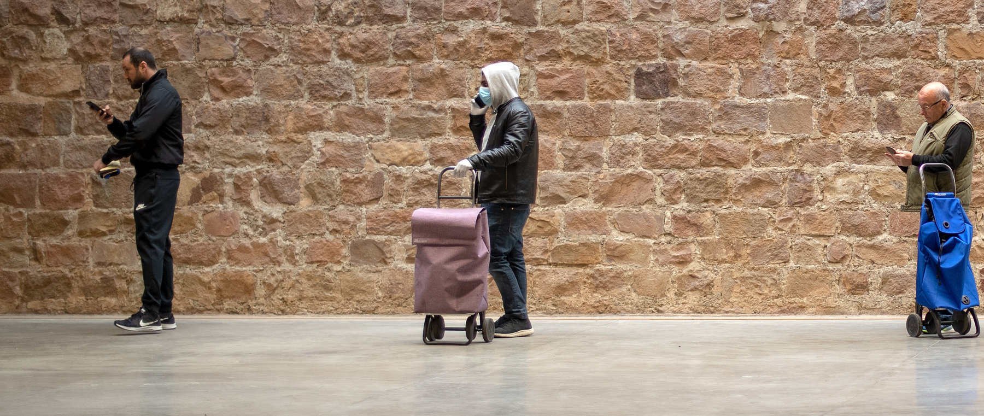

Have you seen this happening
near to where you live?
Notes:
Clapping for NHS working and social distancing in flats
Protective face masks
Social distancing in supermarkets and in a train station

Slide 7
Is called Social Distancing. Have you heard of this before?
Can you think of ways you have been social distancing?
Why have we been doing it?
https://www.heart.co.uk/news/coronavirus/playmobil-video-explain-virus-children/
Notes:
Initially the video it talks about Coronavirus which would be a good recap, after 3 minutes it talks about social distancing and why we should do it.

Slide 8


How long is 2 metres?
Notes:
A standard door is a good start, they are usually 2m

Slide 9
Key Vocabulary
Symptoms
Social distancing
Metre
Coronavirus
Spread
Virus
LKS2
L.O: To understand how to use social distancing to stop the spread of viruses.

Slide 10
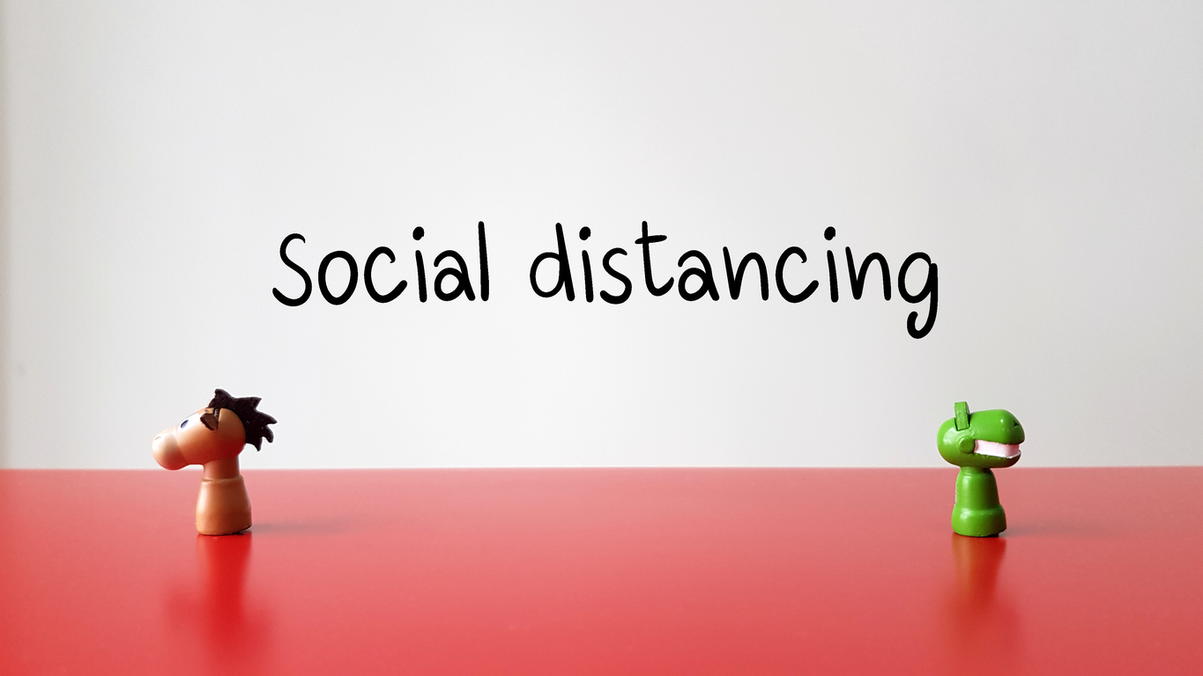
Have you heard of this before? What does it mean?

Slide 11
What Is Social Distancing?
Social distancing puts space between people. When people who are infected with a virus stay away from others, they can't pass it to anyone else. This way, fewer people get sick at the same time. Then, doctors and hospitals are better able to keep up with treating those who need care.

Slide 12
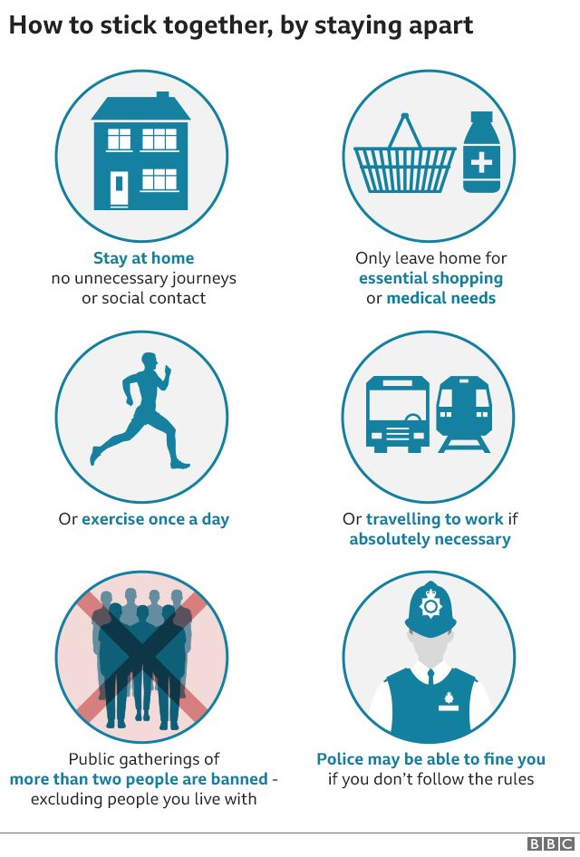
What have you been
doing to social distance?
https://www.bbc.co.uk/newsround/51861111
Notes:
Social distancing means:
Not going out unless it is necessary. Necessary reasons to go out include buying food, getting medical care, or going for a walk or a bike ride alone or with members of the household.
Closing schools, restaurants, shops, cinemas, and other places where people gather
Not getting together in person with friends
Working from home if possible
Not taking public transportation, including buses, trains, taxis.
Stay at home and away from others as much as possible. Don't have friends and extended family over, and don't go to their homes. People who look healthy still can be infected and can spread the virus. That's why it's important to stay away from everyone, even if they don't seem sick.
If you have to go out, make sure you are at least 6 feet (2 metres) away from other people.

Slide 13
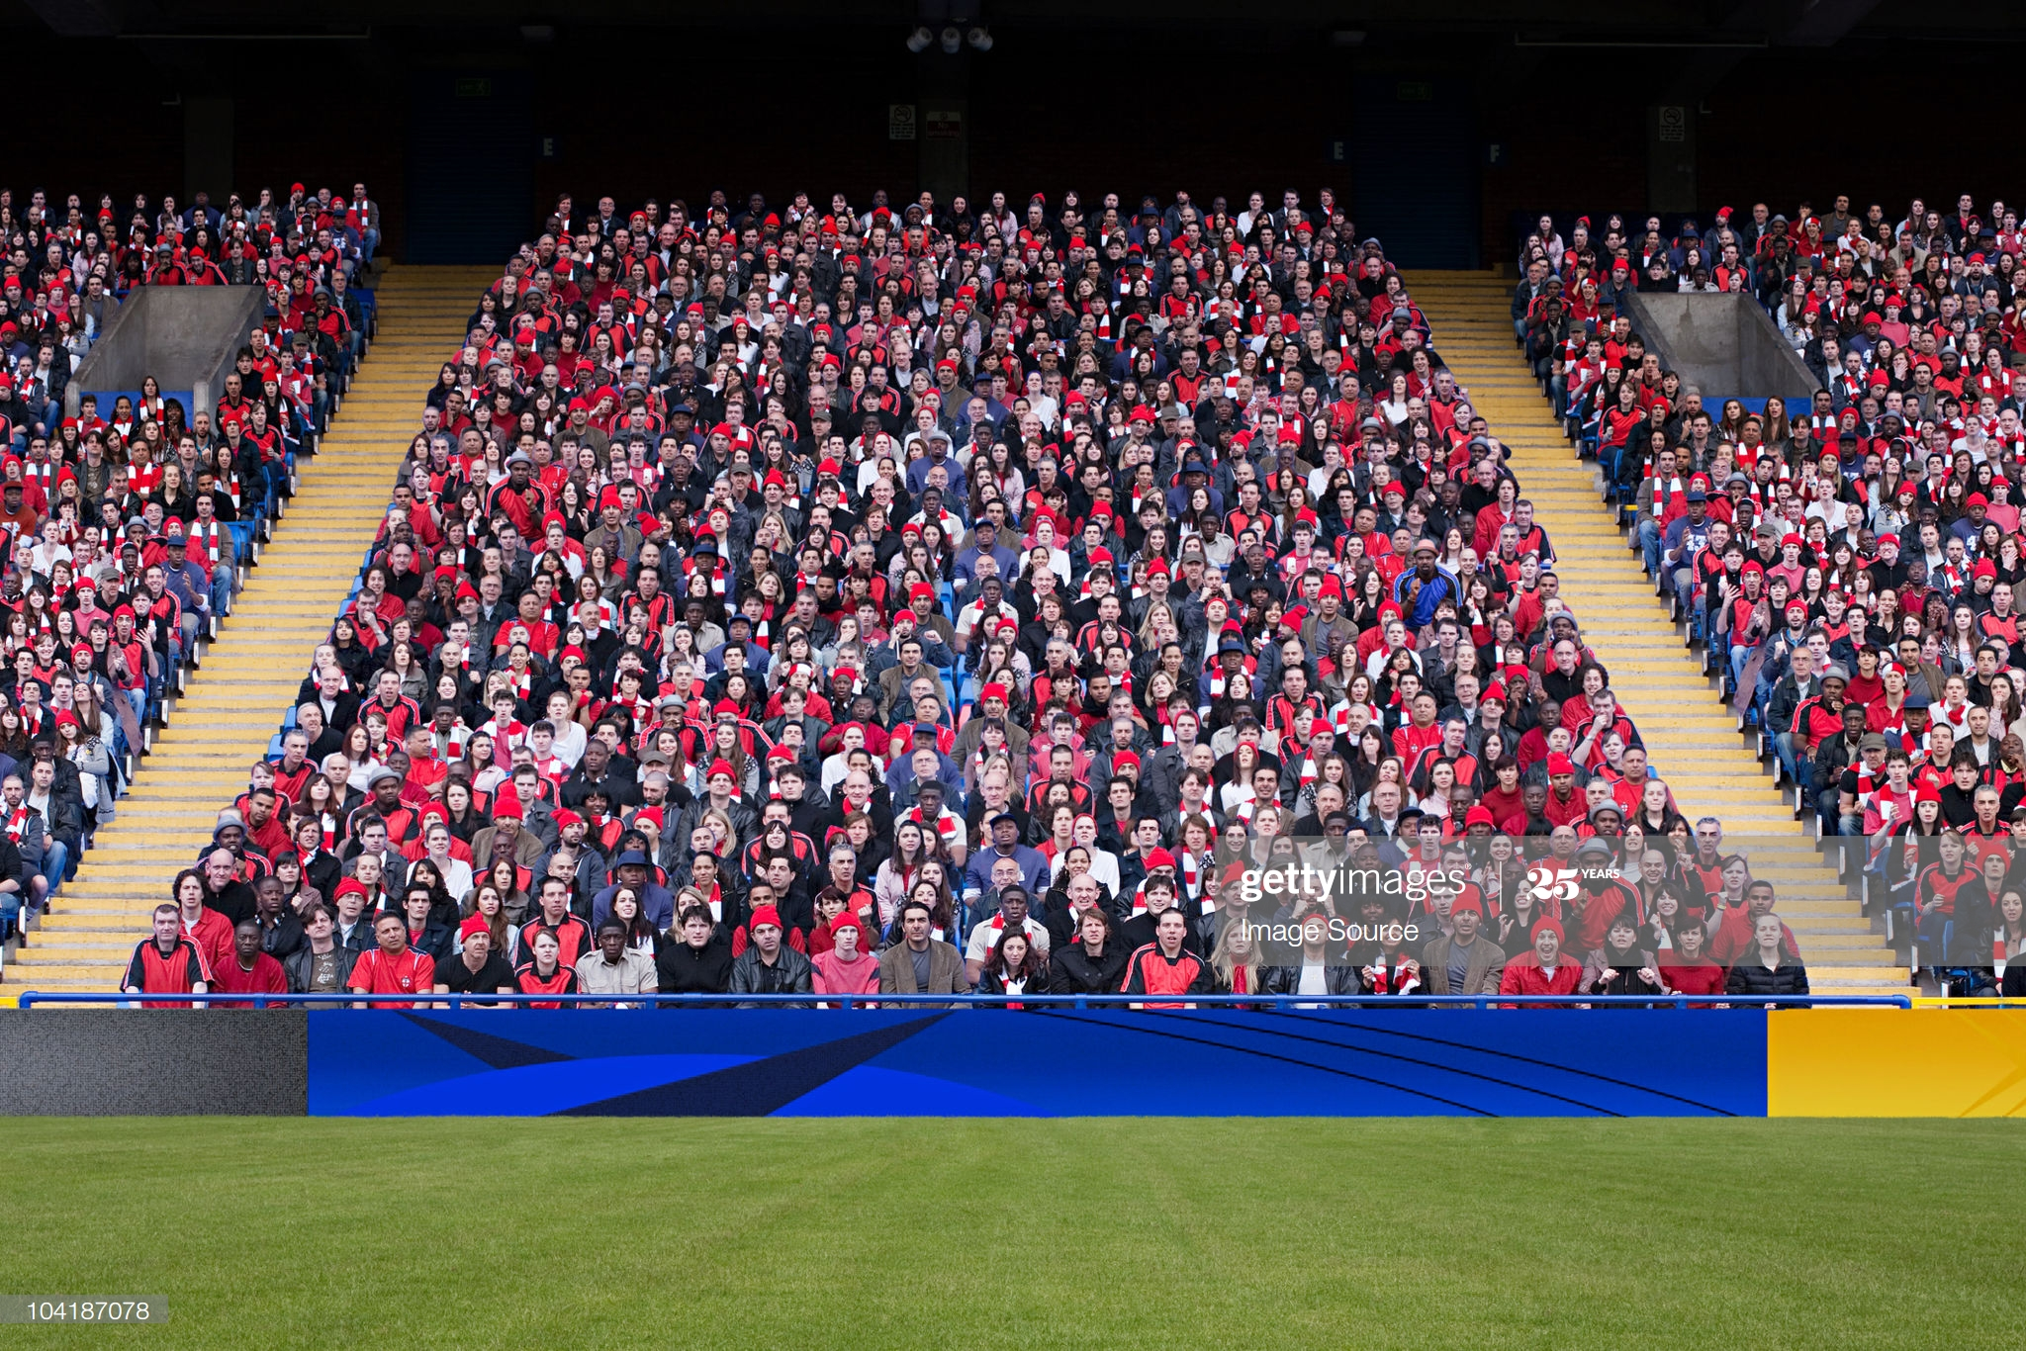
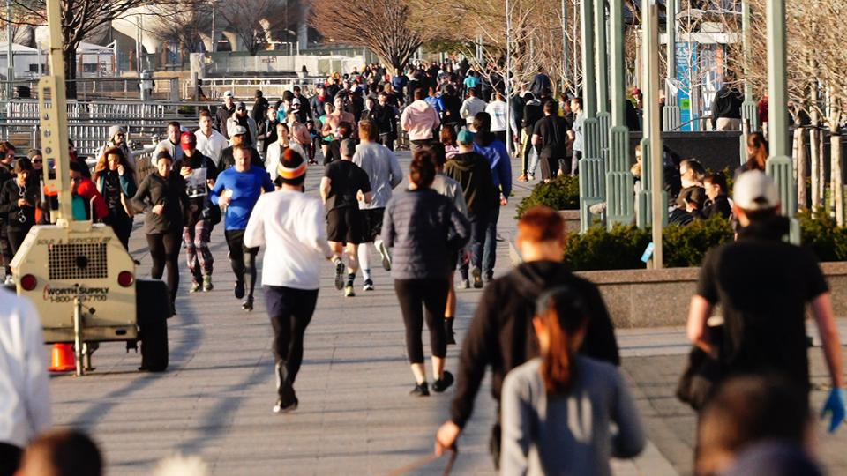
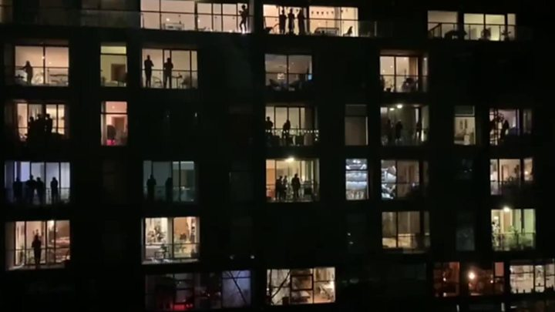
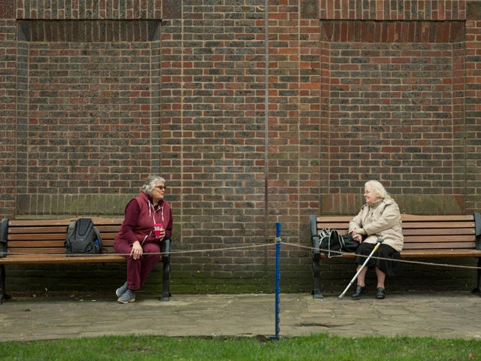
Do the pictures
show good
social
distancing?

Slide 14
Key Vocabulary
Symptoms
Social distancing
Metre
Coronavirus
Spread
Virus
UKS2
L.O: To understand how to use social distancing to prevent the spread of viruses.

Slide 15
Have you heard of this before? What does it mean?

Slide 16

Can you see
social
distancing
taking place in these photos?

Slide 17
Should social distancing stop now we are back at school?
https://www.bbc.co.uk/newsround/51861111

Slide 18
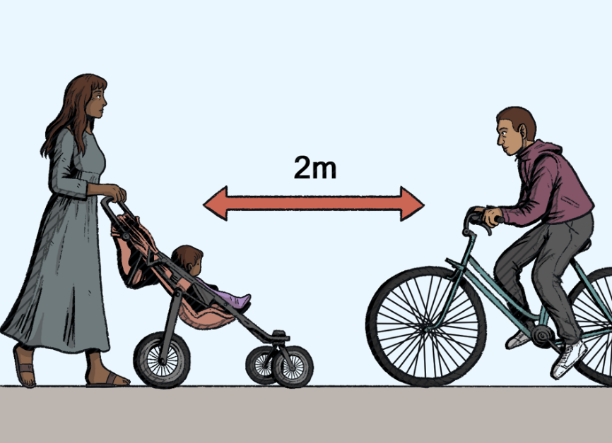
What Might Social Distancing Look Like For You?
You won’t be able to go to the park or meet friends.
You won’t be able to go swimming or visit other attractions.
You won’t be able to go to sports clubs or organised events like park runs.
Sporting events such as football matches will be cancelled.
You can go out once a day for some exercise with the people that live in your house.
While you are outside you should stay at least 2 metres away from anyone who does not live in the same house as you.

Slide 19
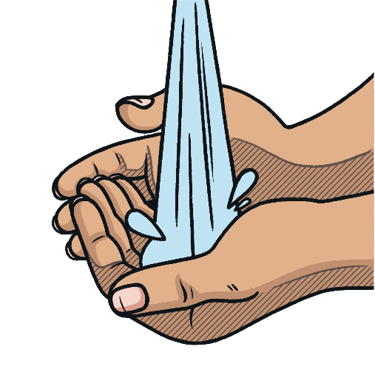
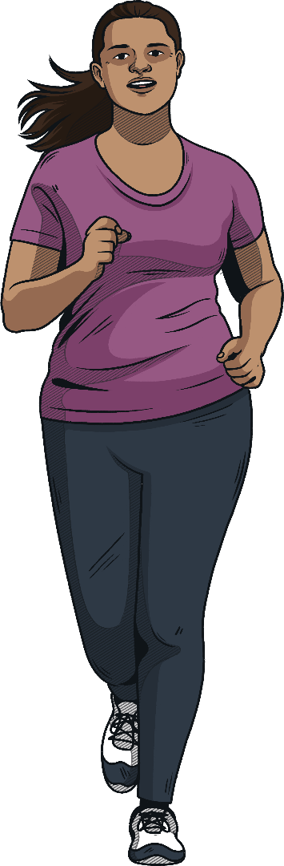
Social Distancing
Wash your hands regularly with soap for at least 20 seconds.
Cover your mouth and nose with a tissue or your sleeve when you cough or sneeze. Throw tissues in the bin and wash your hands straight away.
If you are outside, stay at least 2 metres away from anyone who does not live in the same house as you.
Spend the time at home doing things you enjoy.
Try to get outside every day to get some natural sunlight and fresh air.
Find some exercises that you can do inside or in the garden.

