Slide 1
How well do you know the staff
at VFS and Nursery?
Quiz Time

Slide 2
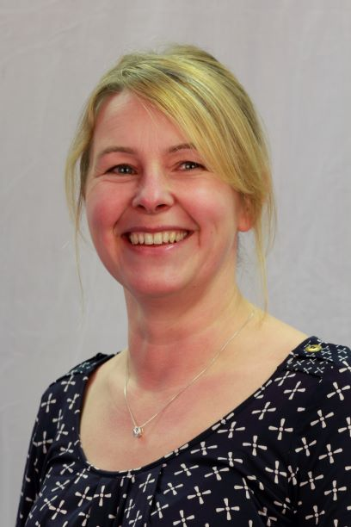
Question 1
Which member of staff is a beekeeper in her spare time?
Click for Answer

Slide 3
Question 1 (B0nus Point)
What is special about the beehive created by the Irish school teacher and wildlife activist that appeared in Picture News newspaper (1st June).
Click for Answer
Lego Beehive

Slide 4
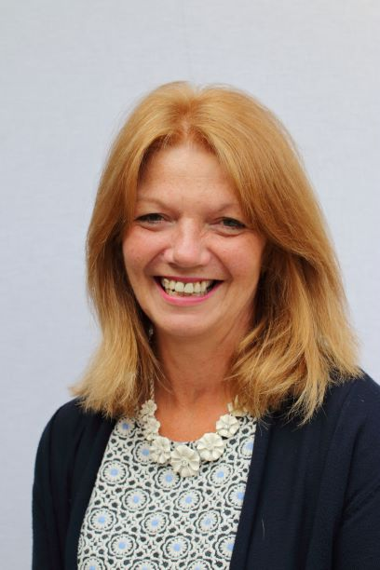
Question 2
Which TA was born in Zimbabwe?
Click for Answer

Slide 5
Question 2 (Bonus Point)
Africa
In which continent would you find the country Zimbabwe?
Click for Answer

Slide 6
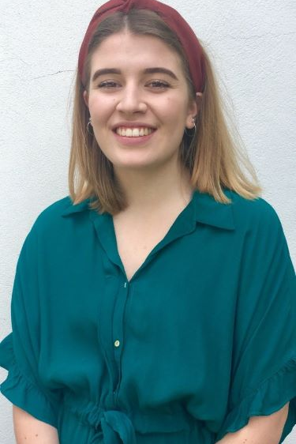
Question 3
Which teacher climbed to the top of Pride Rock from the film the
Lion King?
Click for Answer

Slide 7
Question 3 (Bonus Point)
Kenya
In which country would you find Pride Rock?
Click for Answer

Slide 8
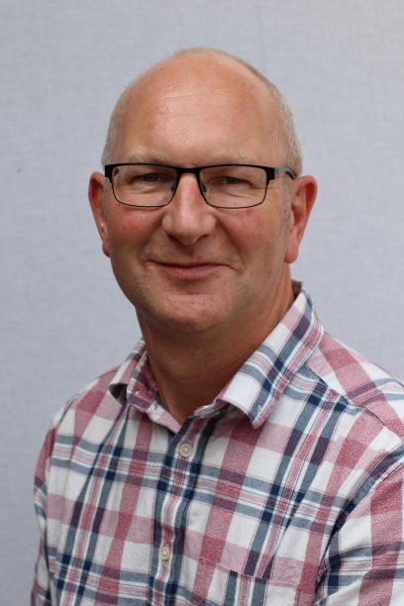
Question 4
Which TA was the fastest 100m runner for Dorset in 1975 and 1976?
Click for Answer

Slide 9
Question 4 (Bonus Point)
26.2
Miles
How many miles is a full marathon?
Click for Answer

Slide 10
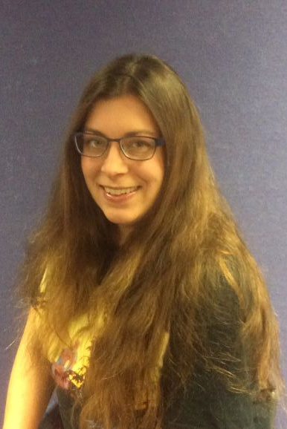
Question 5
Which Lunch Time Supervisor sat next to the actor who played C3PO for Christmas lunch?
Click for Answer

Slide 11
Question 5 (Bonus Point)
6 Million
In how many languages is C-3P0 fluent?
Click for Answer

Slide 12
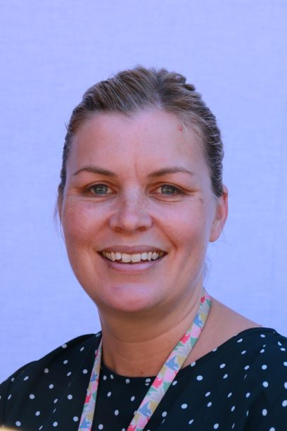
Question 6
Which member of staff left VFS to teach in Australia but missed the school so much that she returned a couple of years later?
Click for Answer

Slide 13
Question 6 (Bonus Point)
Red Kangaroo
What is the official animal of Australia?
Click for Answer

Slide 14
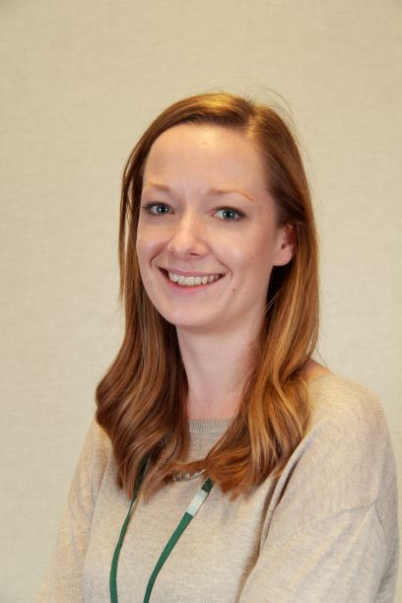
Question 7
Which member of staff attended VFS when she was little?
Click for Answer

Slide 15
Question 7 (Bonus Point)
faithfulness
goodness
self-control
peace
Love
Joy
kindness
gentleness
patience
The spiritual values that we hold dear at VFS and Nursery are the fruits of the Spirit. What are these nine spiritual values?
Click for Answer

Slide 16
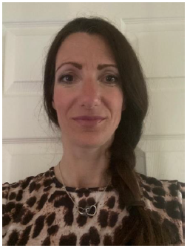
Question 8
Which TA was banned from Bournemouth Beach for walking her three rabbits on it?
Click for Answer

Slide 17
Question 8 (Bonus Point)
Warrens
Where do rabbits live?
Click for Answer

Slide 18
Question 9
Mrs Mearns
Which school governor is also a scout leader?
Click for Answer

Slide 19
Question 9 (Bonus Point)
Baden Powell
Who started the scouts?
Click for Answer

Slide 20
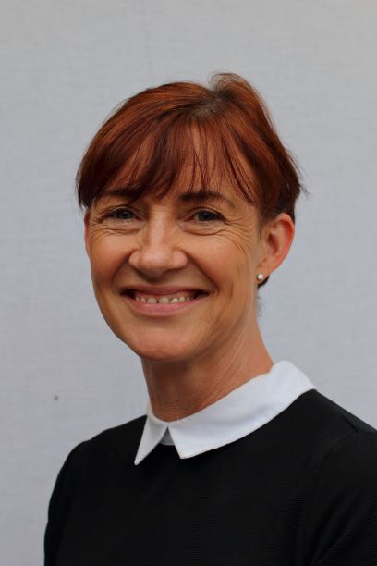
Question 10
Before working at VFS, which member of staff worked for Air UK cabin crew?
Click for Answer

Slide 21
Question 10 (Bonus Point)
Amelia Earhart
Who was the first woman to fly a plane solo across the Atlantic Ocean?
Click for Answer

Slide 22


Shhhh!
Hope you enjoyed the quiz
TOP SECRET!

