Slide 1

Verwood First School
Worship
Friday 19th June 2020

Slide 2
Happy Friday everybody!
The theme of today’s worship is:
Goodness

Slide 3
Before we start, let’s take time to think…
What does the word goodness mean to you?
Mrs Smallbones says “Thinking about others!”

Slide 4
In Monday’s worship, we looked at the theme of kindness. Goodness and kindness are often used hand-in-hand and are very closely related to one another.
Today, we are going to look more at showing goodness through sharing. Many Bible stories state how love and faith in God motivates us to share with friends, family and those in need.
In the video below, Holly shares a Bible story all about sharing: https://www.youtube.com/watch?v=tfcOwZNpUFo

Slide 5
Watch the following episode of The Big Idea. Felix and Lily show Hugo that it can be fun to share things, like a comic book, or an idea, or your time. But Hugo also learns that sometimes sharing is not a good idea, like sharing his bath with a naughty monkey!
https://www.bbc.co.uk/iplayer/episode/b01sfhwl/whats-the-big-idea-26-sharing

Slide 6
Activities to try at home!
Some ways that you could practise sharing:
Paint a picture for a friend or family member and deliver it to their doorstep.
Share a song with your family by putting on a special musical performance.
Share a story with a younger sibling.

Slide 7
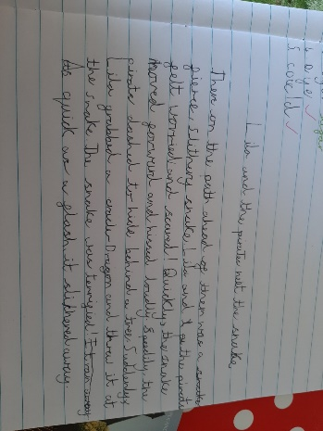
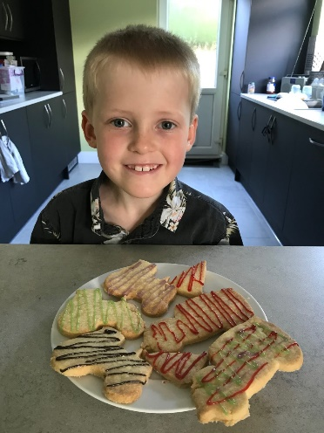
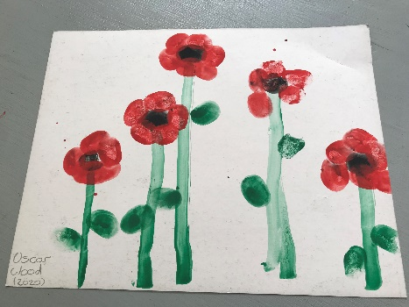
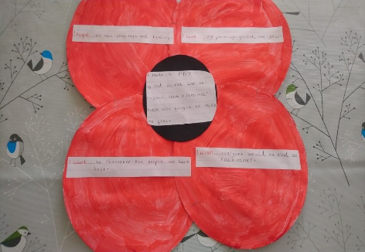
Let’s celebrate!
We have been so impressed with the learning that is happening at home!
Here are a few pictures of the home learning that has been sent in…well done everybody!

Slide 8
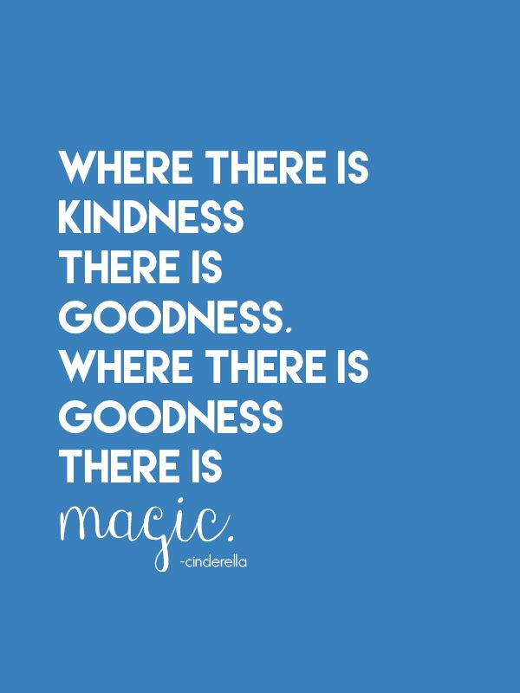
Thought of the Day
Take some time to be still and reflect on the thought of the day. What does it mean to you?

Slide 9
Let’s pray…
Dear God,
Thank you for the people that are thoughtful and forgive other people.
Sorry for the people that aren’t thoughtful and don’t forgive people and hurt others.
Please help people be thoughtful and patient and waiting.
Amen.
Thank you Reilly! (Beech)

