Slide 1

Verwood First School
Worship
Monday 22nd June 2020

Slide 2
Happy Monday everybody!
The theme for today’s worship is…
Self-Control

Slide 3
Before we start, let’s take time to think…
What does the word self-control mean to you?
What do you think of when thinking about self-control?
What happens when you don’t feel in control?
Mrs Clay says « Self-control means not eating that last piece of chocolate even though I really wanted to!! In all seriousness, it means I am aware of my emotions and feelings and am able to control my actions so I am kind to others, even if I’m feeling angry or upset. »

Slide 4
Self-control is the ability to control yourself, in particular your emotions, especially in difficult situations. The Bible offers several examples of self-control.
Points to discuss:
Tell me about a time when you were really, really hungry.
How badly do you want to eat when you are just starving?
Can you imagine how hungry Jesus must have been after not eating for 40 days?
If you had not eaten for 40 days and you had the power to turn stone into bread, would you?
Jesus had all the power in the world and the Devil tempted him to show it off, but Jesus didn’t. How did Jesus resist temptation?
Jesus fights temptation:
The Bible says the Devil tempted Jesus for forty days. During this time, Jesus did not eat. The Devil tempted Jesus with food, power and the opportunity to show off His power and to honour Himself instead of God.
When the Devil tempted Jesus, Jesus used Bible verses to tell the Devil why He wasn't going to do what he asked Him to do. The Bible also tells us Jesus was full of the Holy Spirit, which means God helped him be self-controlled. It is the same for you and I. If we try to fight temptation on our own, it is difficult, and perhaps impossible. If we ask God to fill us with His Holy Spirit to help us fight temptation, we can be strong and victorious like Jesus.

Slide 5
Watch this episode of ‘The Big Idea’ all about anger.
When a cheeky monkey steals Hugo's ice cream, Hugo can't help but feel all hot and bothered ... Is that what you call anger? How does Hugo manage to show self-control?
https://www.bbc.co.uk/iplayer/episode/b01s9df4/whats-the-big-idea-22-anger

Slide 6
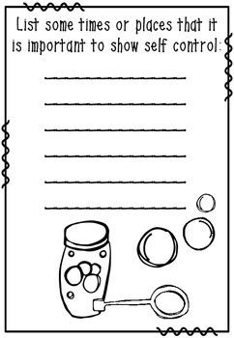
Activities to try at home!
Reflect on your first thoughts and ideas about self-control.
Now write a list of when and where it is important to show self-control.

Slide 7
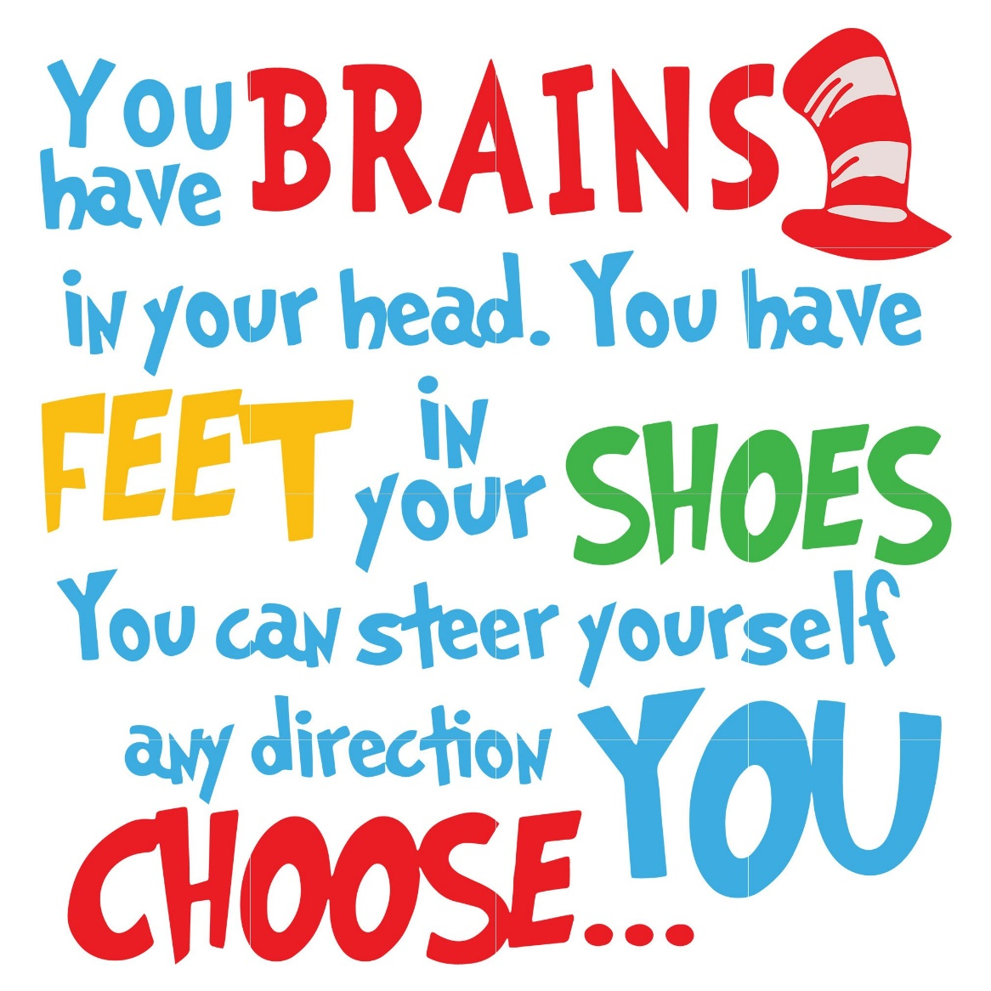
Thought of the Day
Take some time to be still and reflect on the thought of the day. What does it mean to you?

Slide 8
Let’s pray…
Dear God,
Thank you for the kind people.
Sorry for all of the unkind people.
Please help people to be better.
Amen.
Thank you Finley! (Sycamore)

