Slide 1

Verwood First School
Worship
Friday 26th June 2020

Slide 2
Happy Friday everybody!
The theme of today’s worship is:
Gentleness

Slide 3
Before we start, let’s take time to think…
What does the word gentleness mean to you?
When do you have to be gentle?
What happens if someone is not gentle?
Miss Watts says “Being kind and caring to others.”

Slide 4
In the video below, Douglas teaches us all about why being gentle is so important… https://www.youtube.com/watch?v=cFJgacjfO8M

Slide 5
A harsh king and a gentle king:
Rehoboam was a harsh and cruel king. The Israelites, also known as Jews, had become used to living under the authority of harsh kings or rulers. In fact, at the time that Zechariah lived, the Jewish people had just been released from living in slavery in Babylon and had been allowed to go back to Jerusalem.
Zechariah encouraged the people by telling them that they could look forward to the coming of another king. He told them the coming king would bring salvation, and righteousness. He also said the new king would be gentle and come to them riding on a donkey. He was talking about Jesus.
When Jesus did come, the Jews were still waiting for their “Messiah” or “Saviour.” They were expecting an earthly king, but God sent a heavenly king. Jesus told the people He was gentle and humble and that He would carry their burdens and give them a light “yoke.” He was reminding them that He would not be a harsh and cruel ruler, but a kind and gentle leader. Jesus came to save the Jewish people from their sins and He came to do that for us, too.

Slide 6
A harsh king and a gentle king:
Points for discussion:
If you were a king, what kind of king would you be?
Can you think of someone whom you just love to be with? Who is it?
What is it that makes them nice to be around?
When Jesus lived on earth He told the people He was gentle and humble. Why do you think Jesus said this?

Slide 7
Activities to try at home!
Hands On!
The Water Balloon activity:
You will need: Water Balloons, Large Bucket (for the balloons)
Instructions:
To prepare for this activity fill up the water balloons and put them in a large bucket.
Hand each person a water balloon. Place a bucket away from where they are standing. Ask them to try to get the balloon in the bucket by tossing it in as hard as they can. After they’ve thrown the 1st balloon hand them a 2nd one and tell them that this time they should try to get the balloon in the bucket without breaking it by gently placing it in the bucket.
Just like the balloon that we weren’t careful with, when we are harsh or careless with our words we can really hurt other people & make them burst. But when we are gentle with our words and actions it shows that we care about others and want to treat them in a kind and loving way.

Slide 8
Create!
Gentle Words Jar activity:
You will need: Mason Jar or Plastic Jar/Container, Pom Poms (or Cotton Balls) Gentle Answer Printable, Glue, Scissors, Rocks, Baking Sheet
Instructions:
Print out the Gentle Answer Printable, cut around the tag with scissors and glue to the container.
First let’s talk about the difference between harsh and gentle words. Pull out a baking sheet and invite your child to drop the rocks (harsh words) on the baking tray and then have them drop the pom poms (gentle words) on the baking tray. Ask them what type of words they like to be spoken to them—harsh or gentle?
Show your child the gentle words jar. Tell them that over the next week it’s their mission to fill up the jar with gentle words and actions (aka pom poms). Everytime someone in your family shows gentleness in the things they say or do put a pom pom in the jar. Watch your jar fill up over the week!

Slide 9
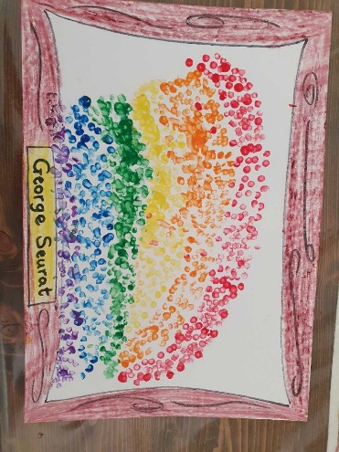
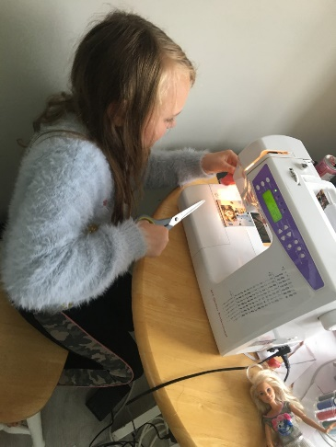
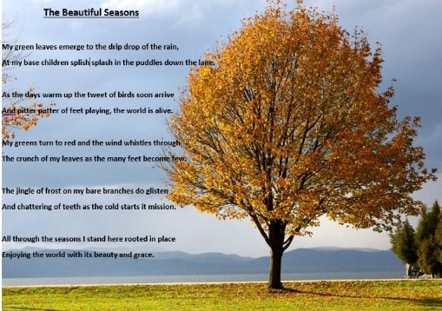
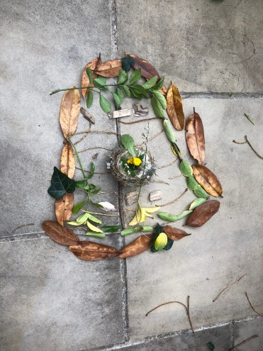
Let’s celebrate!
We have been so impressed with the learning that is happening at home!
Here are a few pictures of the home learning that has been sent in…well done everybody!

Slide 10
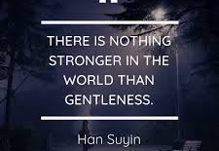
Thought of the Day
Take some time to be still and reflect on the thought of the day. What does it mean to you?

Slide 11
Let’s pray…
Dear God,
Help us to get out of lockdown.
Thank you for making our wonder world.
Please forgive us if we did something wrong.
Amen
Thank you Xander! (Willow)

