Slide 1
Rebuilding friendships
How can we make sure we are being good friends and strengthening our friendships?

Slide 2
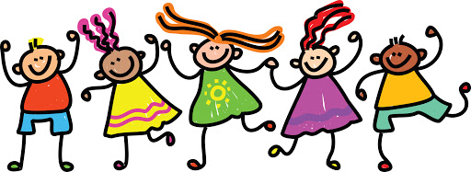
EYFS
I can play with other children.
I know how to be friendly.
It has been a long time since we have seen our friends and today we will be getting to know our friends again and working together.

Slide 3
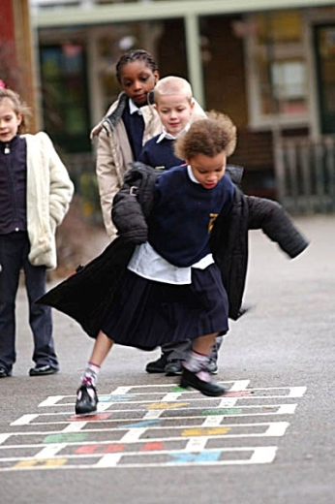
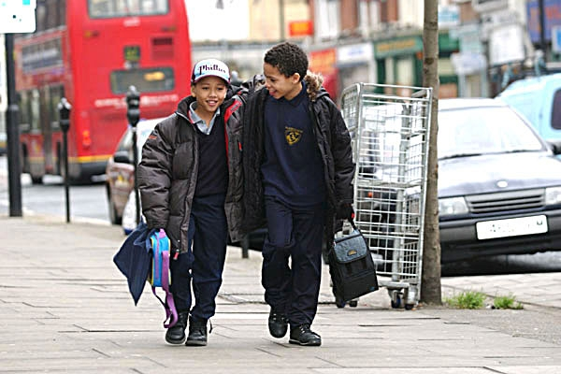
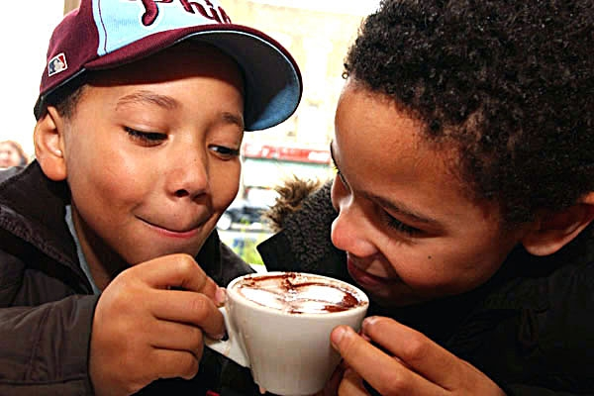
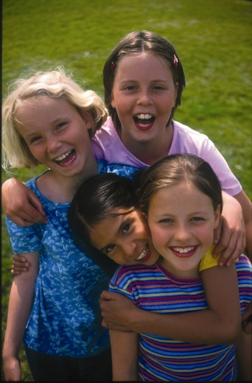
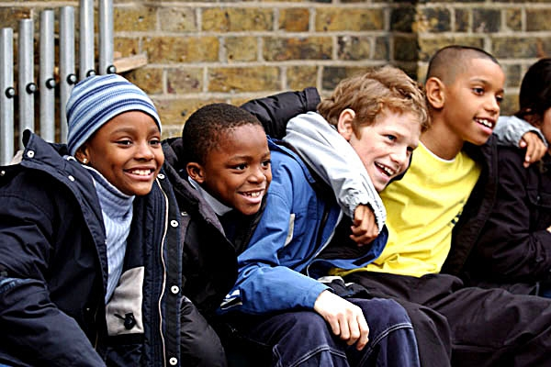
Let’s discuss…
Do you think these children are friends?
How do you know? What are they doing? What makes a good friend?
Are you a good friend? Why?

Slide 4
KS1
It has been a long time since we have seen our friends and today we will be getting to know our friends again and working together and reminding ourselves of what makes a good friend.
I can identify the qualities of a good friend.
I can show qualities of being a good friend.
Circle time round
A good friend is someone who ...
I want to be a better friend by ...
I am a good friend because…

Slide 5
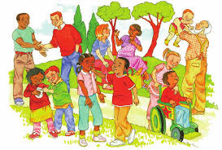
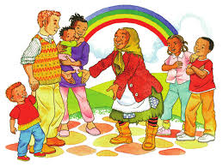
Story- Leroy and Rani and the friendship tokens
What kind of friendship tokens did people give each other?
What other kinds of friendship tokens could you give people?
What qualities make a good friend?

Slide 6
We are going to help rebuild our friendships by reminding ourselves and each other what qualities make a good friends.
Task:
To create a WANTED poster for a good friend.
We need to think about the qualities of a good friend.
What would they do to show they are a good friend?
What kind of friendship tokens would they give out?

Slide 7
LKS2
It has been a long time since we have seen our friends and today we will be working together, listening to each other and reminding ourselves of what makes a good friend.
I can tell you what being a good friend means to me.
I can listen well to other people when they are talking.
Circle time round
I really appreciate it when people ...
A good friend is someone who ...
I want to be a better friend by ...

Slide 8
Story- Leroy and Rani and the friendship tokens
Why do you think the old woman was so mean at first?
What sorts of feelings do you think Leroy might have been feeling when he was so horrible to Rani?
How do you think Rani was feeling when Leroy shouted at her and called her names?
What do you think might have happened if Rani had lost her temper and shouted back at Leroy?
What did Rani do that stopped the old woman from hurting her as she had hurt Leroy and all the others?

Slide 9

Good friends
What kind of friendship tokens did people in the story give each other?
What qualities do we look for in our friends?
What do we offer our friends?

Slide 10
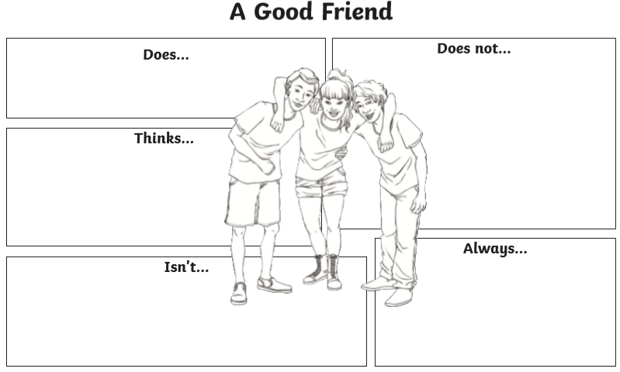
Activity 1

Slide 11
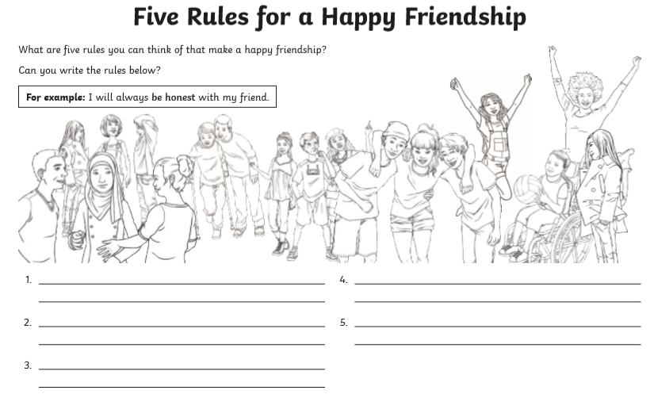
Activity 2

Slide 12
What would happen if we all followed these five rules?
By following these rules the we will strengthen and rebuild our friendships as a class.

Slide 13
UKS2
It has been a long time since we have seen our friends and today we will be reminding ourselves of the characteristics of friendships and good friends.
I can identify and explain what makes a good friend.
I can identify the characteristics of friendships.
Circle time round
I am glad to be back at school because….
I missed ……………… (about my friends)
I am worried to be back at school because………

Slide 14
Think and discuss:
Why are friendships important?
What different types of friendships do you have?
What are the characteristics of a good friendship?
What different ways do you communicate or interact with your friends?
What do you do if you have a problem within a friendship or friendship group?

Slide 15
Story- Leroy and Rani and the friendship tokens
Why do you think the old woman was so mean at first?
What sorts of feelings do you think Leroy might have been feeling when he was so horrible to Rani?
How do you think Rani was feeling when Leroy shouted at her and called her names?
What do you think might have happened if Rani had lost her temper and shouted back at Leroy?
What did Rani do that stopped the old woman from hurting her as she had hurt Leroy and all the others?

Slide 16
Activity
Create a short story or comic strip that illustrates the qualities of good friends through a fictional situation.
Think about the qualities already identified.
You can choose just one quality to focus on or use multiple.
Listen to a friend’s story. What qualities have they written about?

Slide 17
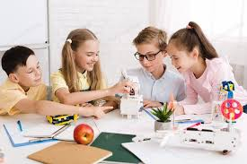
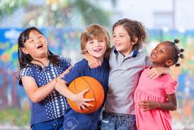
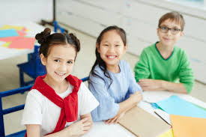
Final thinking:
What ways will we strengthen and rebuild our friendships as a class?

