Slide 1
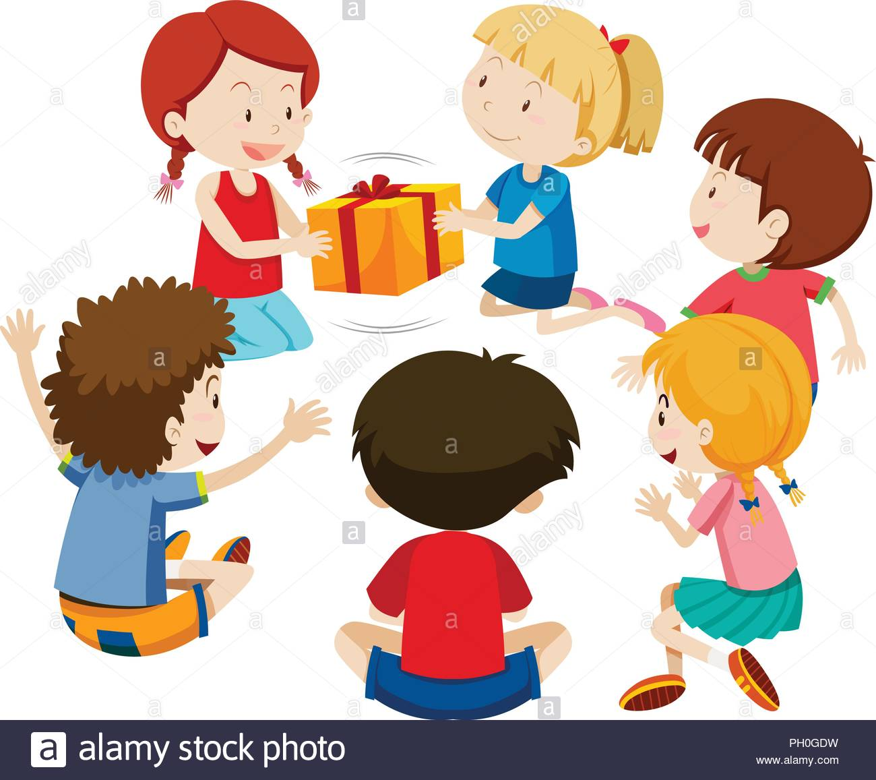
Dealing with Disappointment
EYFS
Notes:
See slide 1 section of the plan.
Explain that the puppet wants to play a game of pass the parcel.

Slide 2
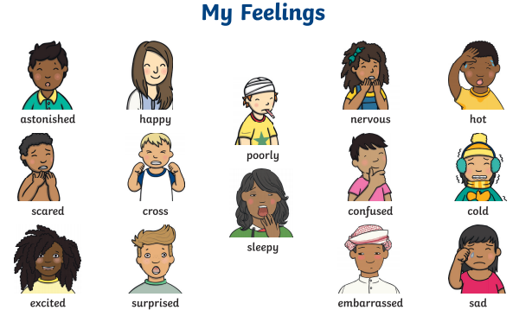
Notes:
See slide 2 section of plan.
As a class, discuss and scribe on board the feelings when passing the parcel around (e.g. happy, excited, nervous)
Then once the present has been opened and nothing is inside, discuss and scribe on board the feelings again (e.g. sad, confused, surprised, disappointed)

Slide 3
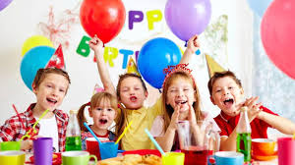
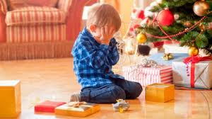
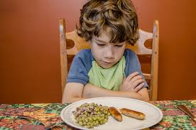
Can you think of a time when you have felt disappointed?
Notes:
See slide 3 section of plan.
Discuss examples such cancelled birthday party, not getting the lunch they were hoping for, not getting the present they were hoping for, getting sent to bed early, a play date being cancelled etc. - Discuss what they could do to feel better?

Slide 4
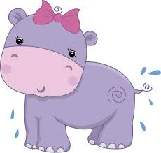

The Hippopotamus's Birthday
He has opened all his parcels
but the largest and the last;
His hopes are at their highest
and his heart is beating fast.
O happy Hippopotamus,
what lovely gift is here?
He cuts the string.
The world stands still.
A pair of boots appear!
O little Hippopotamus,
the sorrows of the small!
He dropped two tears to mingle
with the flowing Senegal;
And the 'Thank you' that he uttered
was the saddest ever heard
In the Senegambian jungle
from the mouth of beast or bird.
E.V.Rieu
Notes:
See slide 4 section of plan.
Read and discuss the poem - How is the hippopotamus feeling? Why is the hippopotamus disappointed?

