Slide 1
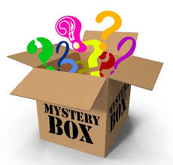

Dealing with Disappointment
Yr 1 & 2
What could be inside?
Notes:
See slide 1 section of the plan.
Role play surprised to see a mystery box in your classroom - discuss in talk partners what could be inside?

Slide 2
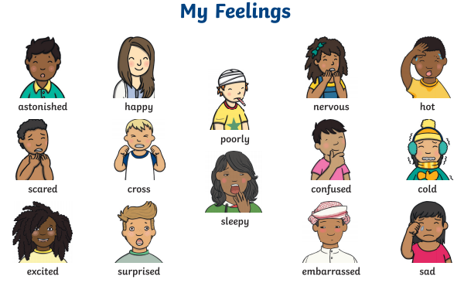
Notes:
See slide 2 section of plan.
As a class, discuss and scribe on board the feelings when anticipating what might be inside the parcel (e.g. happy, excited, nervous)
Then once the parcel has been opened and nothing is inside, discuss and scribe on board the feelings again (e.g. sad, confused, surprised, disappointed)

Slide 3
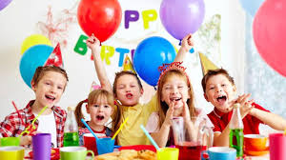
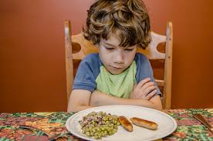
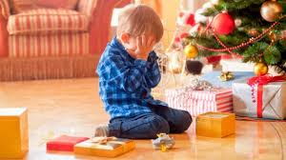
What is disappointment?
Disappointment is when you feel sad about not achieving what you set out to achieve or an event not going the way you wanted it to go. Most people will feel disappointment at some point in their life.
Can you think of a time when you have felt disappointed?
Notes:
See slide 3 section of plan.
Discuss examples such cancelled birthday party, not getting the lunch they were hoping for, not getting the present they were hoping for, getting sent to bed early, a play date being cancelled etc. - Discuss what they could do to feel better?

Slide 4
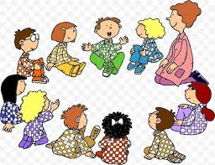
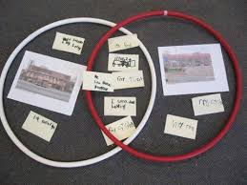
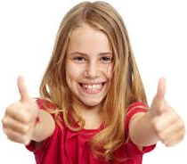
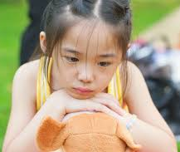
Let’s play a sorting game...
We need to decide if the scenarios would make the person feel…
OR
Notes:
See slide 4 section of plan.
Explain the sorting game - pass the bag/basket around the circle to music or a song - whoever it lands on reads the scenario and as a class discuss if it would make the person feel happy or disappointed.

Slide 5

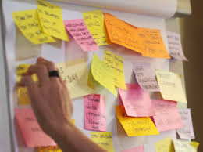
I felt disappointed when....
Notes:
See slide 5 section of plan.
You may wish you pre-write some sentence starters on post-it notes for any children who may need additional support.
When finished encourage chn to stick their post-it on the flipchart - use this as a talking point to emphasise that disappointment is a normal emotion and something that we are likely to all experience in our lives.

Slide 6
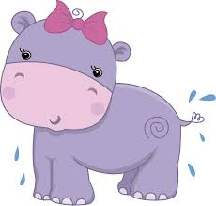
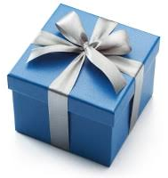
The Hippopotamus's Birthday
He has opened all his parcels
but the largest and the last;
His hopes are at their highest
and his heart is beating fast.
O happy Hippopotamus,
what lovely gift is here?
He cuts the string.
The world stands still.
A pair of boots appear!
O little Hippopotamus,
the sorrows of the small!
He dropped two tears to mingle
with the flowing Senegal;
And the 'Thank you' that he uttered
was the saddest ever heard
In the Senegambian jungle
from the mouth of beast or bird.
E.V.Rieu
Notes:
See slide 6 section of plan.
Read and discuss the poem - How is the hippopotamus feeling? Why is the hippopotamus disappointed? What could he do to make himself feel better?

