Slide 1


Dealing with Disappointment
Yr 3 & 4
What could be inside?
Notes:
See slide 1 section of the plan.
Role play surprised to see a mystery box in your classroom - discuss in talk partners what could be inside?

Slide 2
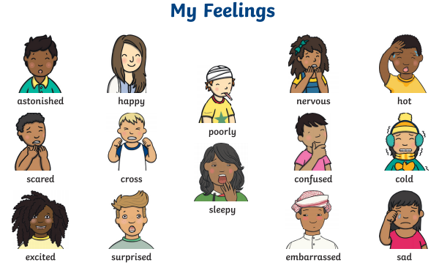
Notes:
See slide 2 section of plan.
As a class, discuss and scribe on board the feelings when anticipating what might be inside the parcel (e.g. happy, excited, nervous)
Then once the parcel has been opened and nothing is inside, discuss and scribe on board the feelings again (e.g. sad, confused, surprised, disappointed)

Slide 3
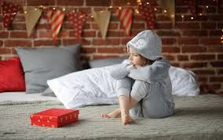
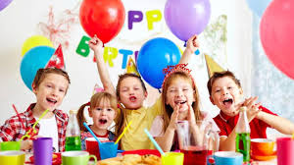
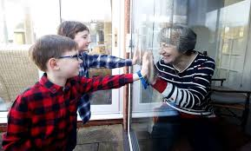
What is disappointment?
Disappointment is when you feel sad about not achieving what you set out to achieve or an event not going the way you wanted it to go. Most people will feel disappointment at some point in their life.
Can you think of a time when you have felt disappointed?
Notes:
See slide 3 section of plan.
Discuss examples such cancelled birthday party, not getting the lunch they were hoping for, not getting the present they were hoping for, getting sent to bed early, a play date or holiday being cancelled, not being able to see loved ones etc. - Discuss what they could do to feel better?

Slide 4
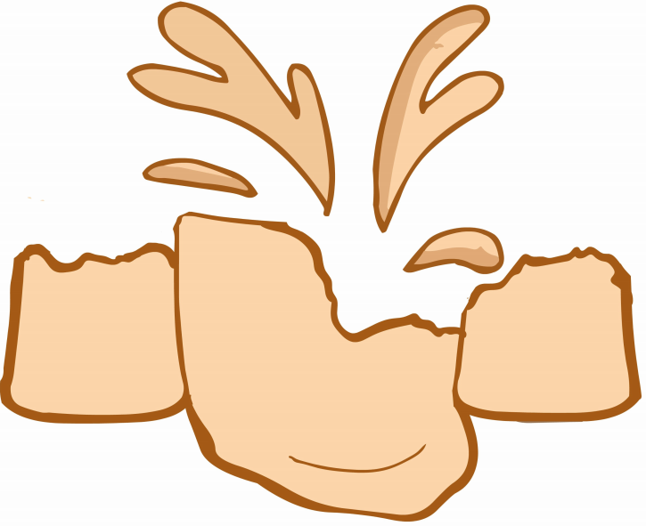
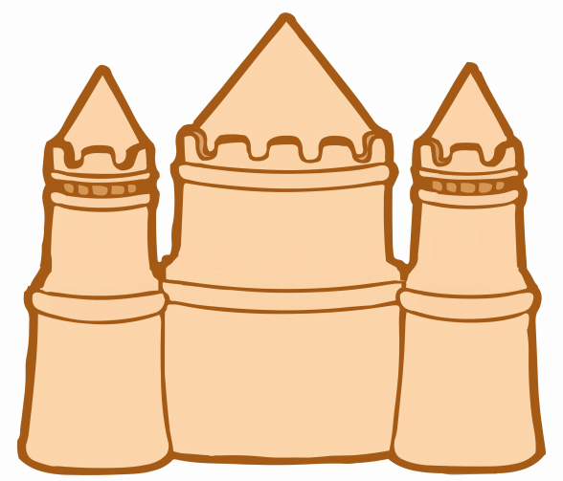
Time for reflection...
A time you have been disappointed
What you can do to make yourself feel better
Notes:
See slide 4 section of plan.
Explain the concept of this activity (could model with real sandcastle if your school has the resources e.g. borrow from EYFS). Chn then have a go at reflecting on a time when they felt disappointed and consider strategies to made them feel better.

Slide 5
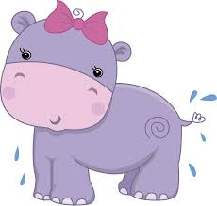

The Hippopotamus's Birthday
He has opened all his parcels
but the largest and the last;
His hopes are at their highest
and his heart is beating fast.
O happy Hippopotamus,
what lovely gift is here?
He cuts the string.
The world stands still.
A pair of boots appear!
O little Hippopotamus,
the sorrows of the small!
He dropped two tears to mingle
with the flowing Senegal;
And the 'Thank you' that he uttered
was the saddest ever heard
In the Senegambian jungle
from the mouth of beast or bird.
E.V.Rieu
Notes:
See slide 5 section of plan.
Read and discuss the poem - How is the hippopotamus feeling? Why is the hippopotamus disappointed? What could he do to make himself feel better?

