Slide 1

Verwood First School
Worship
Monday 29th June 2020

Slide 2
Happy Monday everybody!
The theme for today’s worship is…
Faithfulness

Slide 3
Before we start, let’s take time to think…
What does the word faithfulness mean to you?
What do you think of when thinking about faithfulness?
Mrs Boyle says « Faithfulness means staying loyal your family and friends! »

Slide 4
Faithfulness is the act of being true to your word or promise. It’s the ability to follow through on commitments with dedication. The Bible offers several examples of faithfulness.
The story of Jonathan and David is a sweet reminder of what it means to be faithful friends. Jonathan could have been jealous of David, who was chosen by God to proceed his father as king. He could have compared himself to David, the courageous man who seemed to be getting all the attention. But he didn’t. Instead, Jonathan vowed to remain by David’s side no matter what. He promised to support him and cheer him on.
There may be times in life when we are David, the “chosen” one. In those seasons, it’s a gift to have a friend like Jonathan to faithfully support us. There may be other times when we get to be a Jonathan to our friends, choosing to be present and faithful as they shine.
David and Jonathan | Faithfulness in Friendship
1 Samuel 19-23
And Jonathan, Saul's son, rose and went to David at Horesh, and strengthened his hand in God. And he said to him, “Do not fear, for the hand of Saul my father shall not find you. You shall be king over Israel, and I shall be next to you. Saul my father also knows this.” And the two of them made a covenant before the Lord. 1 Samuel 23:16-18 ESV

Slide 5
Watch this great video from PACE all about faith.
https://thepacetrust.blogspot.com/2020/04/faith.html

Slide 6
Activities to try at home!
Have a go at the Friends Forever word challenges!
Can you solve the two riddles based on the story David and Johnathan?

Slide 7
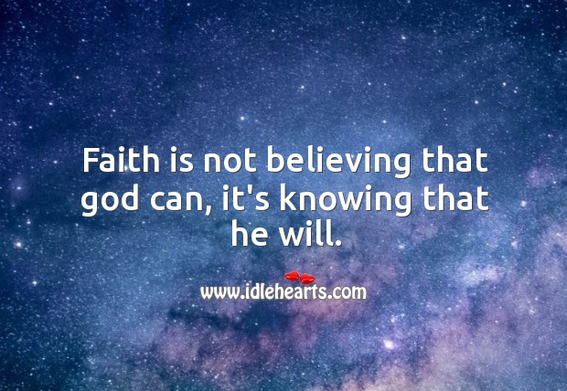
Thought of the Day
Take some time to be still and reflect on the thought of the day. What does it mean to you?

Slide 8
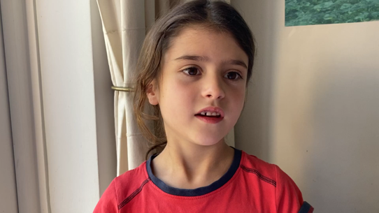
Let’s pray…
Dear God,
Thank you for keeping my family, friends and teachers safe.
Please help us to get back together again.
We will be happy when the virus is over.
Then school can be normal and I can be close to my friends and family again.
Amen.
Thank you Phoebe! (Sycamore)

