Slide 1

Verwood First School
Worship
Friday 3rd July 2020

Slide 2
Happy Monday everybody!
The theme for today’s worship is…
Respect

Slide 3
Before we start, let’s take time to think…
What does the word respect mean to you?
How do we show respect?
What sort of behaviour deserves respect?
How do you feel when someone doesn’t show respect?
Mr Luford says « For me, respect means listening, not always agreeing but trying to understand people, their views and the wonderful world we live in. »
Mr Bishopp says « Respect is understanding and values different opinions and beliefs. »

Slide 4
Not only is respect one of our 6Rs at Verwood First School, it is a very important value to carry with us for the rest of our lives. The Bible is full of stories all about showing respect.
Watch the video below and think about the main themes from Luke 6 31.
https://www.youtube.com/watch?v=25K_oWOvbxQ

Slide 5
There are a few links below to episodes that focus on different themes within the bigger theme of respect.
https://www.bbc.co.uk/iplayer/episode/b01rn5k4/whats-the-big-idea-15-is-everybody-different
https://www.bbc.co.uk/iplayer/episode/b09qhttm/treasure-champs-series-1-8-obedience
https://www.bbc.co.uk/iplayer/episode/b09w7pzq/cbeebies-bedtime-stories-624-jb-gill-families-families-families

Slide 6
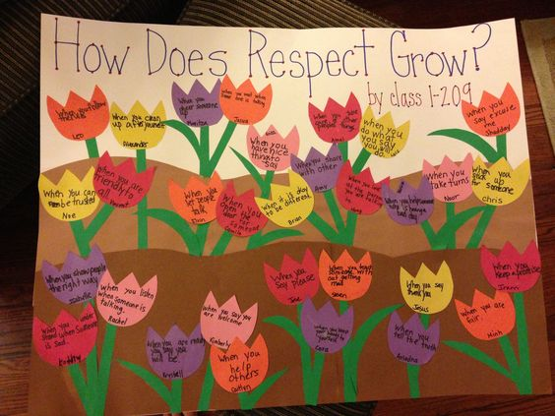
Activities to try at home!
Can you create your very own ‘Respect Garden’. On each flower, write the different ways you can show respect and the different times you might have to show respect.

Slide 7
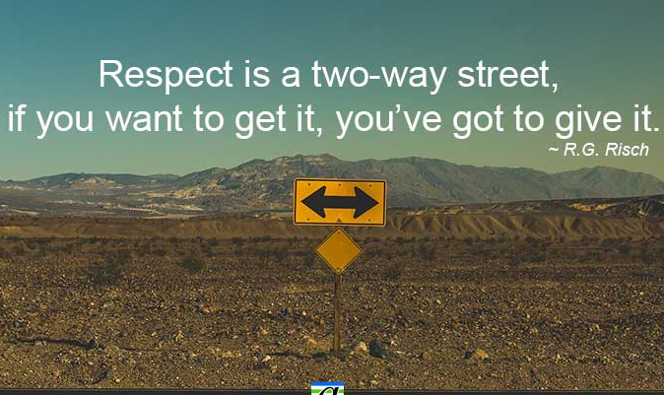
Thought of the Day
Take some time to be still and reflect on the thought of the day. What does it mean to you?

Slide 8
Let’s pray…
Dear God,
Thank you for the World.
Thank you for the animals, they are cute.
Amen

