Slide 1

Verwood First School
Worship
Monday 6th July 2020

Slide 2
Happy Friday everybody!
The theme for today’s worship is…
Responsibility

Slide 3
Before we start, let’s take time to think…
What does the word responsibility mean to you?
How do we show that we are responsible?
How do you feel when someone doesn’t show responsible?
Miss Tizzard says « Responsibilty is looking after one another. »

Slide 4
There are lots of different themes to explore when thinking about responsibility.
Taking responsibility for our actions - recognising when we are at fault, not trying to pass the blame on to someone else, owning up to our mistakes, having the courage to face the music.
Taking responsibility for a task - being a responsible person, honouring another's trust in you, doing a job to the best of your ability, being a willing volunteer, seeing the job through, taking the blame if the job goes wrong.
Taking responsibility for someone or something - looking after another person or a pet, making sure someone is properly looked after, being a reliable carer, not giving up halfway through, focusing attention on another's needs.
Sharing responsibility for our environment - not leaving it up to others, playing your part in making the classroom, school and community a safer and better place, doing what you can to care for the world

Slide 5
Take a listen to this episode of Kids Corner.
In this episode, Liz and his friends put on a three-act play to teach about responsibility.
https://kidscorner.reframemedia.com/terrene/episodes/three-on-responsibility
The Bible has a lot to say about taking responsibility. For example, we are to be responsible for the way we act toward others (Luke 10:30-37). We are responsible for the way we treat our families (1 Timothy 5:8). We are responsible to study God’s Word (2 Timothy 2:15). And we are responsible for the way we handle money (Hebrews 13:5).
God has done so much for us. He created us. He sent his son, Jesus, to die for us. He saves us from the punishment for our sins. As a way to show our thanks to him for all he’s done for us, we want to honor him. We do this by taking responsibility to live a life pleasing to him

Slide 6
Also, check out this episode of DipDap.
https://www.bbc.co.uk/iplayer/episode/b00ycvc8/dipdap-21-plant
In this episode, The Line draws a picture of a plant that DipDap has to look after!

Slide 7
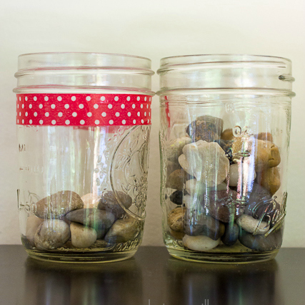
Activities to try at home!
Responsibility Jar
Get two jars and a supply of something small, like candy pieces, coins or small rocks.
Put a strip of tape on each jar. On one jar, write “Responsible.” On the other jar, write “Not so much.” Over the next week, ask your parents to tell you when they think you’ve been responsible and when you haven’t. When they say you have been, put an item in the “Responsible” jar. When they say you haven’t, put an item in the “Not so much” jar. At the end of the week, see which jar is fuller. If your “Not so much” jar has more items, reflect on how you can be more responsible next week.

Slide 8
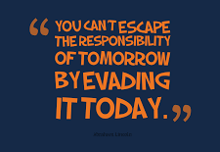
Thought of the Day
Take some time to be still and reflect on the thought of the day. What does it mean to you?

Slide 9
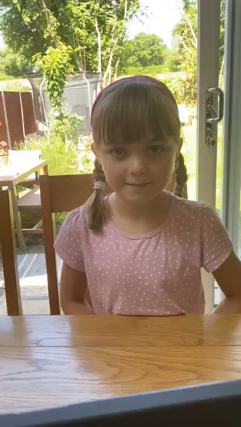
Let’s pray…
Dear God
Thank you for the kind and lovely people that help others and forgive,
Thank you for our homes that give us space to play and learn when we can’t go to school
Thank you for our families that keep us safe in this different and sometimes scary time
Thank you for all of the beautiful space we have around us in Verwood that we can explore in
I hope that everyone who has this virus gets better and the doctors and nurses don’t ever give up.
Amen
Wow, thank you for the lovely prayer Imogen (Willow)

