Slide 1

Keeping safe online
EYFS

Slide 2
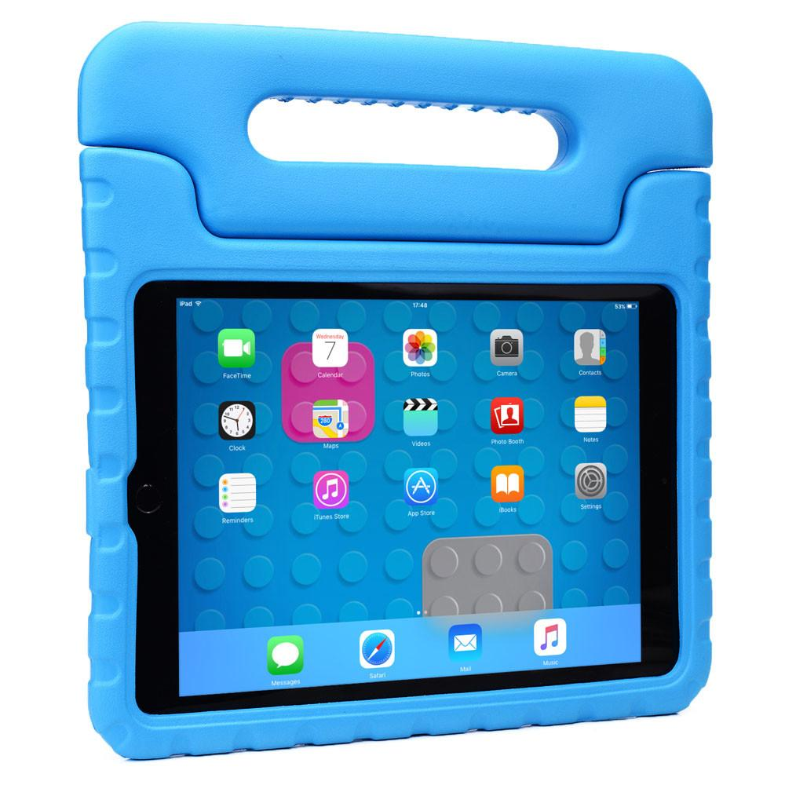

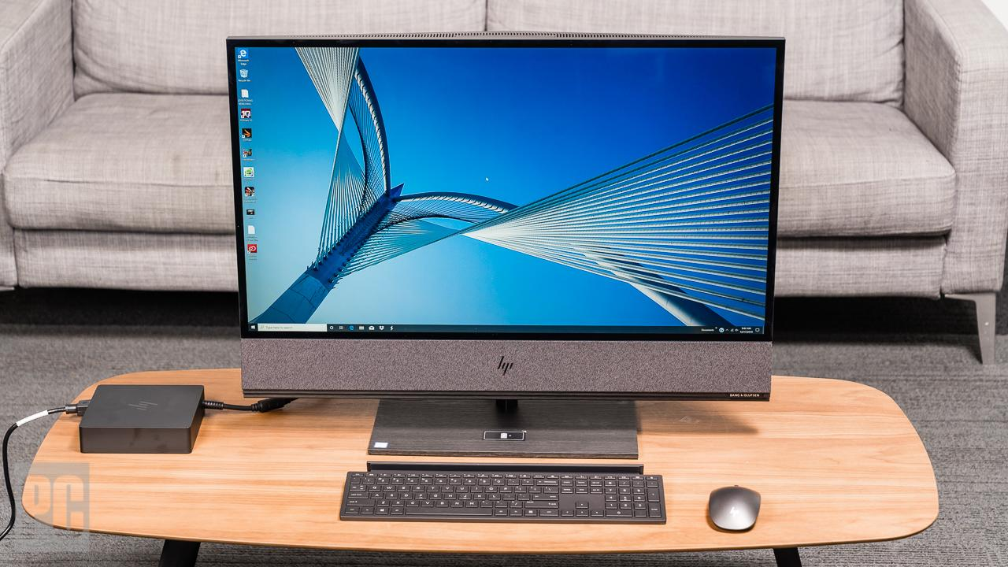
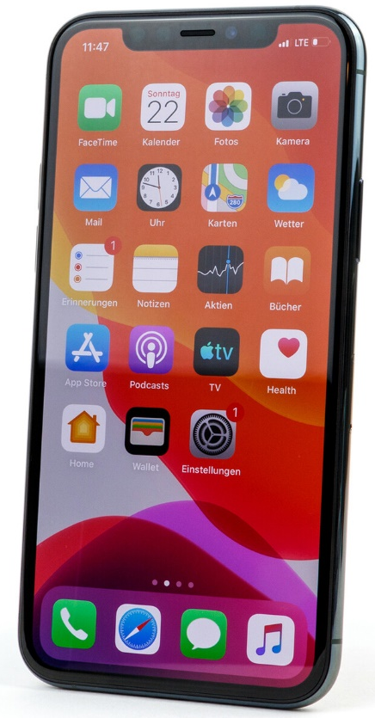
These are called devices.
Who has used one of these devices?
Laptop
Tablet
Smartphone
Home computer

Slide 3





What do you do on your device?
Some people might:
Play games
Watch videos
Listen to songs
See and speak to family and friends
Discover new things
Learn at home

Slide 4
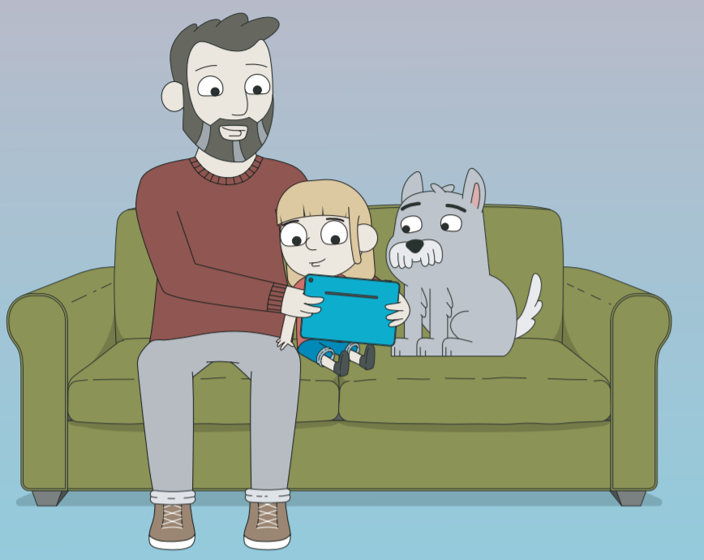
We are going to learn about how we can stay safe when we use our devices.
Click the picture and play ‘Episode 1’

Slide 5
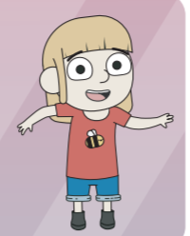

Can you remember what Jessie told us?
Lets fill in the gaps together!
If it makes you feel funny in your ______
worried, scared or______,
then you must tell a _______you trust,
like a ______ or a _____or dad!
tummy
sad
grown-up
teacher
mum

Slide 6
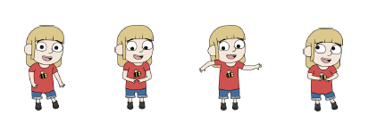
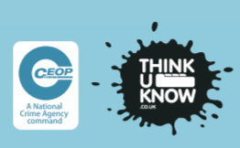
Lets singalong one more time!
Click here

