Slide 1
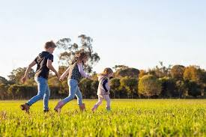
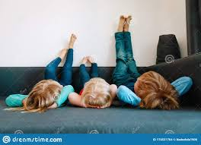
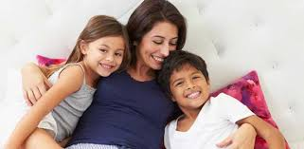
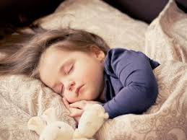
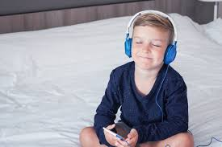
Wellbeing - Learning to relax in different ways
EYFS
What does it mean to relax?
And why is it important?
Notes:
See slide 1 section of the plan.
Talk about the word ‘Relax’ - What does it mean? What do you do to relax? How do you feel after you have had a nice long nap?
How does rest help your body and mind?

Slide 2
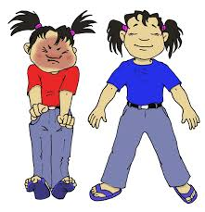
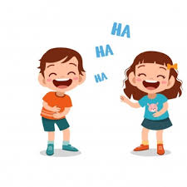
Different people might choose to relax in different ways. It is important that we know about different ways that we can help our minds and bodies to relax… So today we are going to learn about 2 ways we can relax...
Muscle relaxation
Laughter
and
Notes:
See slide 2 section of plan.
Explain that we are going to learn about 2 different ways we can relax our bodies...

Slide 3

Muscle relaxation
Notes:
See slide 3 section of plan.
Remember to ensure children are in a comfortable position before starting (allow them to choose) e.g. lying on the floor, sitting on a chair with their hands in their lap and feet flat on the floor, sitting with their legs crossed and hands in their lap etc.

Slide 4
Did you know that laughing...
relaxes your muscles for up to 45 minutes after
boosts your immune system/makes it less likely for you to get ill
releases hormones which make you feel good
helps you to manage feelings of anger
can help you to live longer!
Laughter
Notes:
See slide 4 section of plan.
Share the benefits of laughing (may need to explain in a more child friendly way.

Slide 5
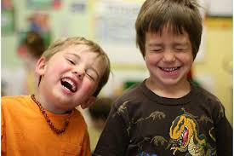
Let’s go outside and ‘have a laugh’!
Laughter
Notes:
See slide 5 section of plan.
Take the children outside (ideally) for the laughing exercise (see plan)

Slide 6
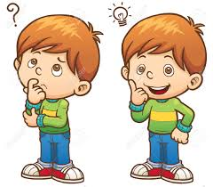
Let’s think about it...
Would it be a good idea to choose to relax using laughter, during a Phonics lesson?
Why or why not?
When might it be a good time to relax using laughter?
Notes:
See slide 6 section of plan.
Encourage chn to think about what relaxation techniques would be appropriate at different times and places.

