Slide 1

Keeping safe online
KS1

Slide 2



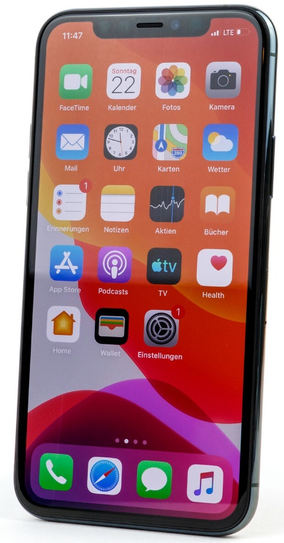
These are called devices.
Have you been using any of these devices whilst you’ve been staying home?
Laptop
Tablet
Smartphone
Home computer
All of these devices can access the internet and connect millions of other devices and people together across the world!

Slide 3





What do you do on your device?
Some people might:
Play games
Watch videos
Listen to songs
See and speak to family and friends
Discover new things
Learn at home

Slide 4


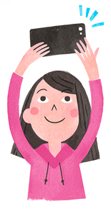


The internet is a fantastic way of sharing things with people when we can’t be with them in person.
What sort of things might we share with somebody on our devices?
Photos
Comments
Videos

Slide 5
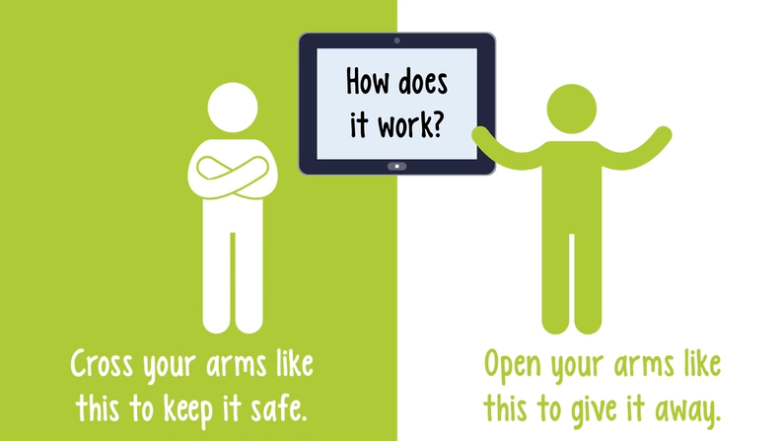
Time for a challenge…
We are going to look at some information that someone might share online. Do you think we should keep it safe or give it away?

Slide 6


What do you think?
Your full name
Keep it safe! Your full name is personal information and should never be shared online.

Slide 7
What do you think?
The school you go to
Keep it safe! You should never tell someone you don’t know where you go to school. It is personal information.

Slide 8
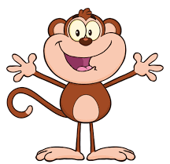
What do you think?
Your favourite flavour of ice-cream
Give it away! This information is safe to talk about, lots of people might say the same as you.

Slide 9
What do you think?
Your passwords
Keep it safe! Your password should only be shared with adults you trust. You wouldn’t want someone else pretending to be you!

Slide 10
What do you think?
Where you live
Keep it safe! Like your name, this is personal information and should not be shared.

Slide 11
What do you think?
Your teddy’s name
Give it away! This is information that is ok to talk about.

Slide 12
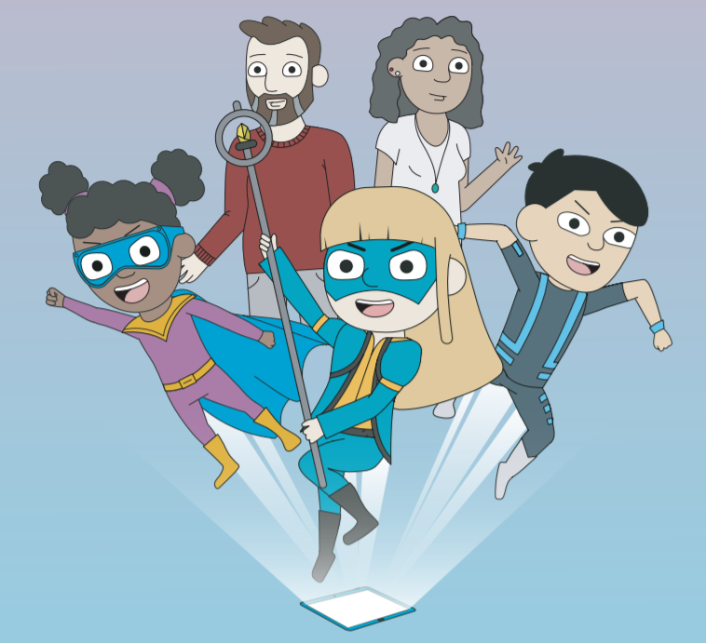
Let’s watch…
Click the image to watch.

Slide 13
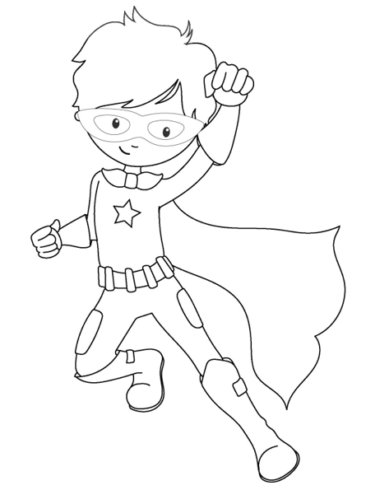
What have we learnt today?
The internet can be great, but we must remember never to share any personal information online.
If we ever see anything online that makes us feel worried, scared or sad and we get a funny feeling in our tummy, then we must tell one of our trusted adults. This could be a member of your family or a teacher.
Activity time!
Colour in your superhero. What advice will they have for other children on how to stay safe online?

