Slide 1

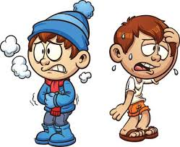

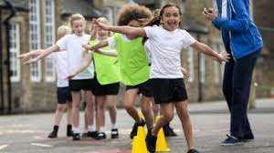
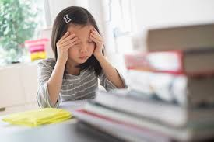
Wellbeing - Learning to use breathing exercises to relax
Yr 1&2
When did you last do some exercise?
How did it make you feel?
What happens to your body and how do you feel when you are nervous, worried or stressed?
Notes:
See slide 2 section of plan.
Talk about exercise and the effects that it has on the body - compare this to the effects that stress can cause e.g. sweaty palms, heart beating fast, muscles shaking etc. Explain that this can be a good thing because it is our body trying to calm us down and get us ready for what comes next.

Slide 2
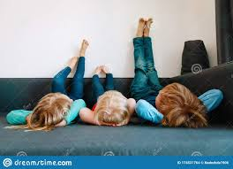
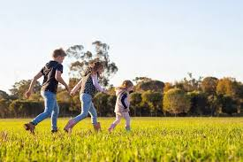
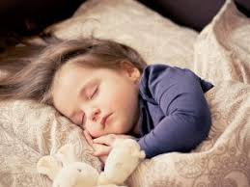
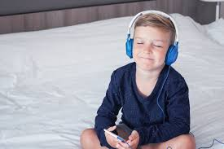
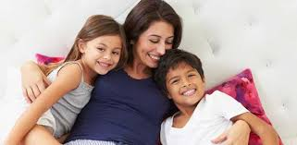
What does it mean to relax?
And why is it important?
Notes:
See slide 1 section of the plan.
Talk about the word ‘Relax’ - What does it mean? What do you do to relax? How do you feel after you have had a nice long nap?
How does rest help your body and mind?

Slide 3
Did you know that relaxing...
Why is it important to relax?
allows your body to repair itself
restores your energy
makes you more alert
helps your memory
helps you to learn and concentrate
helps your immune system - can stop you from getting ill
can make is easier to stay calm
Notes:
See slide 4 section of plan.
Relaxation not only has positive effects on the body, but it can also help you to respond calmly and thoughtfully to difficult situations. Often, if dealing with difficult emotions, it helps to step back, use relaxation techniques to calm down and then look at the situation again. This can help you to see more clearly rather than doing or saying something that you will regret once you have calmed down. Get pupils to suggest ways to relax and note ideas on the board.

Slide 4

Do you think breathing can help you to relax? How?
We are about to take part in a breathing exercise. It will mean that we will need to sit comfortably and quietly for about 10 minutes… it is really important that you take part as it will help you to feel relaxed.
Notes:
See slide 4 section of plan.
Ensure you talk to children about the ‘rules’ - respect others, take part, it’s ok to become distracted but then try your best to refocus. You may wish to say that you will be giving stickers to chn who are trying really hard to relax.

Slide 5
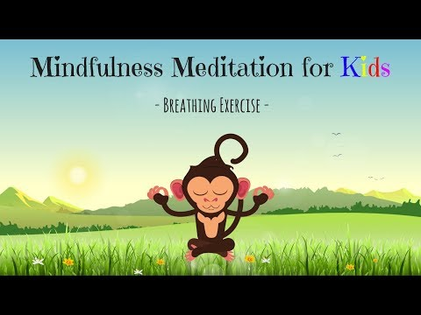
Let’s do a breathing exercise together
Notes:
See slide 5 section of plan.
https://www.youtube.com/watch?v=Bk_qU7l-fcU
It is incredibly important that the teacher models successful mindful meditation during this video.

Slide 6
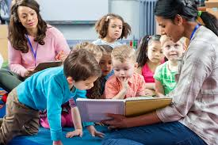
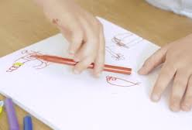
We are going to make a class relaxation book to help people with ideas on how to relax
Notes:
See slide 6 section of plan.
Teacher model on the flip chart how to create a page for the book - model writing a sentence and drawing a picture on your page that will be included in the book.

Slide 7
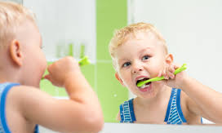
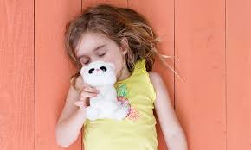
Let’s think about it...
Notes:
See slide 7 section of plan.
Encourage chn to think about how just like when we brush our teeth twice a day to keep them clean rather than only cleaning them when they start to look dirty or unhealthy. In this same way, it is better to include relaxation into our daily routine rather than only using it when we are feeling stressed or trying to manage difficult feelings.

