Slide 1

Online Safety
LKS2
Year One

Slide 2

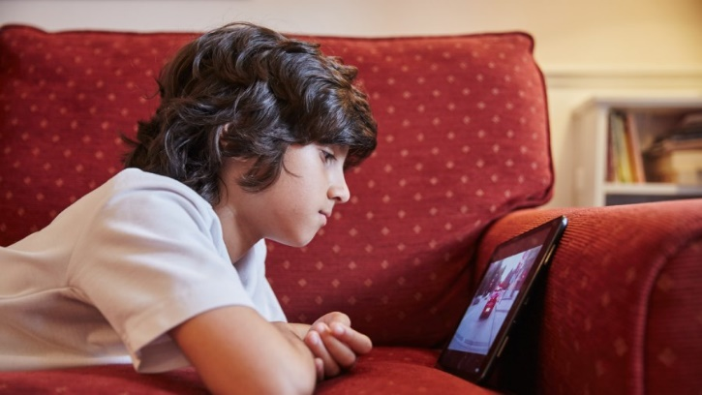

Coronavirus
During this uncertain time, lots of people have been affected across the world. More children than ever have spent time online.
What have you been using your devices and the internet for at home?
Home learning
Online gaming
Watching videos and listening to music
Speaking to family and friends

Slide 3
Coronavirus
Social media and gaming sites have been used far more as people have adapted to staying home.
How do you think people might have felt having to stay at home for long periods of time?
frustrated
anxious
sad/upset
lonely
worried

Slide 4
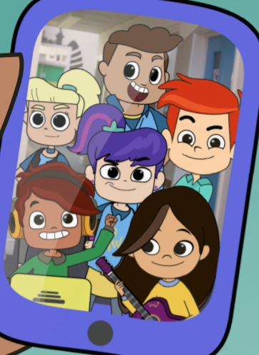
Staying safe online
The internet is a great place to play, share and like things but we must make sure we are keeping ourselves safe online, just like we would in real life.
We are going to watch a video about a group of friends who love going online.
Click on the picture to watch:

Slide 5
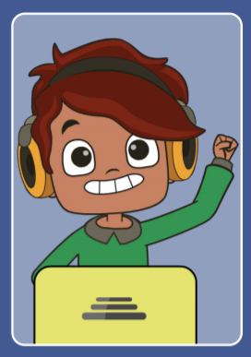
Play, Like, Share.
What was Alfie doing at the beginning of the video?
What problem did he face?
How might Alfie have felt when the
gamer said to him ‘Don’t leave?’
Alfie was being pressured into staying on the game and missing school by a game player he didn’t know. Alfie did the right thing… what did he do?

Slide 6
Play, Like, Share.
When Alfie got home from school, he had lots of messages from the gamer. This might have made Alfie’s body experience some ‘warning signs’ that something wasn’t quite right.
What could have happened to Alfie’s body when he experienced the ‘warning signs’?
On your post it, write down as many warning signs as you can. Then, we will stick them on our body outline.

Slide 7
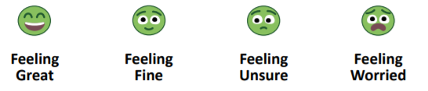
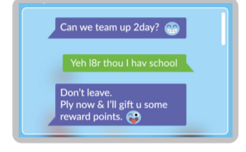
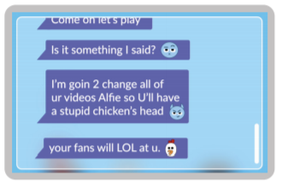
How do you think Alfie felt when they gamer sent him these messages?
Did Alfie do the right thing?

Slide 8
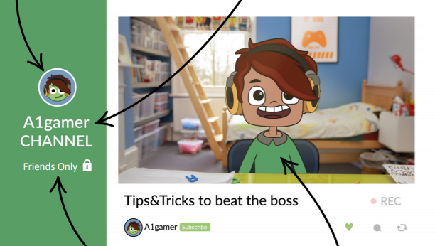
Play, Like, Share.
He has used an avatar instead of a real photo of himself
His username does not have his real or full name
He set his privacy to only friends
He is not wearing his school uniform or anything personal, like pyjamas

Slide 9
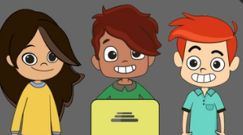
Play, Like, Share.
What did the children do at the end of the film?
Why do you think they wanted to make their video public?
What happened when they made their video public?

Slide 10
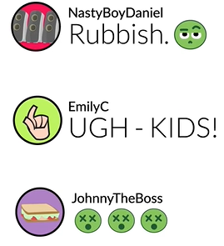
Comments
After they had shared their video with the public, what sort of comments did the children receive?
How would this have made them feel?
When we write or post something online, we must always think about how we might make other person feel.

Slide 11

Fake adverts and ‘phishing’
What happened when the children clicked the link in this comment?
‘Phishing’ is when someone might pretend to be someone else, like a company, to get you to click on a link that might take you to an inappropriate website, one that might be harmful to your device or trick you into giving personal information.

Slide 12
Worried?
After receiving lots of messages from someone he did not know, Alfie realised something wasn’t right and had those ‘warning signs’ in his body. What did he do?
He did not reply, he told a trusted adult, blocked the user and reported him to the website. If anything makes you feel uncomfortable online, you should always tell a trusted adult right away. Who would you tell?

Slide 13
Online Safety
LKS2
Year One

