Slide 1
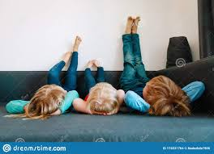
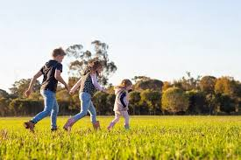
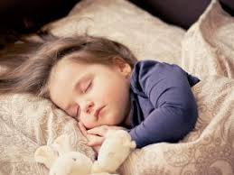
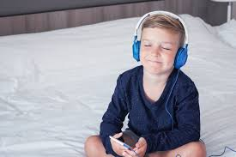
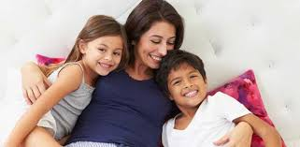
Wellbeing - Learning what relaxation feels like and where we can use relaxation techniques.
Yr 3&4
What does it mean to relax?
And why is it important?
Notes:
See Slide 1 section on the plan.
Discuss the questions displayed. THEN ask the children to think of the most relaxing place possible.

Slide 2
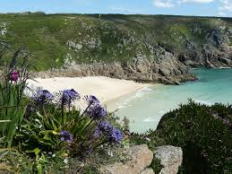
Relaxing places...

Slide 3
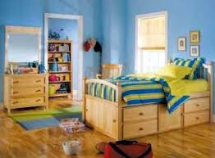
Relaxing places...

Slide 4
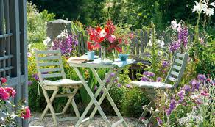
Relaxing places...

Slide 5
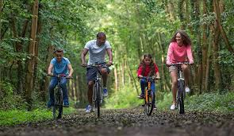
Relaxing places...

Slide 6
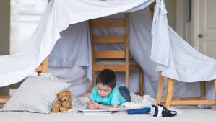
Relaxing places...

Slide 7
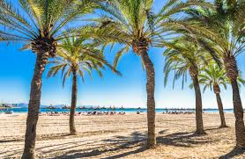
Relaxing places...

Slide 8
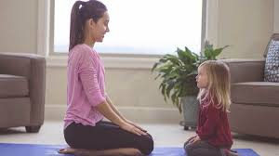
Relaxing places...

Slide 9
* What place did you think was the most relaxing and why?
* What makes these places relaxing?
Notes:
Encourage chn to reflect on which place they think is most relaxing and give reasons WHY (not just because it looks nice!).
What makes these environments relaxing?

Slide 10
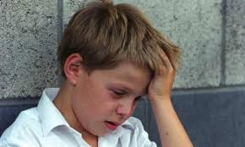
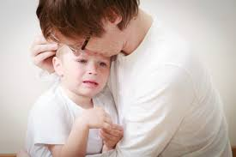
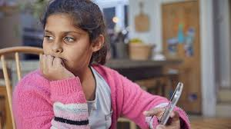
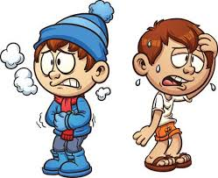
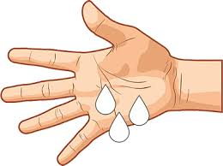
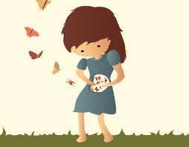

When have you felt worried, angry or upset?
What did you think about and how did your body feel?
Notes:
See slide 10 section of plan.
Encourage discussion about when they have felt worried, upset or angry - how did it make them feel?

Slide 11
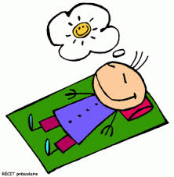

Visualisation Relaxation
We are about to take part in a visualisation exercise. It will mean that we will need to sit comfortably and quietly for about 6 minutes… it is really important that you take part as it will help you to feel relaxed.
Notes:
See slide 11 section of plan.
Ensure you talk to children about the ‘rules’ - respect others, take part, it’s ok to become distracted but then try your best to refocus. You may wish to say that you will be giving stickers to chn who are trying really hard to relax.

Slide 12
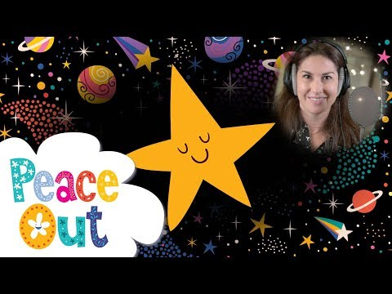
Visualisation Relaxation
Notes:
See slide 12 section of plan.
https://www.youtube.com/watch?v=YtmjV49YEWs&feature=emb_title
It is incredibly important that the teacher models successful mindful meditation during this video.

Slide 13
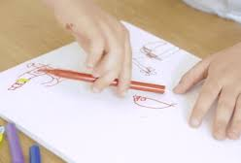

We are going to think about and create where your calm place would be.
Remember to describe your calm place using your senses.
Notes:
See slide 13 section of plan.
Teacher model on the flip chart drawing and labelling a picture of their favourite calming place using descriptive language.

Slide 14
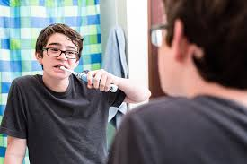
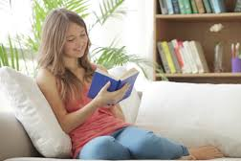
Let’s think about it...
Notes:
See slide 14 section of plan.
Encourage chn to think about how just like when we brush our teeth twice a day to keep them clean rather than only cleaning them when they start to look dirty or unhealthy. In this same way, it is better to include relaxation into our daily routine rather than only using it when we are feeling stressed or trying to manage difficult feelings.

