Slide 1

Verwood First School
Worship
Friday 10th July 2020

Slide 2
Happy Friday everybody!
The theme for today’s worship is…
Resilience!

Slide 3
Before we start, let’s take time to think…
What does the word resilience mean to you?
How do we show that we are resilient?
How do you feel when you aren’t resilient?
Mrs Brason says « I think that resilience is being able to find the learning in making mistakes. »

Slide 4
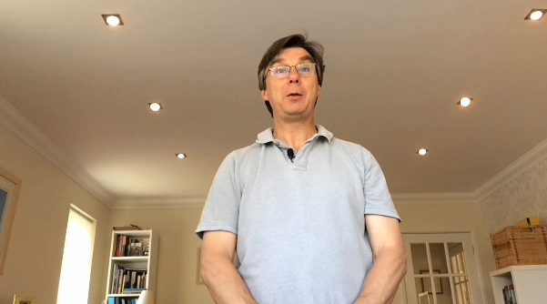
In today’s worship, Keith Jewell teaches us a Bible story all about showing resilience.
See website for video.

Slide 5
Wow, what a lot of different ways of showing resilience! Thank you for sharing that story Keith.
Hugo is learning all about resilience in this episode of
‘What’s the Big Idea?’.
https://www.bbc.co.uk/iplayer/episode/b01rh82l/whats-the-big-idea-9-what-does-it-mean-to-learn-something
Hugo learns at school, but also from his parents and friends. He discovers that sometimes you have to make lots of mistakes before you can learn something.

Slide 6
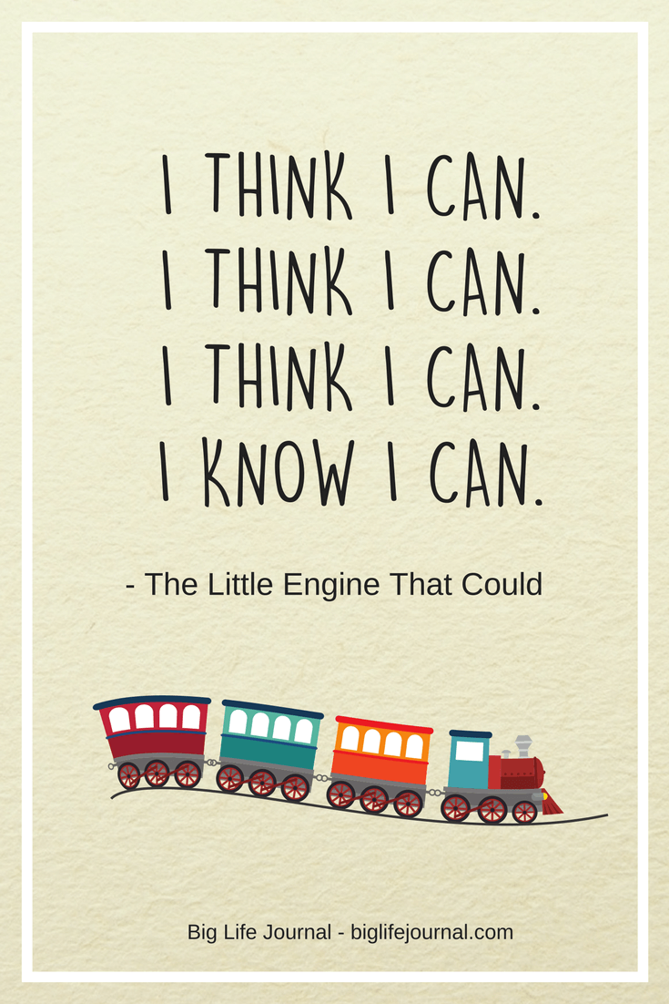
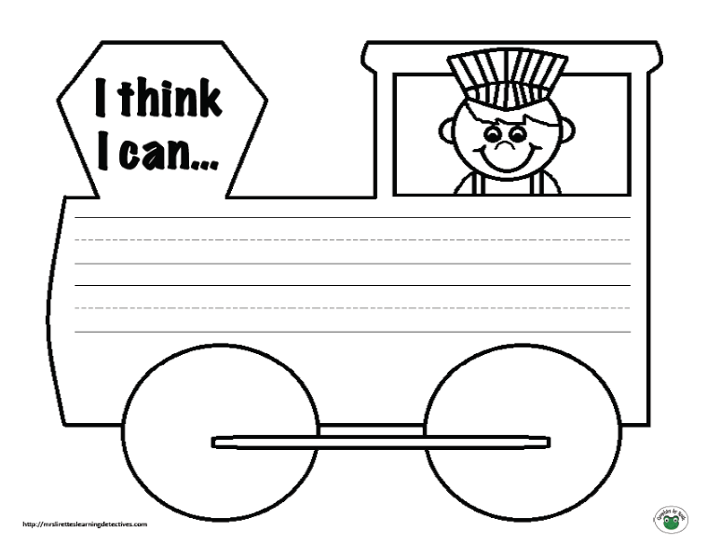
Activities to try at home!
Listen to the story ‘The Little Engine That Could’.
https://www.youtube.com/watch?v=5TPUwrURo6M
Can you create your own ‘I think I can…’ little engine? Draw a picture of your train and then write something that you may find tricky at the moment but, with a bit of resilience, you’ll be able to get better and better at.

Slide 7
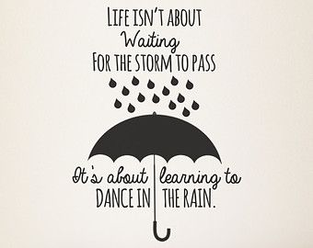
Thought of the Day
Take some time to be still and reflect on the thought of the day. What does it mean to you?

Slide 8
Let’s pray…
Dear God,
Please keep our family and friends safe during this time.
Please keep us happy instead of feeling sad.
Thank you for keeping us safe.
Thank you for taking our worries away from us.
Sorry for all of the people that have not been following the Coronavirus rules.
Sorry if we are cutting too many trees down.
Amen.
Thank you for the lovely prayer Olivia! (Syc)

