Slide 1
Key Stage 1
PSHE
Keeping safe- physical health and exercise

Slide 2
LO: To understand how exercise can keep my body and mind healthy
TTYP- What are some of the different ways that you like to exercise and be active?
Did any of you do some exercises with your families whilst you have been at home?

Slide 3
How does our body and mind feel before and after exercise?
As well as being lots of fun, exercise is really important for your amazing body
Discuss with your partner how your body and mind feels now you have been sitting down for a while.
Children to feel their heart beat- this is how our heart feels before we do exercise

Slide 4
Let’s do some exercises together
Joe Wicks 5 minute workout https://www.youtube.com/watch?v=u0_1QBQ8Syk

Slide 5
How do you feel after doing our exercises?
Children to now feel their heart rate after doing their exercises
Now TTYP about how your body and mind feels now we have done a little bit of exercise
Sometimes when we feel sad, doing some exercise helps us feel a little bit better
When you’re at home and you feel sad or scared, you can do some exercises to make you feel a little bit better

Slide 6
How does exercise help our body and brain?
Brain
Exercise helps your brain to concentrate so that you can learn better.
Makes us feel happier
Improves our sleep
Body
It helps us with our weight
Keeps our bones and muscles strong
Helps with our movement and co-ordination
Helps us to have more energy

Slide 7
How much exercise should we do each day?
Being active every day is really important.
You should try to be active for 60 minutes (or one hour) each day.
Remember: This doesn’t have to be all in one go.
It doesn’t matter how you choose to exercise, what is important is that you have fun while exercising!

Slide 8
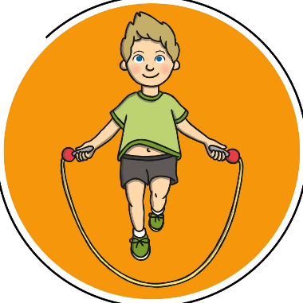

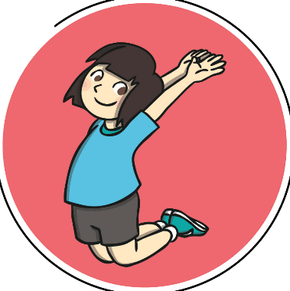
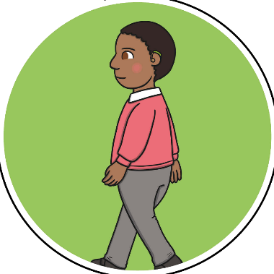
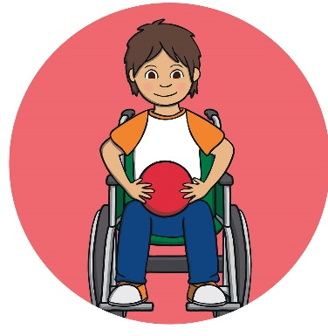
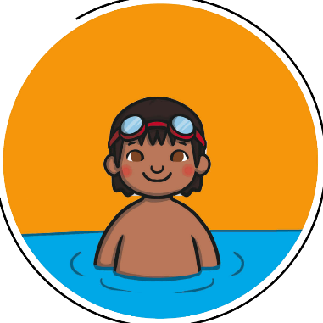
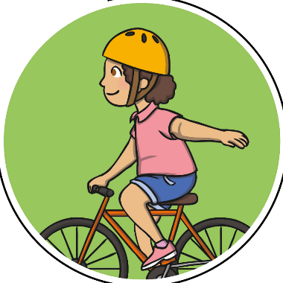
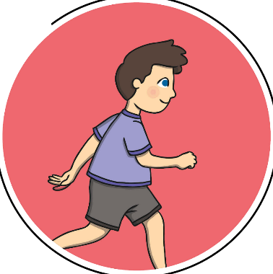
What exercises can I do?
TTYP and discuss some exercises you can do
Skipping
Dancing
Jumping
Walking
Playing with a ball
Riding a bike
Swimming
Running

Slide 9
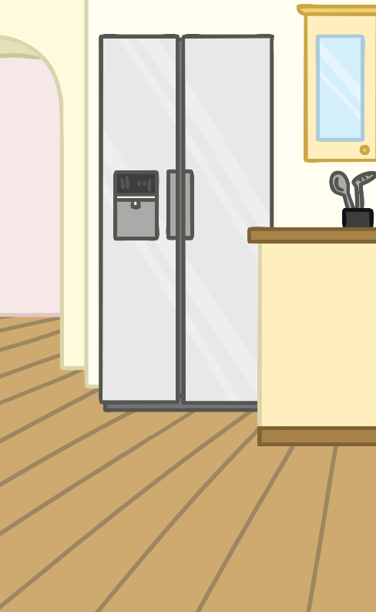
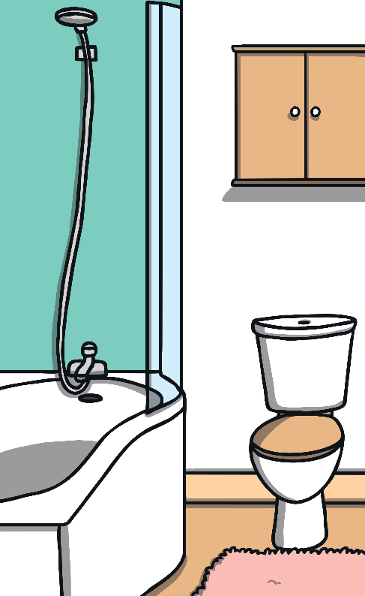
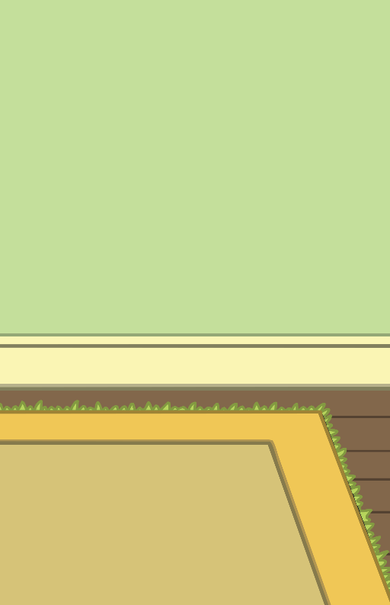

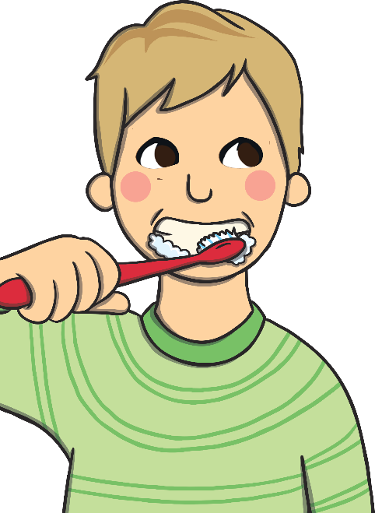
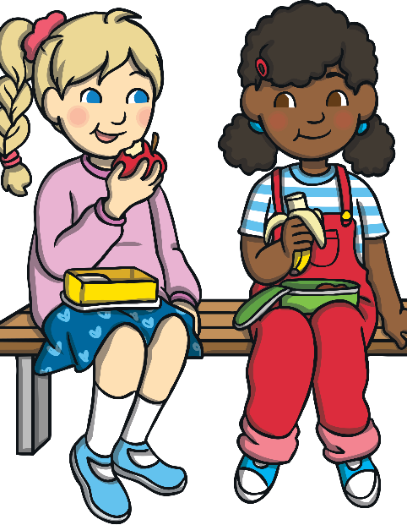
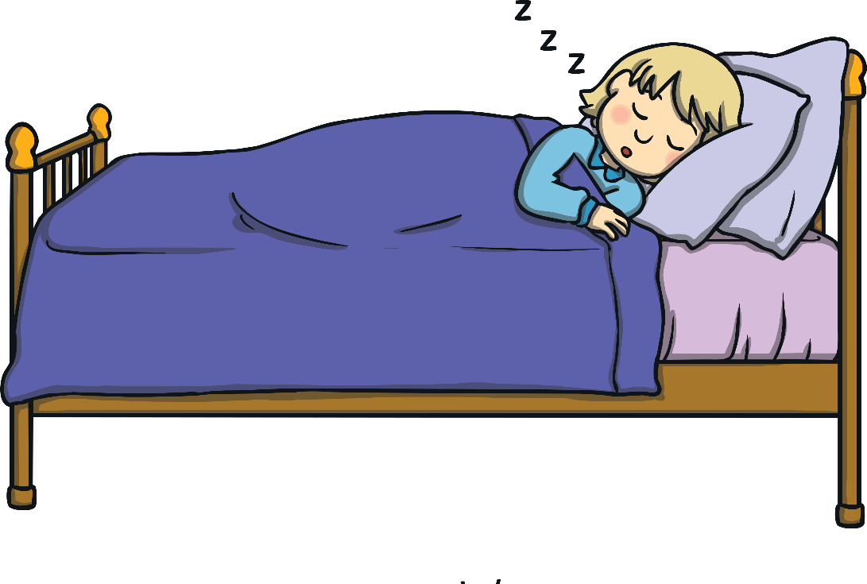
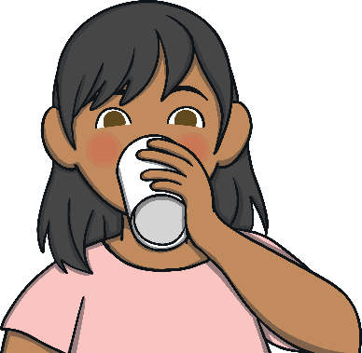
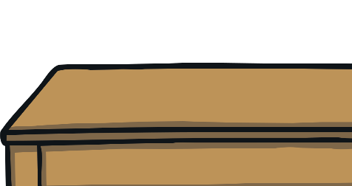
Other things we can do keep our body and mind stay healthy
Eat a
balanced diet.
Drink plenty
of water.
Keep your body and teeth clean.
Get plenty
of sleep.

Slide 10
Let’s finish with some supermovers!
Supermovers- Believe- https://www.bbc.co.uk/teach/supermovers/ks1-pshe-believe-with-naomi-wilkinson/zjchd6f
https://www.bbc.co.uk/teach/supermovers/just-for-fun-alex-scott-l1/zj4pwty

