Slide 1
Lower key stage 2
PSHE
Keeping safe- physical health and exercise

Slide 2
LO: To understand how exercise can help my physical health and mental wellbeing
Physical activity at home
TTYP and discuss the things you have been doing at home to keep yourself physically active

Slide 3
Experiencing exercise
Children to feel their heartrate before exercise
Joe Wicks 5 minute workout
https://www.youtube.com/watch?v=d3LPrhI0v-w
Children to feel their heartrate after exercise
When we exercise, we change how our bodies work and how they feel.
Although it can be hard work, exercise makes us feel good.

Slide 4
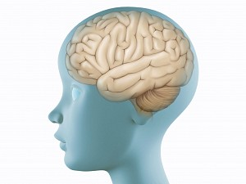
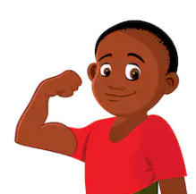
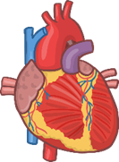
Head, Heart and Muscles
To keep healthy, we need to do lots of healthy things every day.
This will help your heart, your muscles and your mind.
Your body will be stronger and your mind will be happier.
Some of the healthy things we do are good for our bodies, and some of them are good for our minds, but they all work together to keep our minds and bodies healthy and happy.

Slide 5
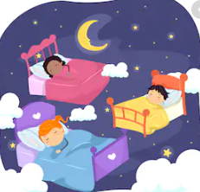
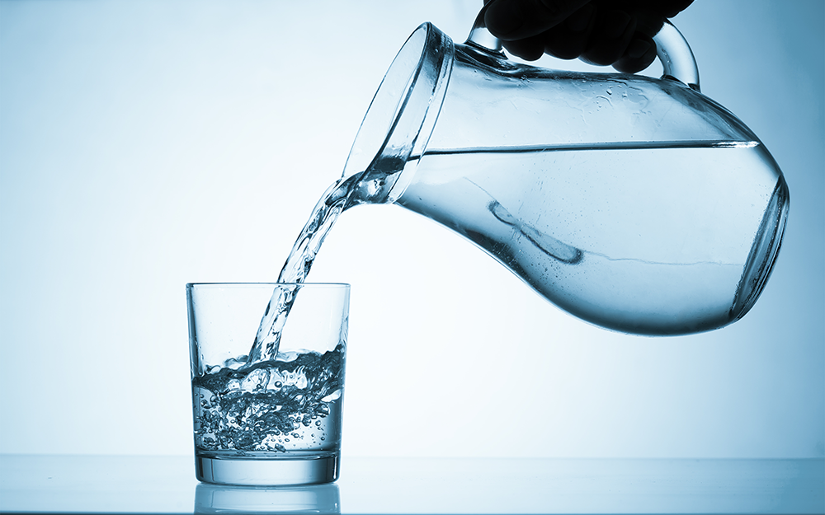
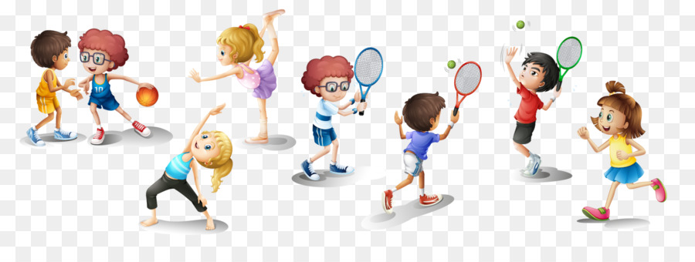
What can I do to have a healthy mind?
Sleep so your mind works properly.
Drink water to keep hydrated
Consume energy (food) to keep your brain
cells buzzing.
Spend time with friends and do things that
make you enjoy yourself and feel good.
Spend time being active outdoors - being outside is great for our mental wellbeing'.
Activities such as yoga and mindfulness can help you cope with feelings of anger and stress.
Limit the amount of screen time each day and each week.
If you are feeling angry or stressed, talking
to an adult you trust and asking for help is important.

Slide 6
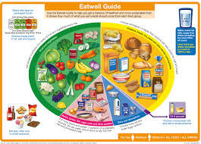
What can I do to have a healthy heart?
Exercise to keep the heart muscles strong.
Relax to allow the heart to rest.
Eat a balanced diet to get all of the vitamins and minerals you need – try to eat a whole rainbow of food each day.
Eat sensible portions of food to keep a
healthy weight.
Your heart does not like stress or saturated fat
(like you find in junk food), as this reduces
the blood flow to the heart.

Slide 7
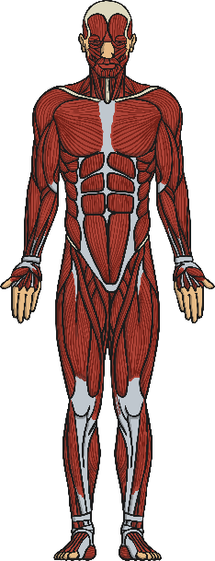
What can I do to have healthy muscles?
Exercise to keep your muscles healthy and strong.
Do a variety of exercises to use all of your different muscles.
Eat protein, like cheese, beans and eggs to build new muscles.
Stretch to make sure that your muscles don’t get too tight.
Drink water to keep your muscles hydrated.
Your muscles do not like you sitting down too much.

Slide 8
What can I do if I am worried about my physical or mental wellbeing?
If you are worried about your physical or mental wellbeing, talking to an adult you trust is a great place to start and an important first step.
They can listen to your worries and help you take steps to make the situation better.
In school, talk to someone who knows you well and who can help you, such as a teacher, a teaching assistant or your headteacher. Remember, you are not alone and there are people who can help.

Slide 9
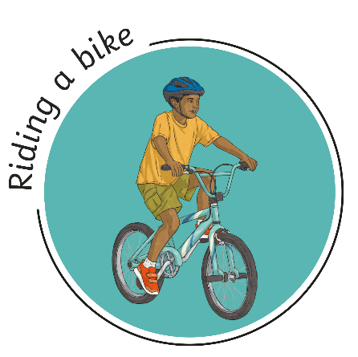
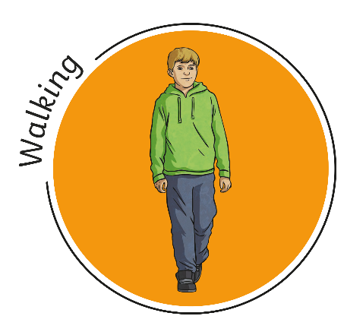
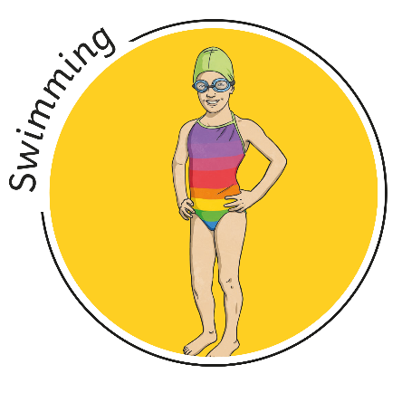
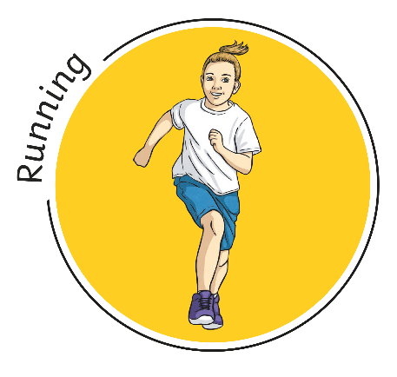
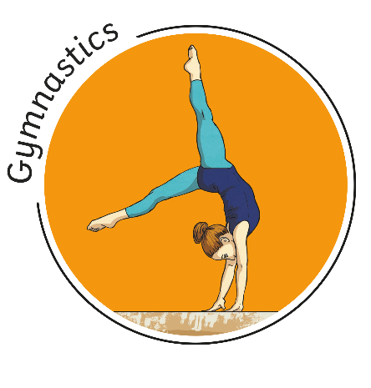
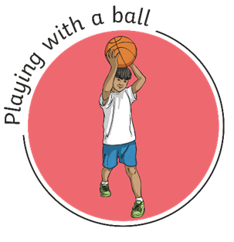
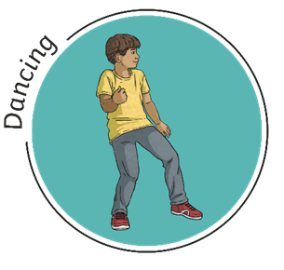
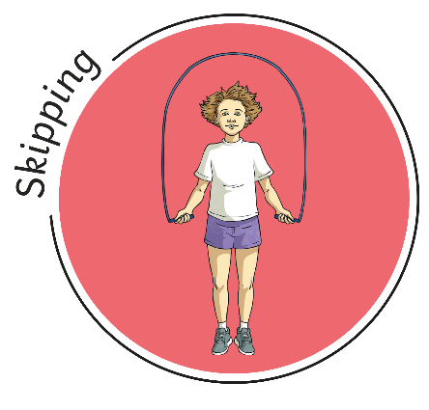
What activities can I do to keep active?

Slide 10
Task
In partners, design a poster which advertises the benefits of exercise
Think about the following points whilst preparing your poster:
Why is exercise important?
How does your body respond when we exercise?
How does exercise help our mind, heart and muscles?
What are the different types of exercise?
Where do people go to exercise?

