Slide 1

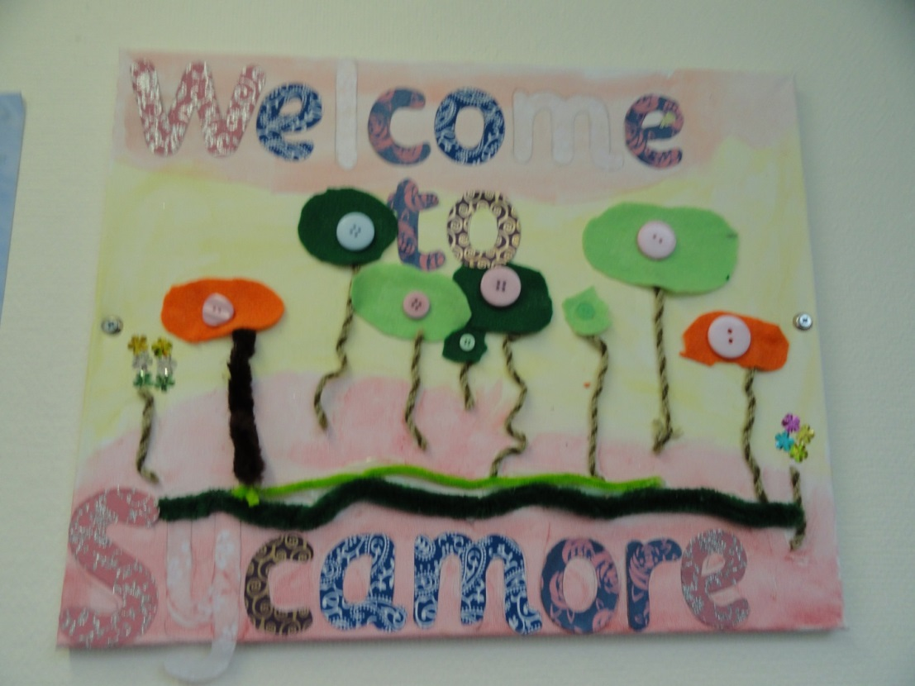
Moving to Sycamore Base

Slide 2
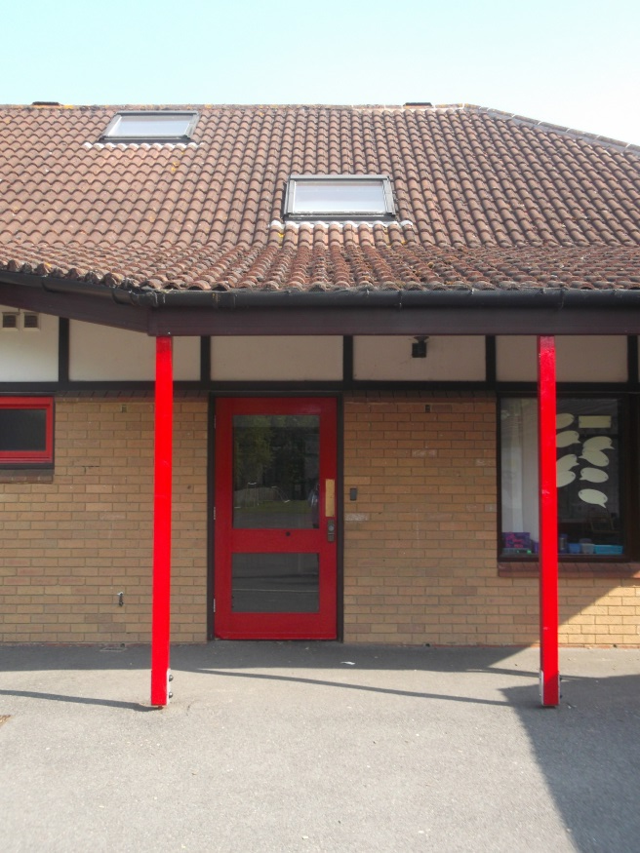
After the Summer holidays you will be in Sycamore base, your Oak base friends will be too.
This is the door you will come in.

Slide 3
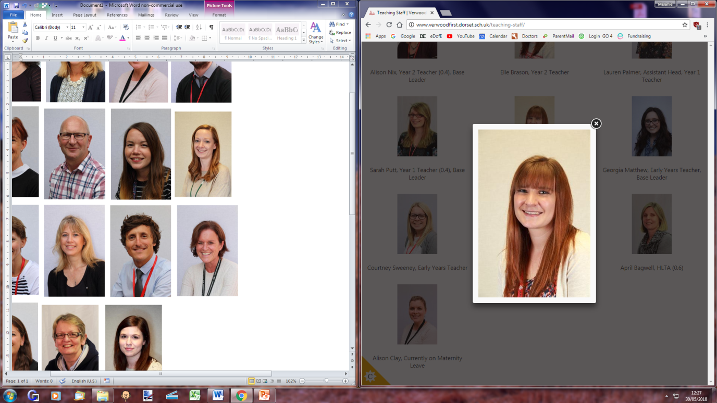
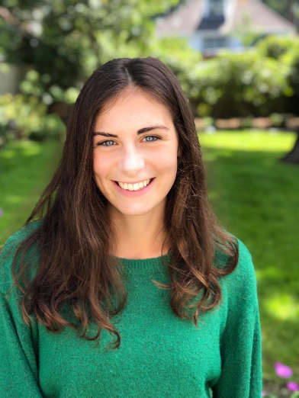
The teachers in Sycamore base are
Miss North
and
Miss Burrows
They will help you with your learning.

Slide 4
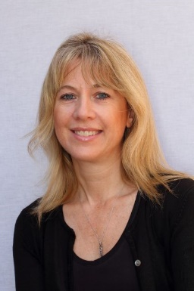
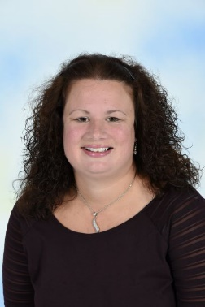
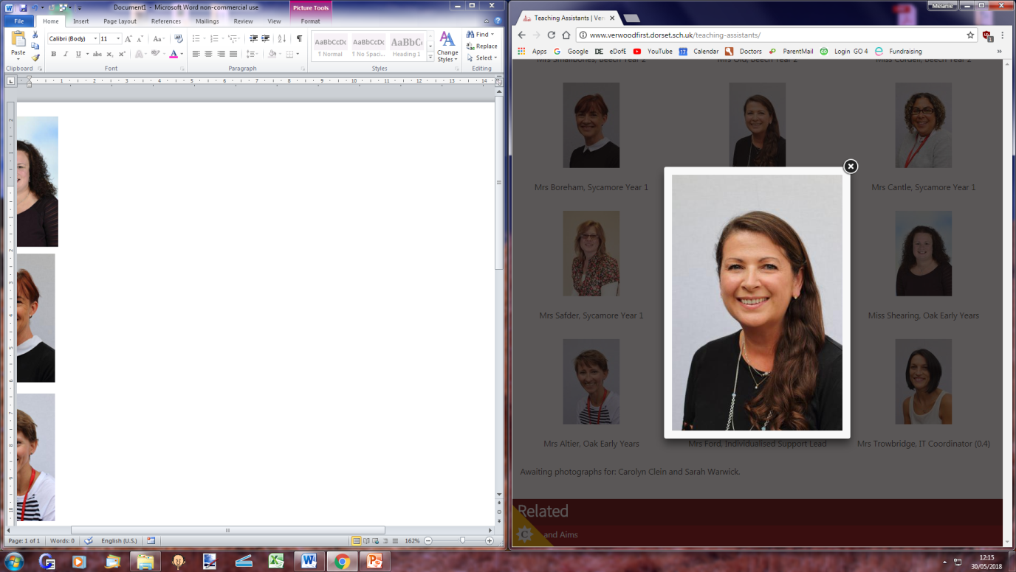
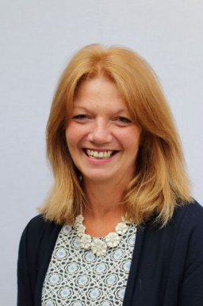
The Teaching Assistants in Sycamore base are
Mrs Old
HLTA
Miss Mrs Boyle Mrs
Shearing Smallbones
They will help you with your learning.

Slide 5
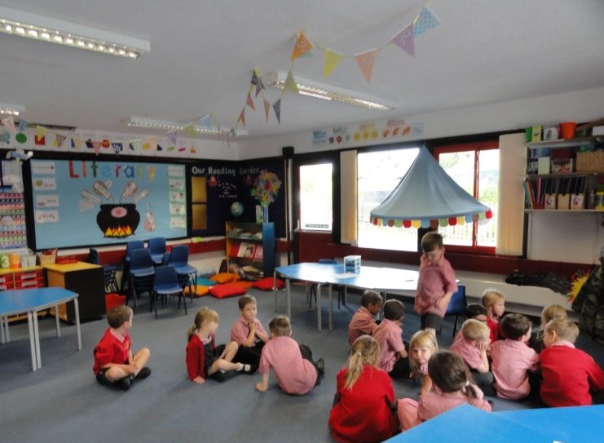
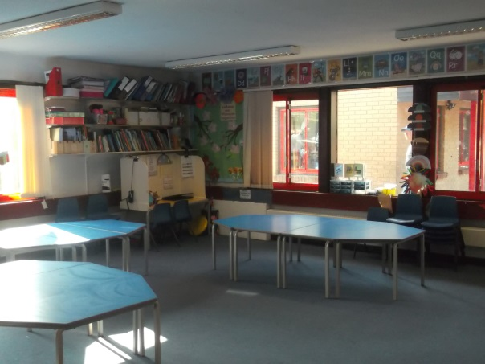
The Sycamore base Classrooms look like this.

Slide 6
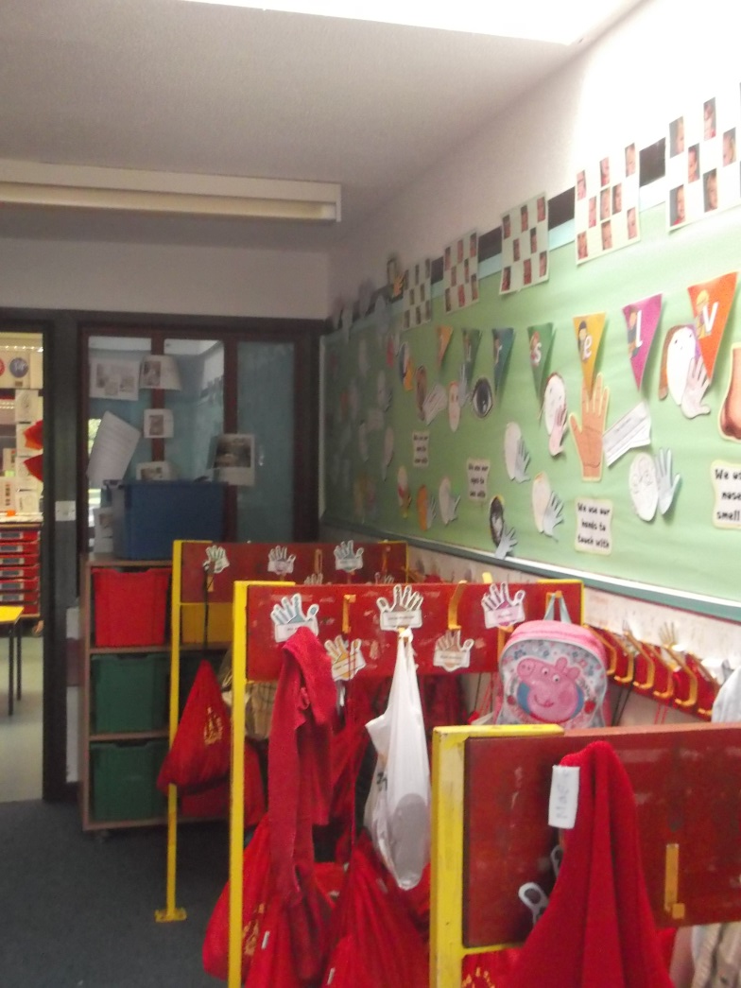
You will have a peg with your name on just like in Oak Base

Slide 7
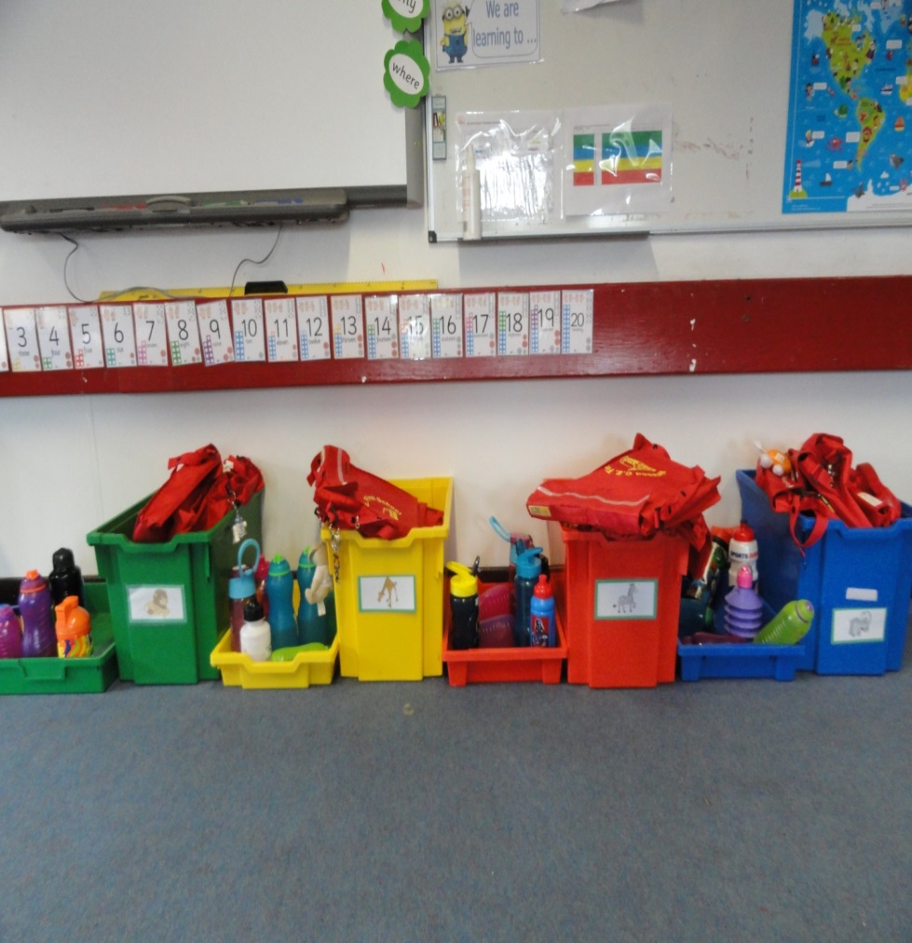
You will put your bag away in your group box in the classroom.

Slide 8
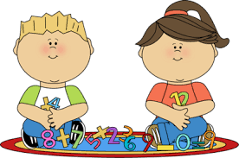
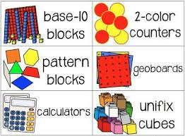


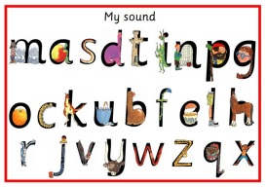
You will have lots of fun new learning to do in Sycamore base.
Numeracy
Literacy
Phonics

Slide 9


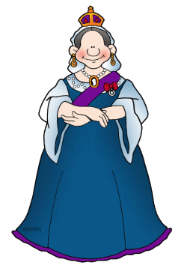


Art
Geography
History
Science
Music

Slide 10
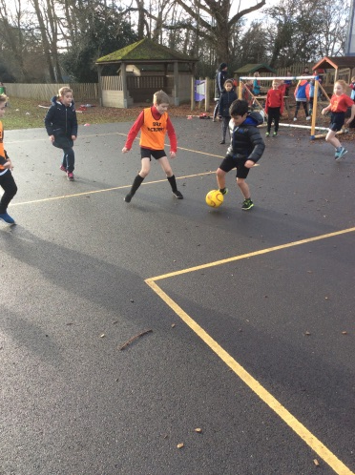
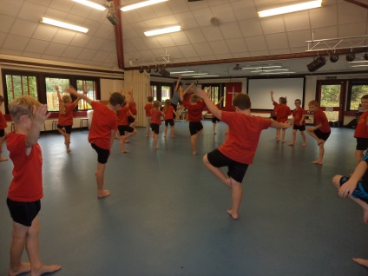
You will get to do P.E. twice a week, sometimes outside and sometimes inside.

Slide 11
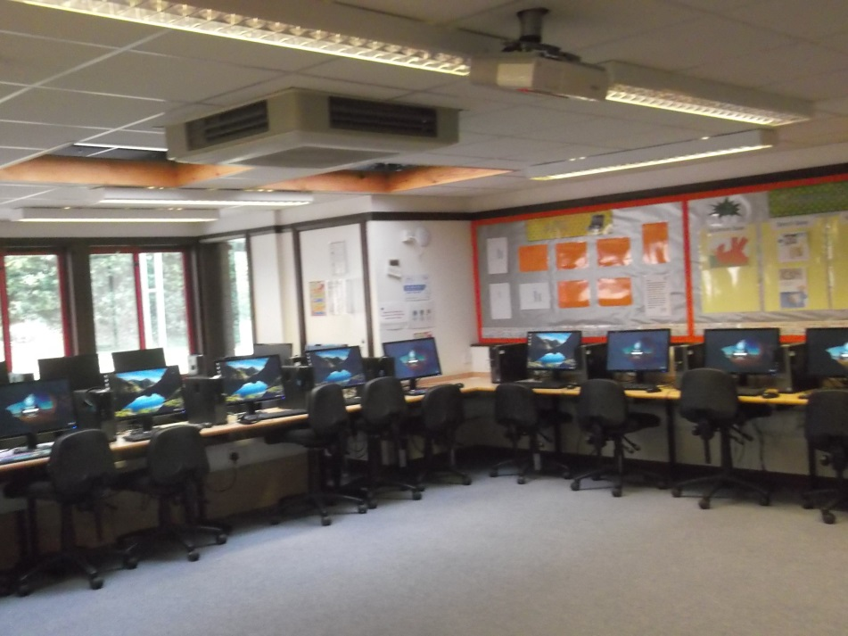

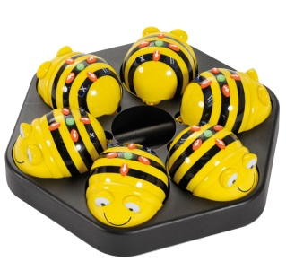
Sycamore Base children get to use the ICT Suite for learning every week.

Slide 12
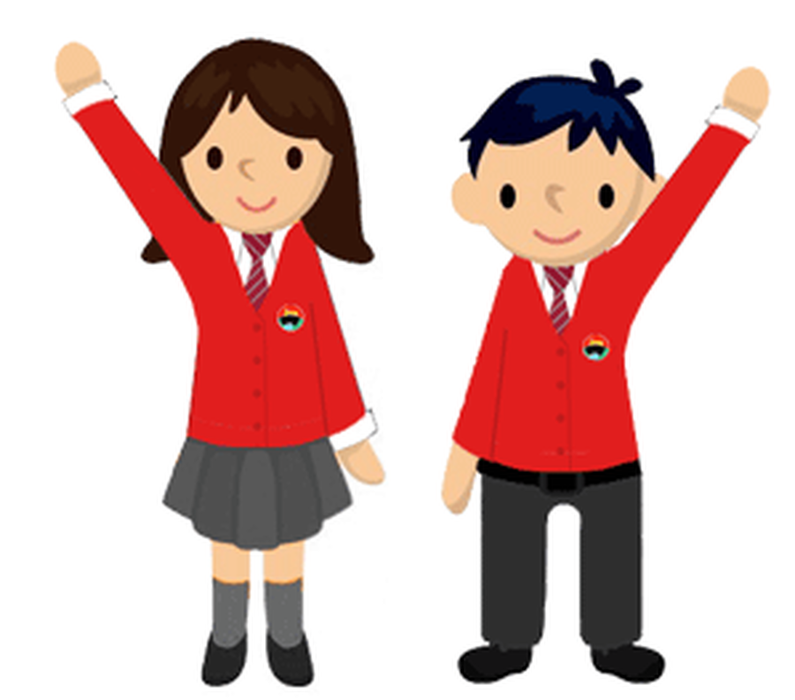
You and your friends will have lots of fun in Sycamore base.

