Slide 1

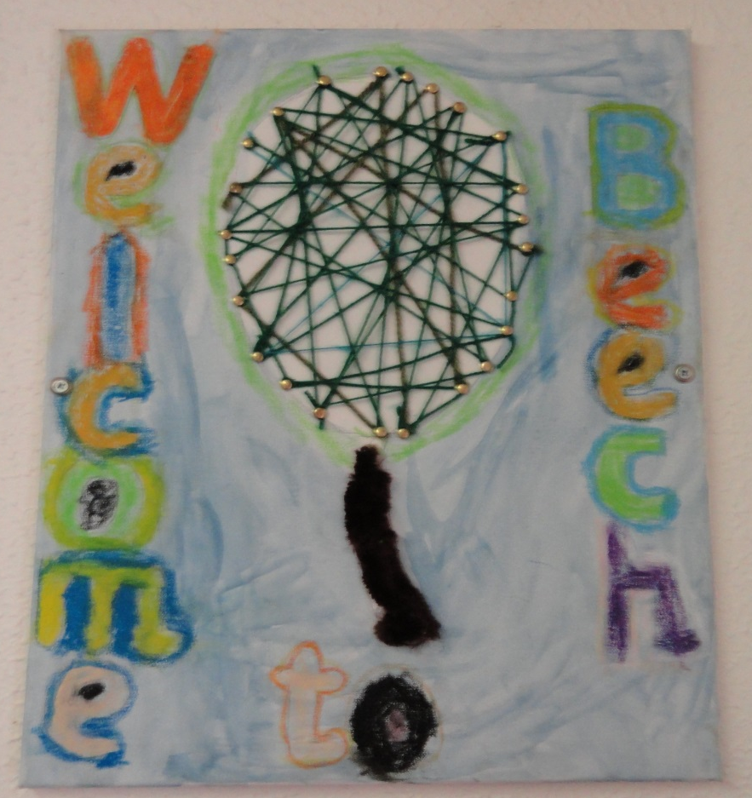
Moving to Beech Base

Slide 2
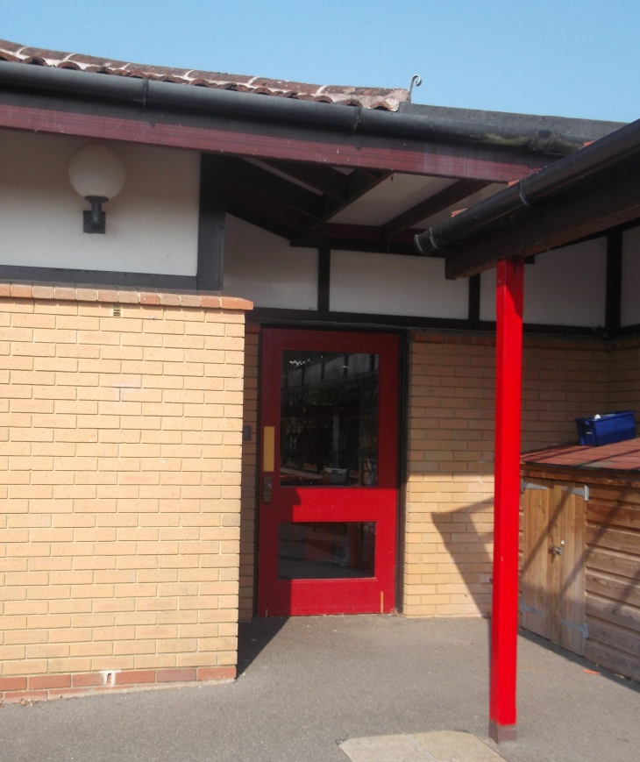
After the Summer holidays you will be in Beech base, your Sycamore base friends will be too.
This is the door you will come in.

Slide 3
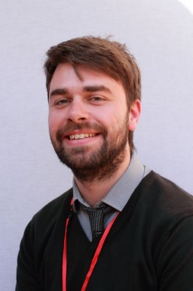
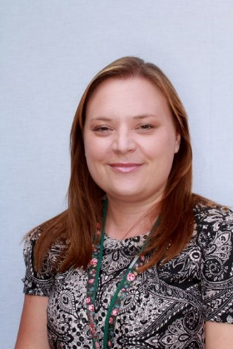
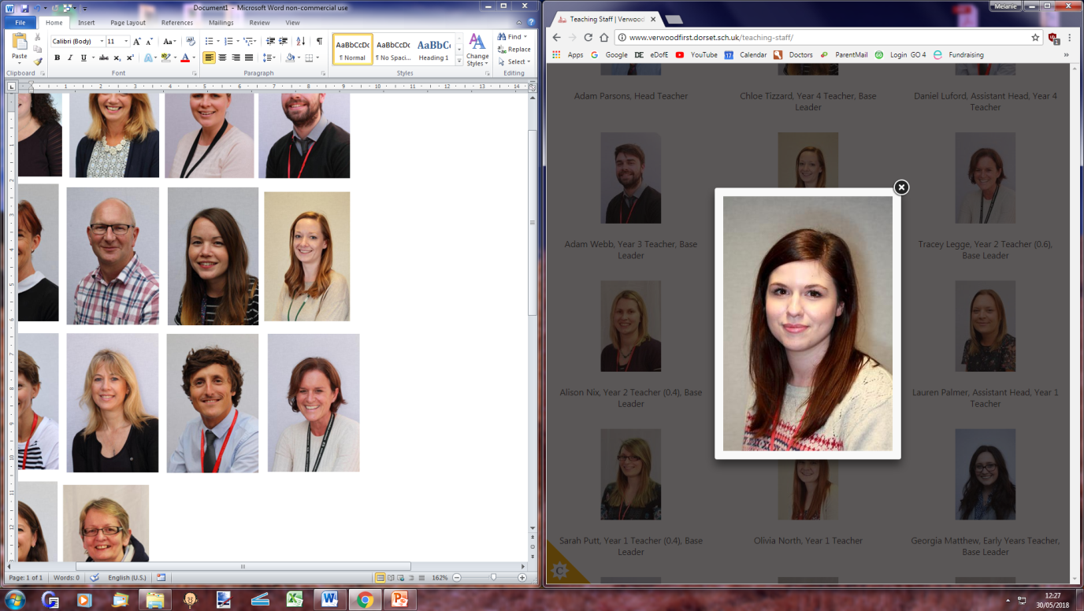
The teachers in Beech base are
Mr Webb
Mrs Palmer and Mrs Brason
They will help you with your learning.

Slide 4
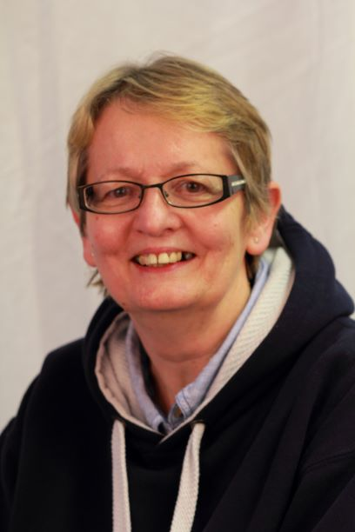
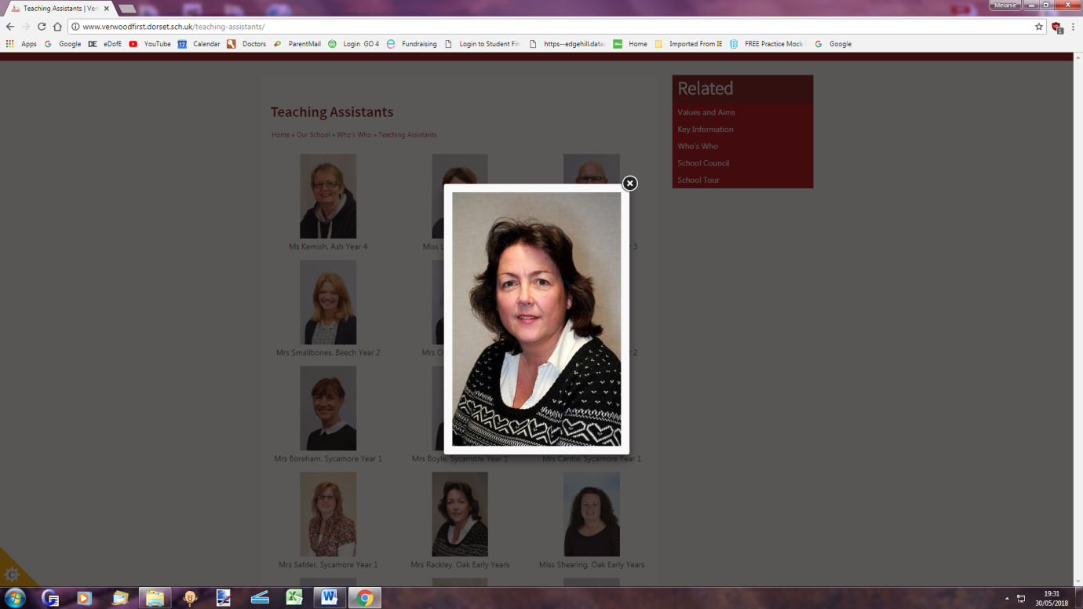
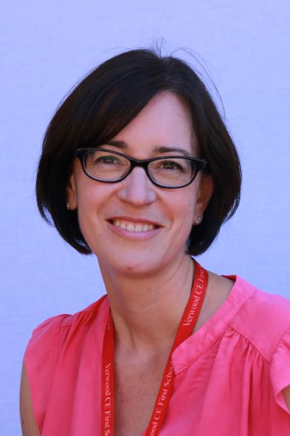
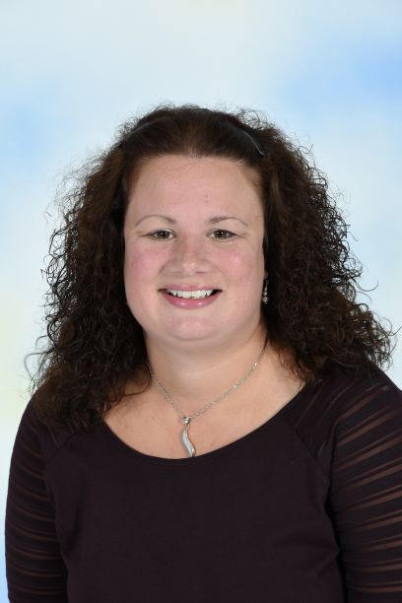
The Teaching Assistants in Beech base are
Ms Kemish Mrs Rackley
Mrs Clein and Miss
Shearing
They will help you with your learning.

Slide 5
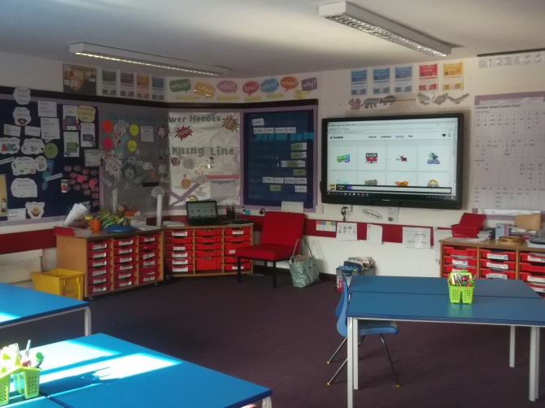
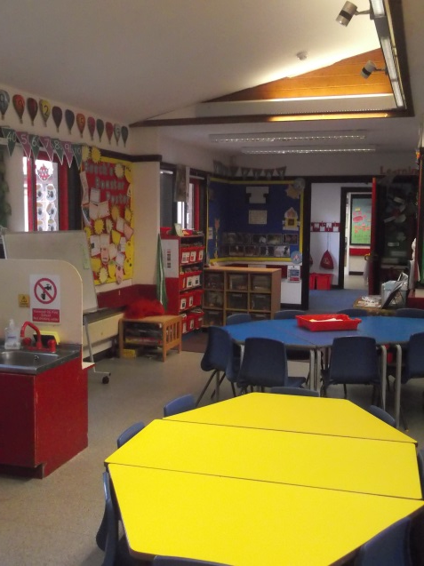
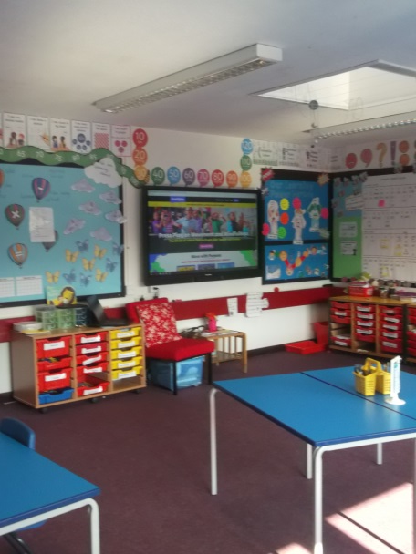
The Beech base Classrooms look like this.

Slide 6
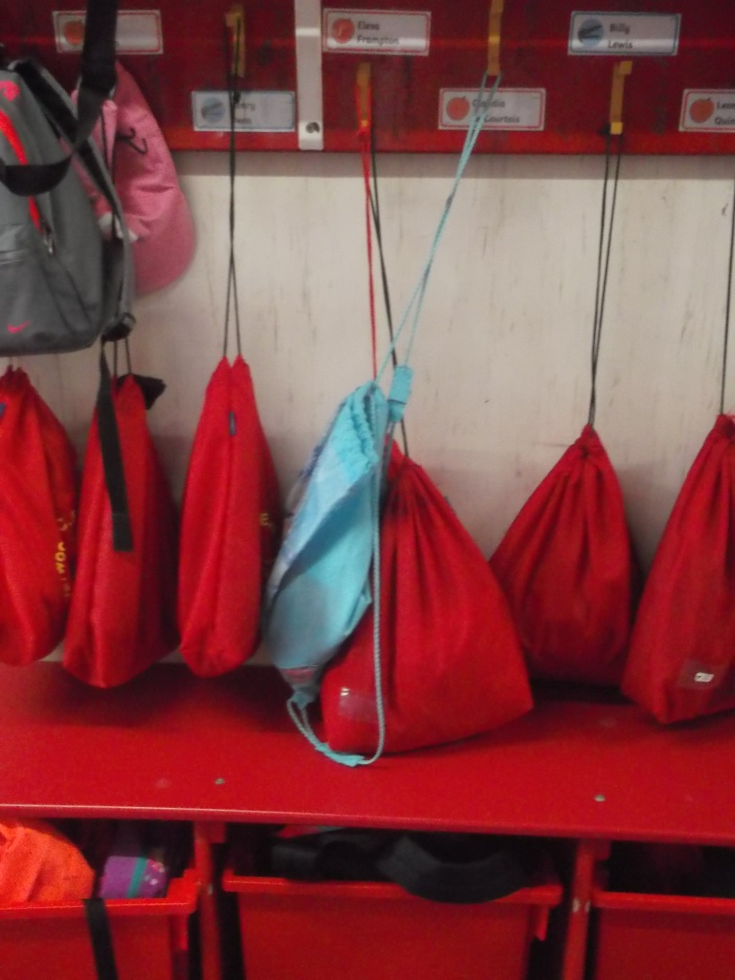
You will have a peg with your name on just like in Sycamore base

Slide 7
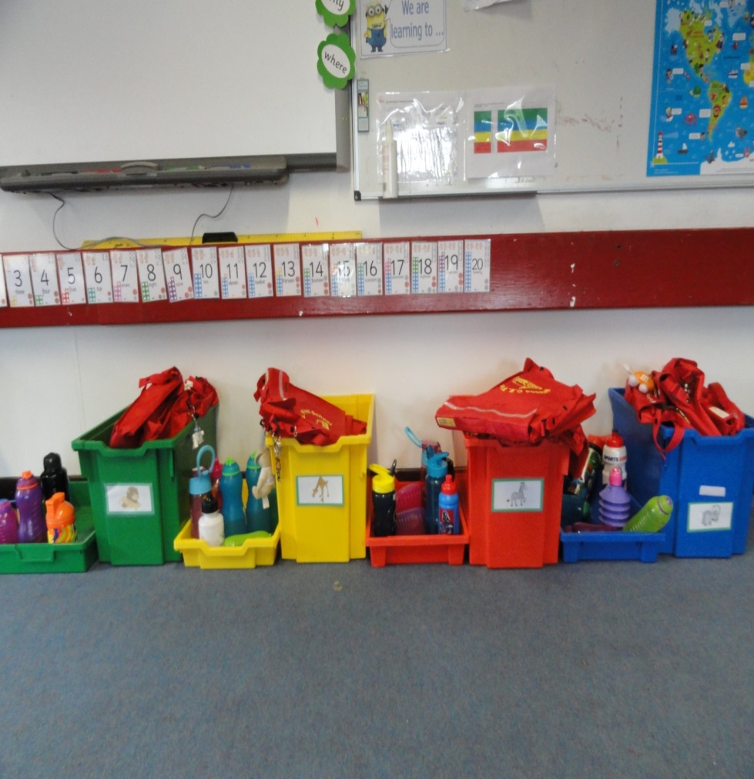
You will put your bag away in your group box in the classroom.

Slide 8
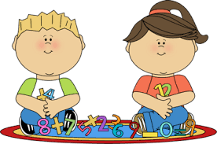
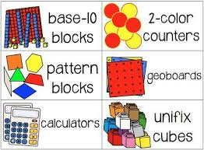


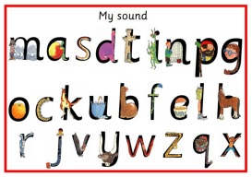
You will have lots of fun new learning to do in Beech base.
Numeracy
Literacy
Phonics

Slide 9


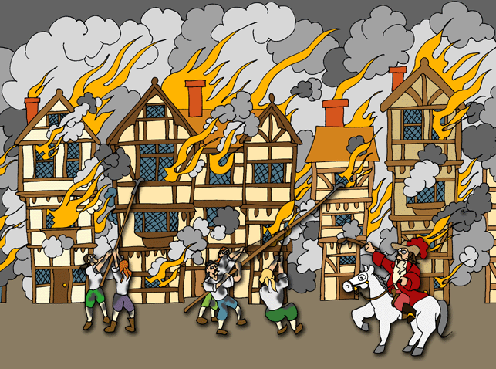



Art
Geography
History
Science
Music

Slide 10
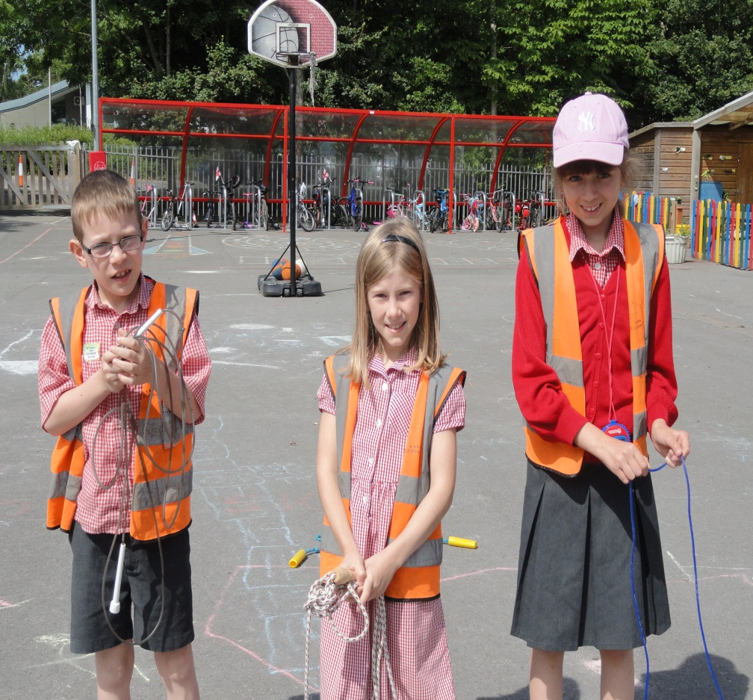
Beech Base children get to be Playtime Role Models

Slide 11

You and your friends will have lots of fun in Beech base.

