Slide 1

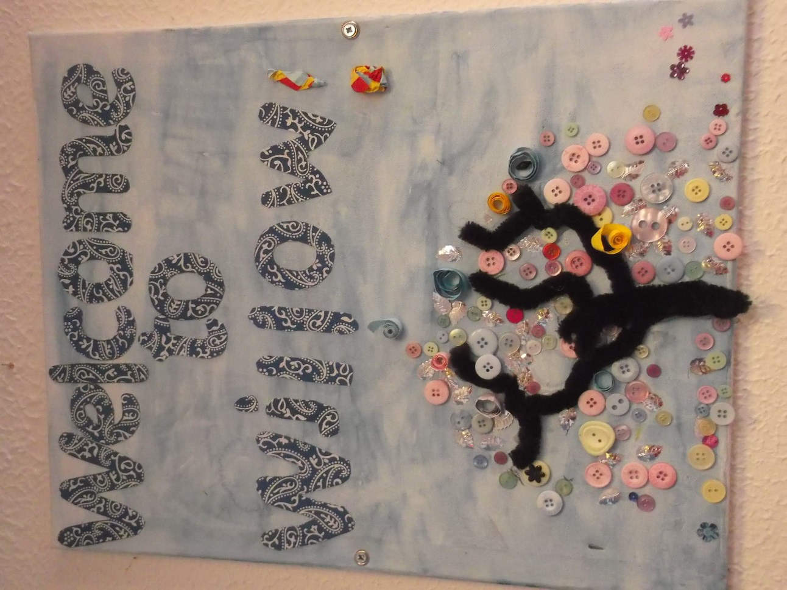
Moving to Willow Base

Slide 2
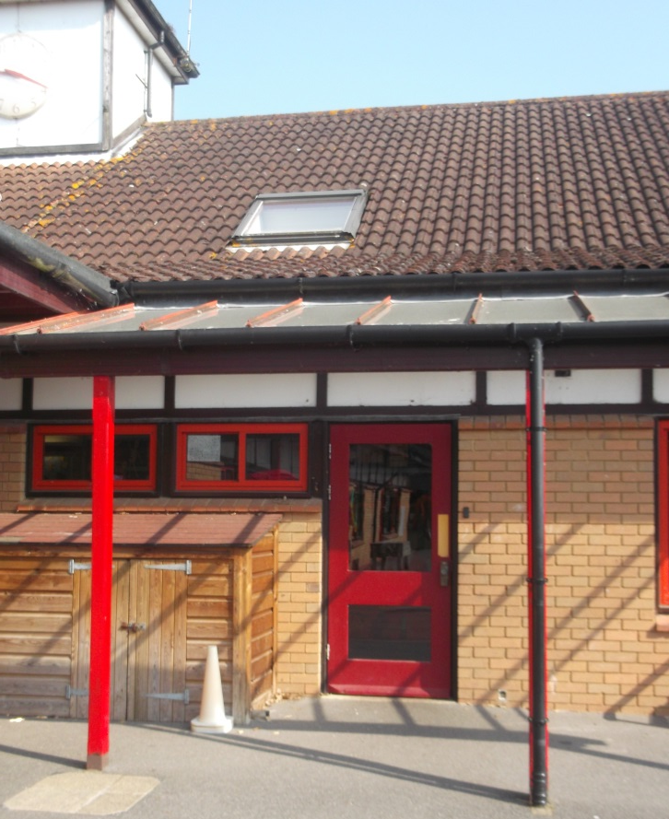
After the Summer holidays you will be in Willow base, your Beech base friends will be too.
This is the door you will come in.

Slide 3
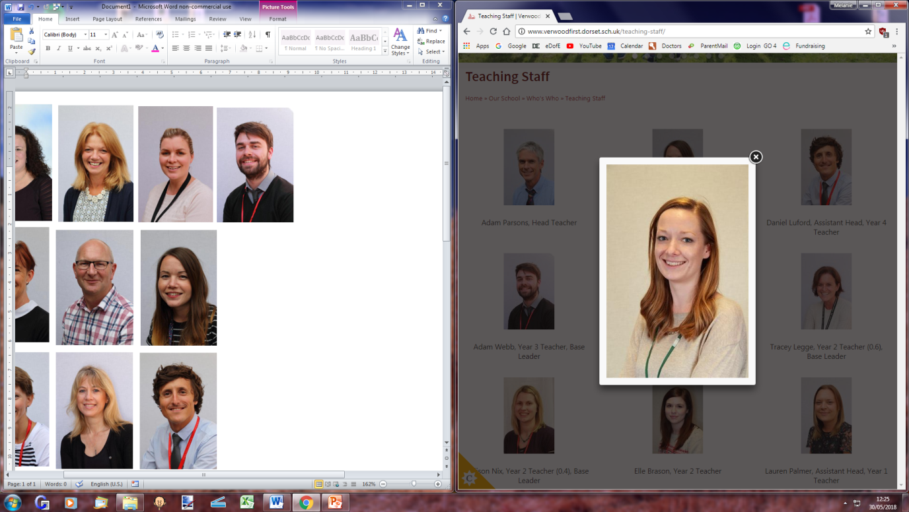
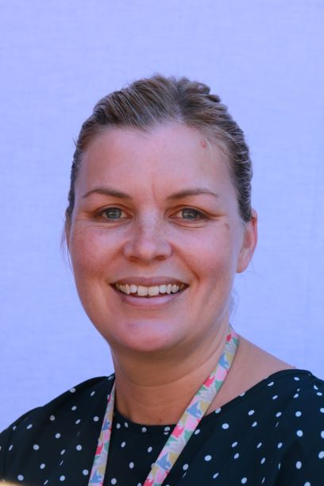
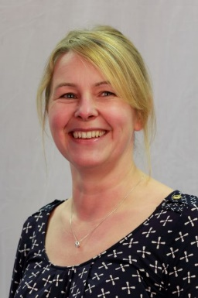
The teachers in Willow base are
Miss Snow
Mrs Clay and Mrs Palmer
They will help you with your learning.

Slide 4
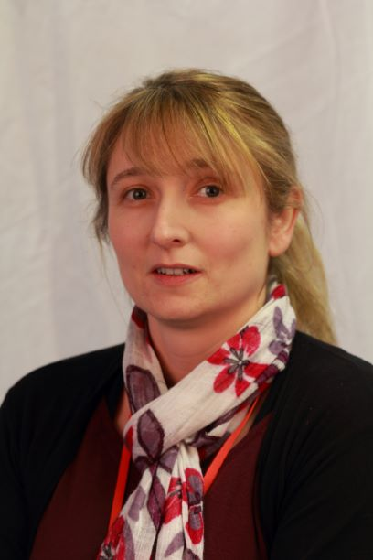
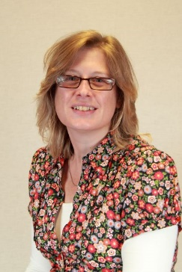
The Teaching Assistants in Willow base are
Mrs Ford and Mrs Safder
They will help you with your learning.

Slide 5
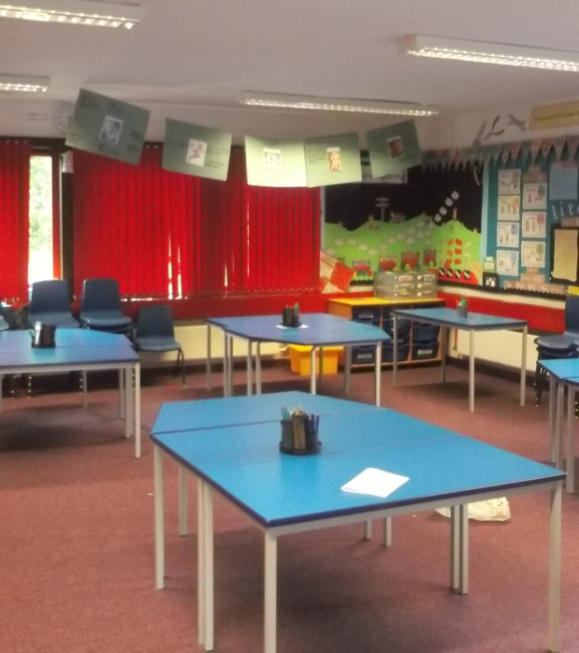
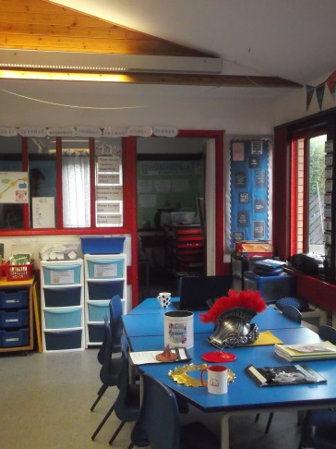
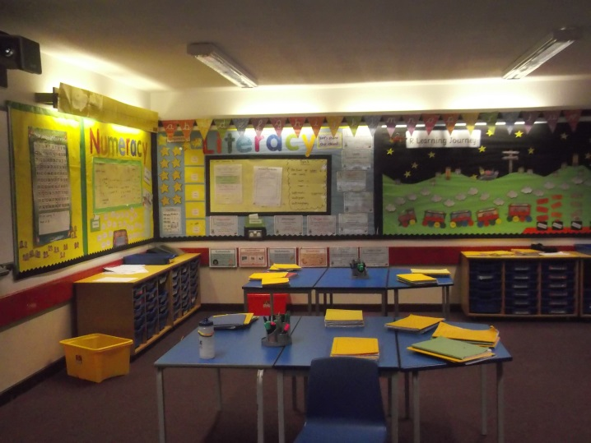
The Willow base Classrooms look like this.

Slide 6
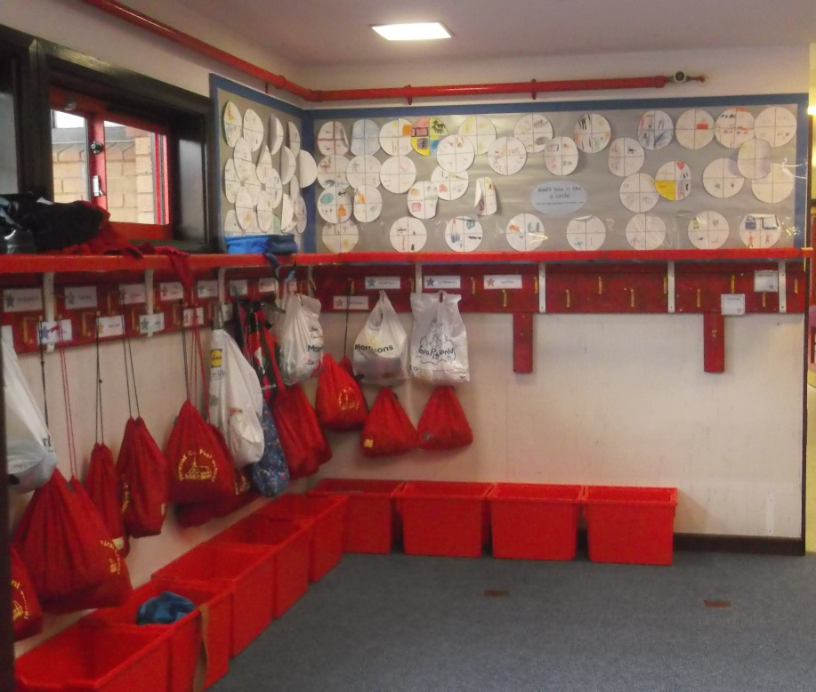
You will have a peg with your name on just like in Beech base.

Slide 7
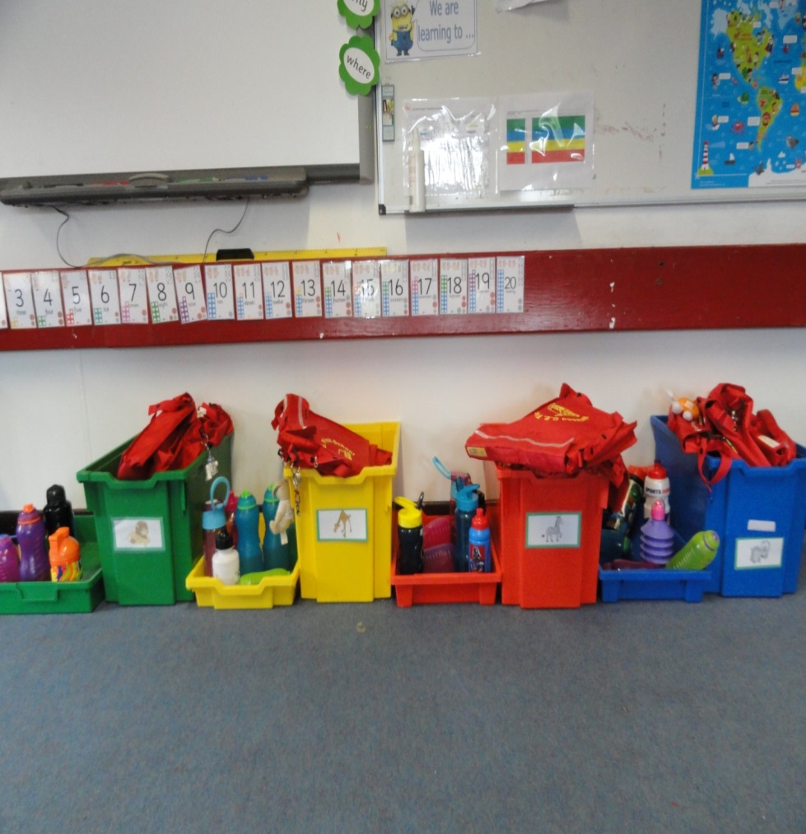
You will put your bag away in your group box in the classroom.

Slide 8



You will have lots of fun new learning to do in Willow base.
Numeracy
Literacy
Guided Reading

Slide 9




Art
Geography
History
Science

Slide 10



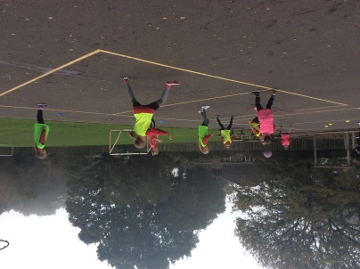
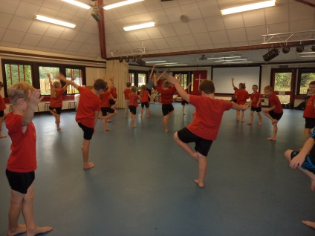
French
99 Club
P.E

Slide 11
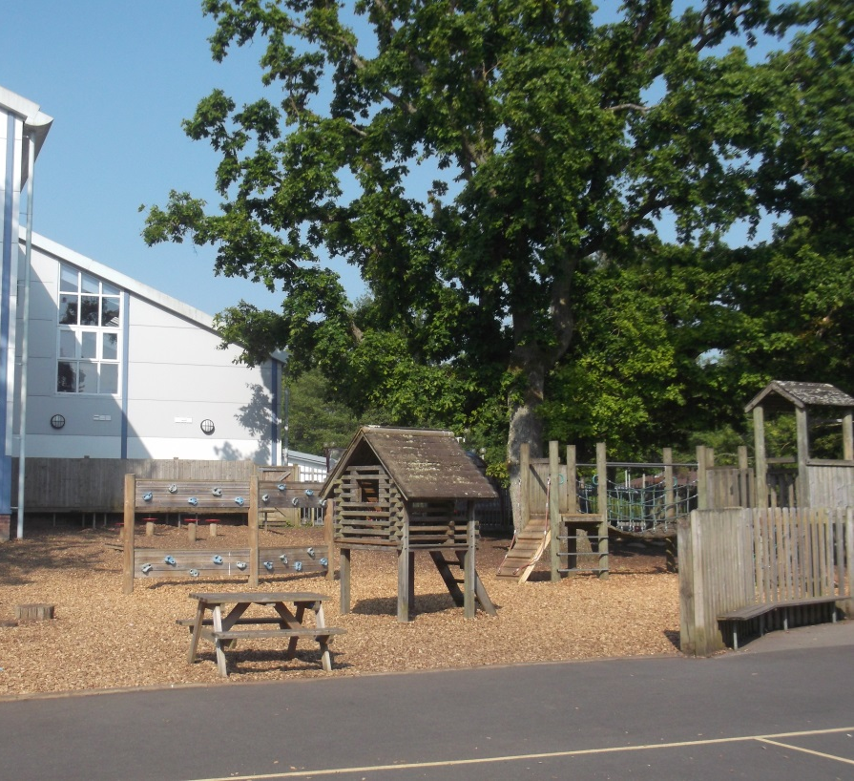
You will have morning play a little bit later at 10:40. You get to play on all of the adventure playground.

Slide 12

You and your friends will have lots of fun in Willow base.

