Slide 1

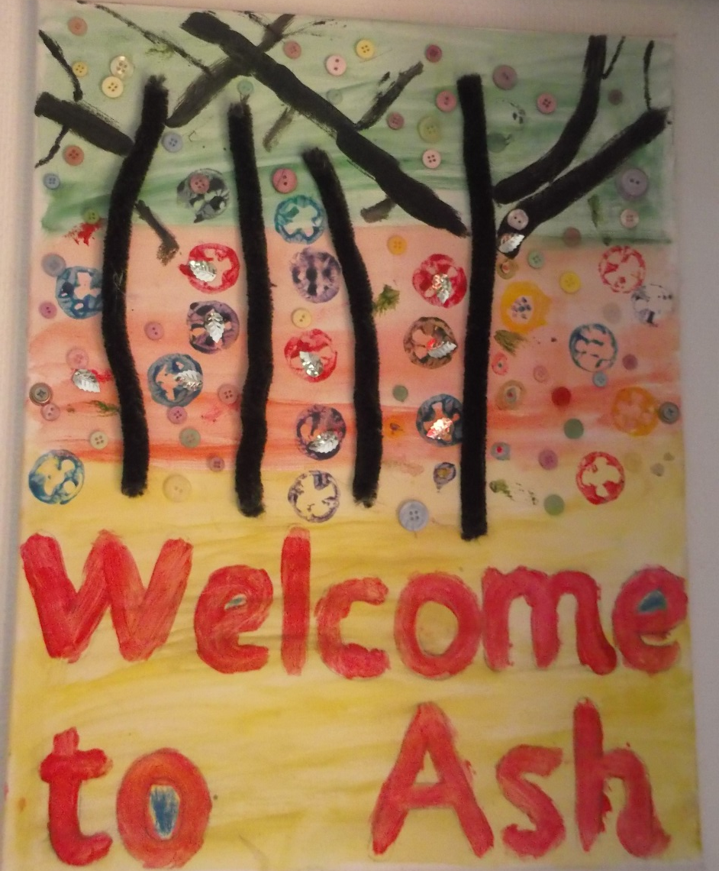
Moving to Ash Base

Slide 2
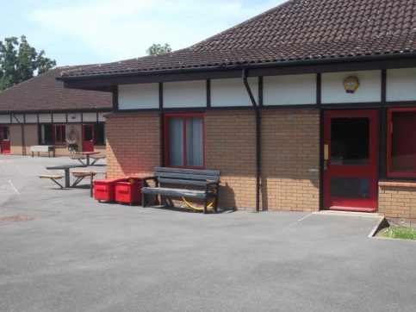
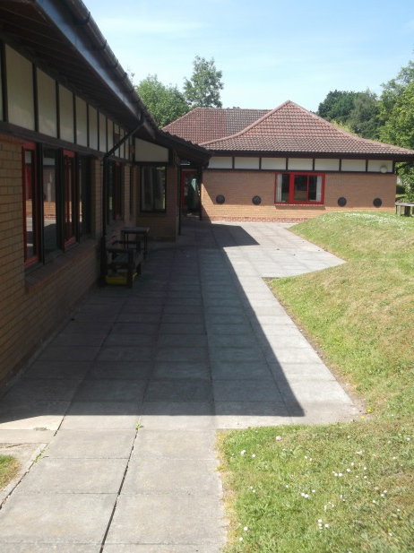
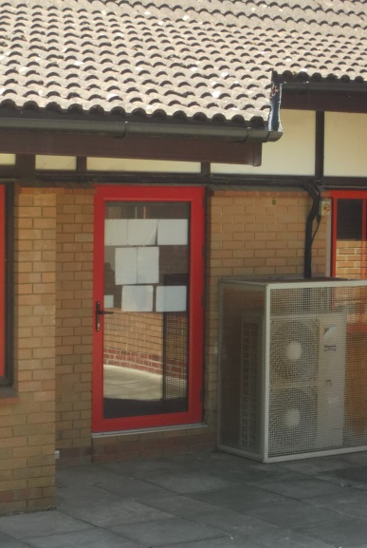
After the Summer holidays you will be in Ash base, your Willow base friends will be too.
You will go around behind Willow base and in the Ash base door.

Slide 3
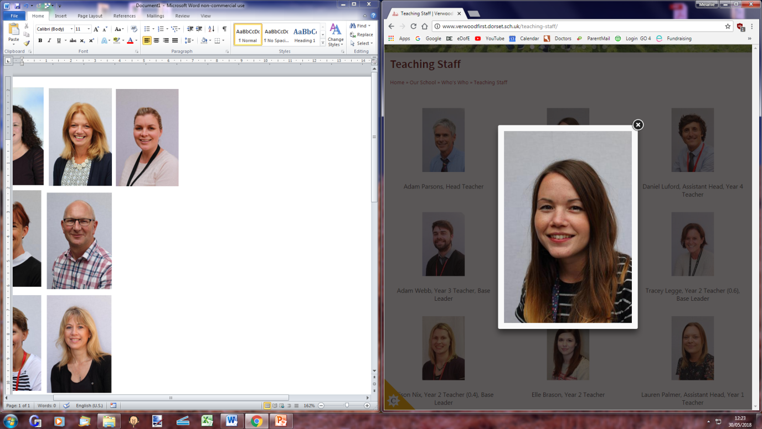
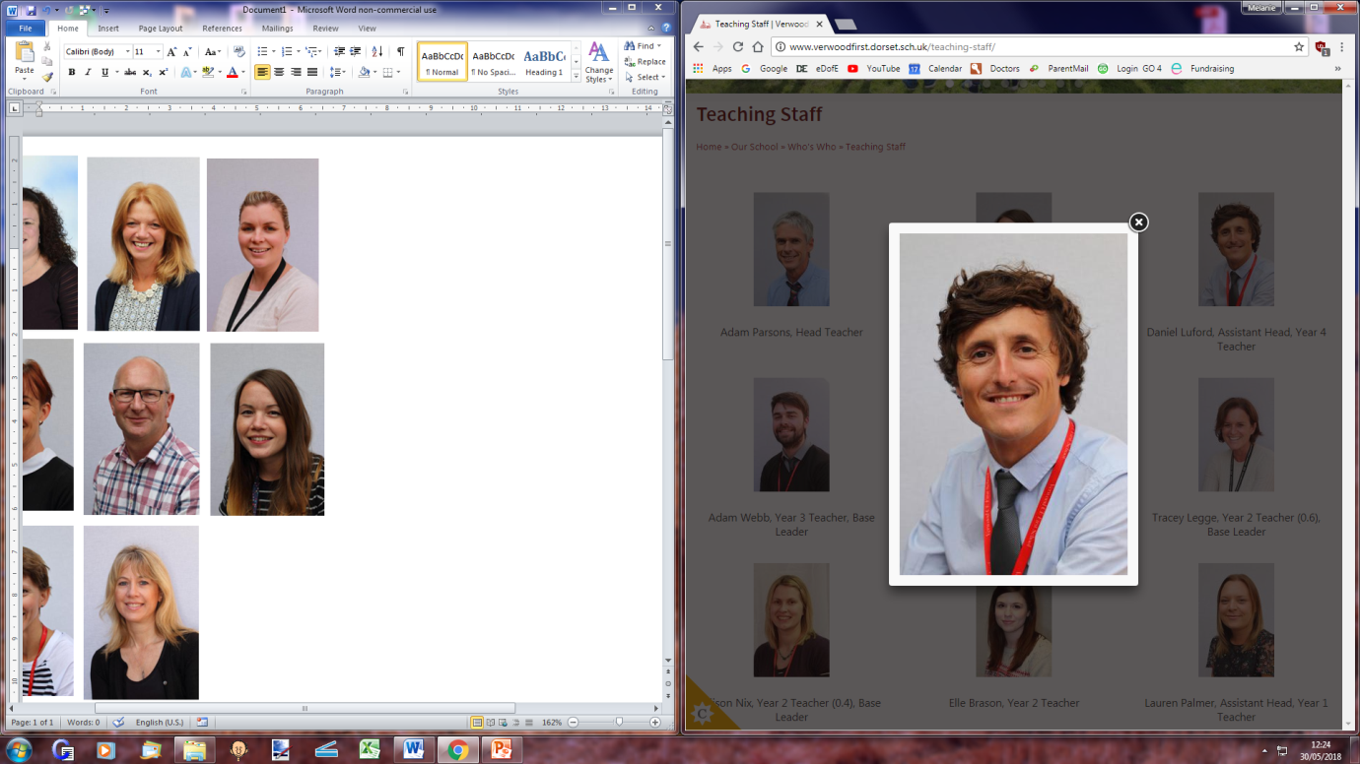
The teachers in Ash base are
Miss Tizzard
and Mr Luford
They will help you with your learning.

Slide 4
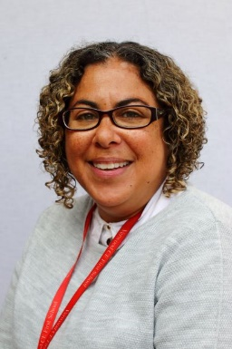
The Teaching Assistant in Ash base is Mrs Cantle
She will help you with your learning.

Slide 5
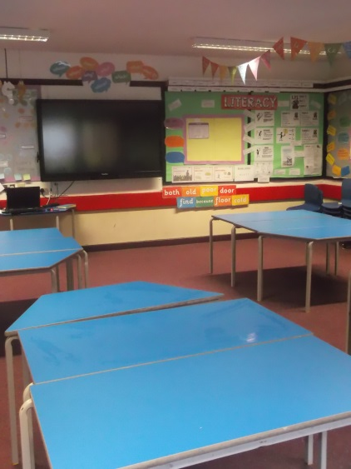
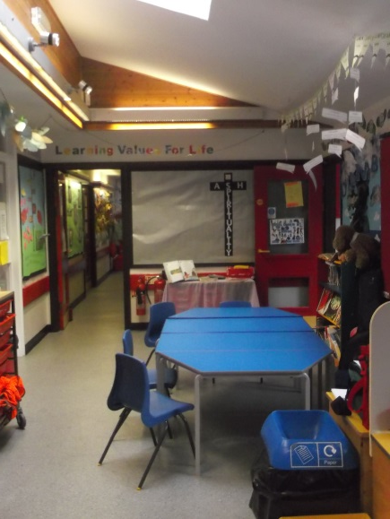
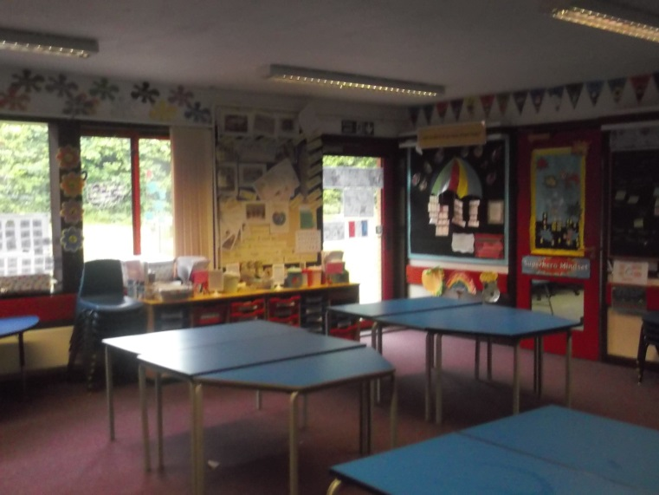
The Ash base Classrooms look like this.

Slide 6
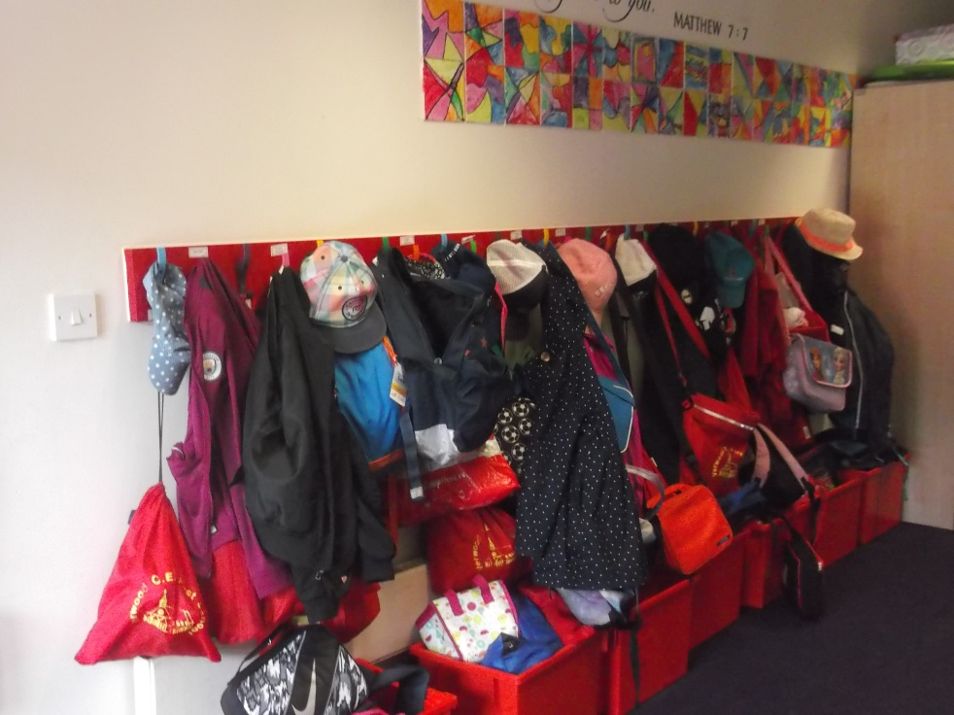
You will have a peg with your name on just like in Willow base.

Slide 7
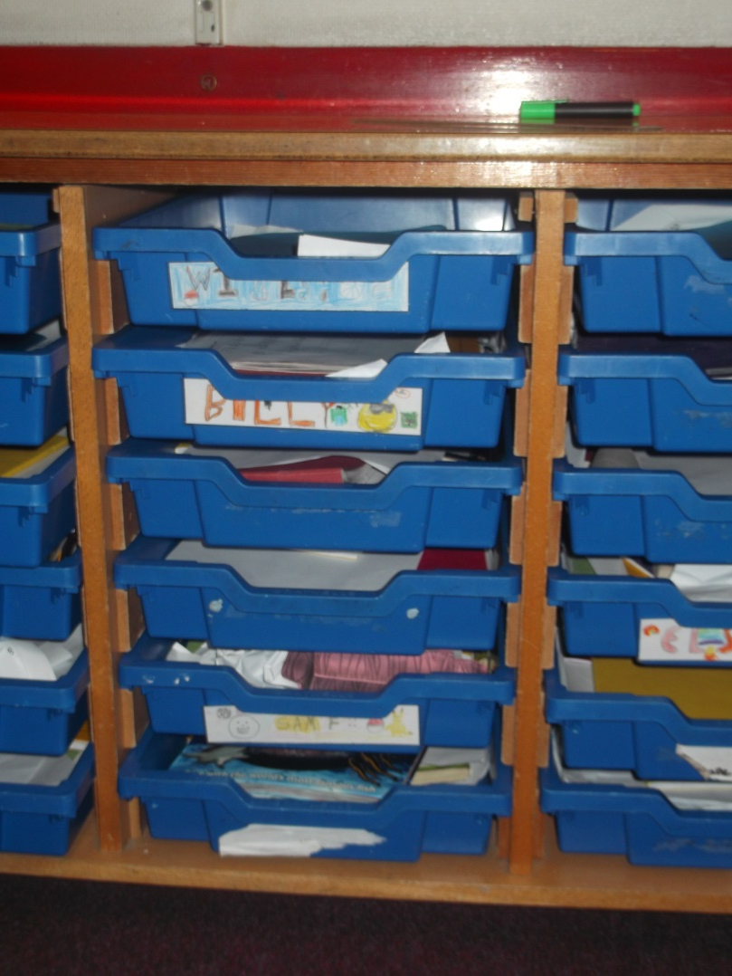
You will have a tray to put your book bag away in, it will be in your register classroom.

Slide 8



You will have lots of new learning to do in Ash base.
Numeracy
Literacy
Guided Reading

Slide 9


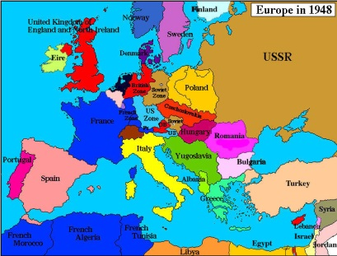




Art
Geography
History
Science

Slide 10


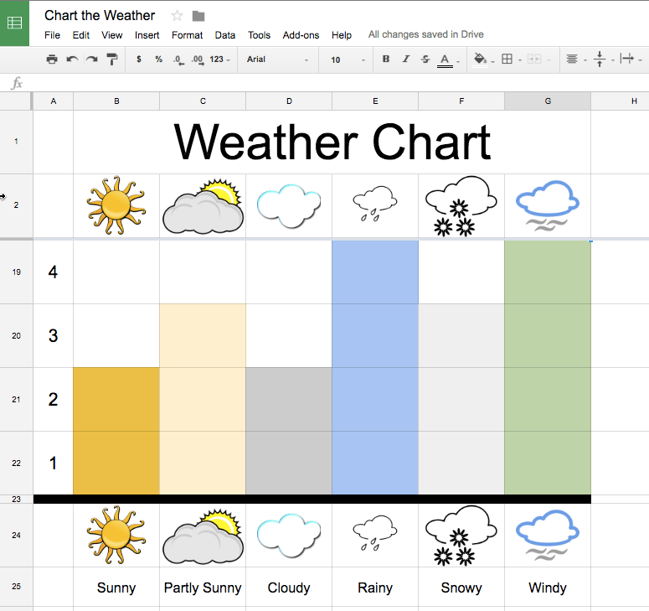
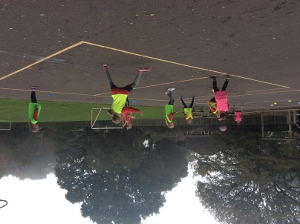
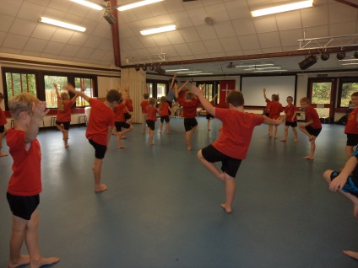
French
ICT
P.E

Slide 11

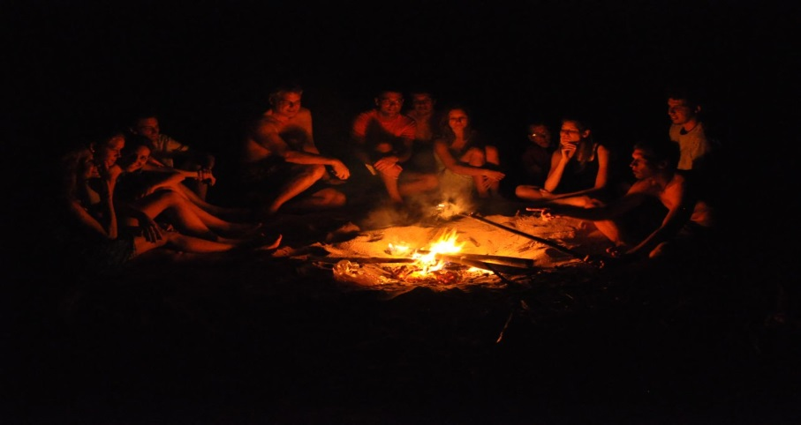
In June Ash base will go to Springhead for 3 days, it is lots of fun.
Springhead
You will get to spend lots of time outside learning, have a BBQ and campfire too.

Slide 12
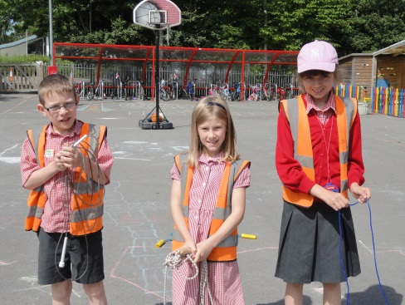
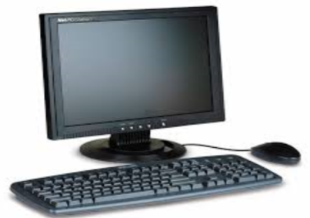
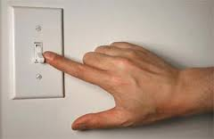
Ash base children are the role models for the rest of the school, they have lots of roles to help the rest of the school.
Positive Play Leaders
Digital Leaders
Light monitors

Slide 13
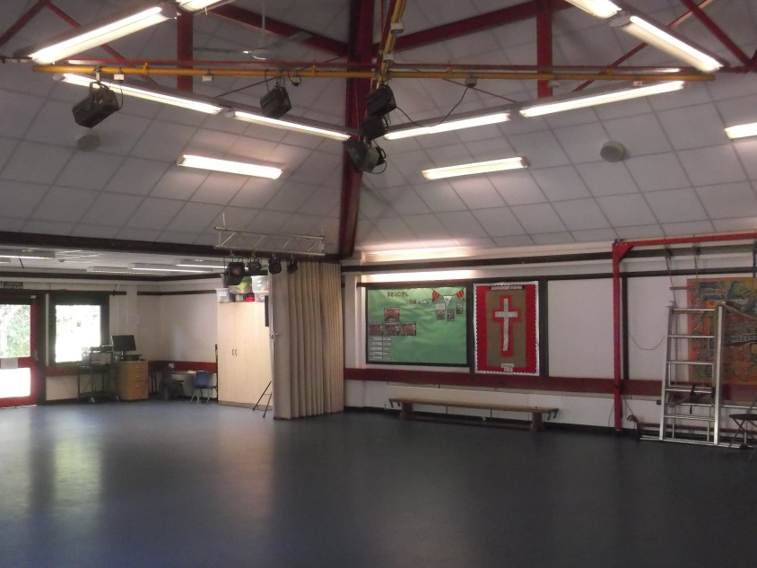
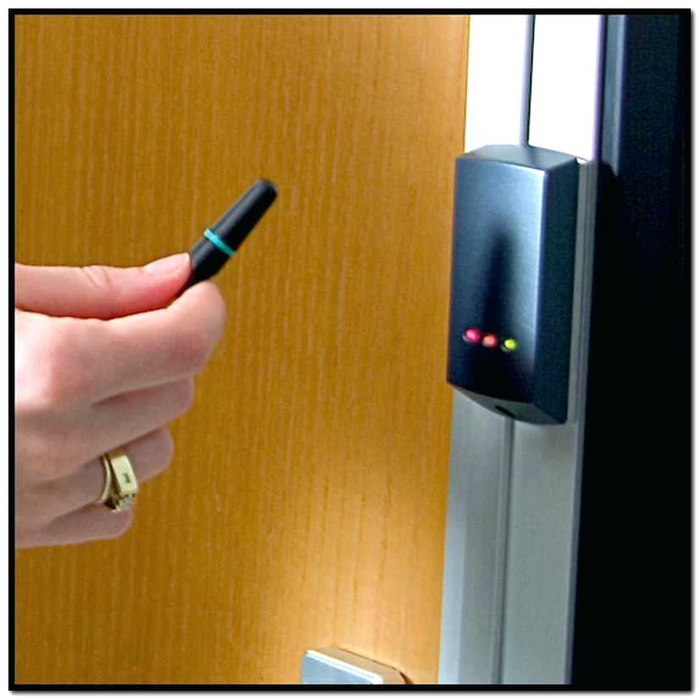
Music and door monitors for worship
Fob Monitor

Slide 14


In Ash base if your handwriting is really neat, you get given a pen license which means you can use your pen in literacy.

Slide 15

You and your friends will have lots of fun in Ash base.

